Slide 1

Stage 2
Creating graphs
Downloaded from: rsc.li/4gA2Lp7

Slide 2
Introduction
The purpose of these activities is to interpret the line of best fit on a graph.
Learning objectives
Compare the gradient of a slope.
Calculate the gradient of a slope.
Use a tangent to find the gradient at a point on a curve.
Introduction

Slide 3
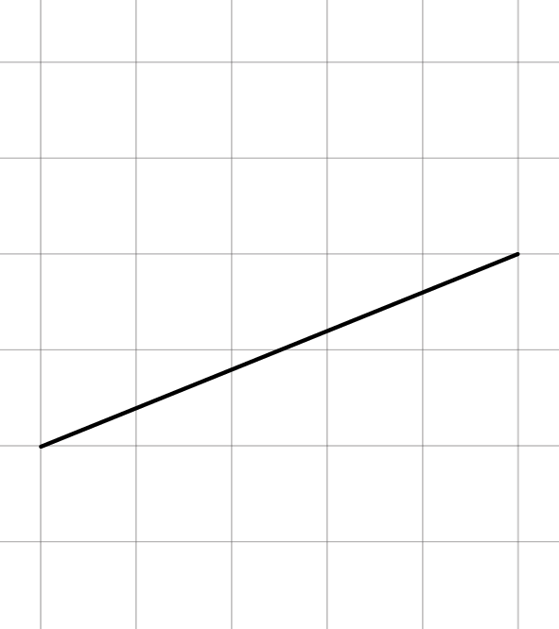
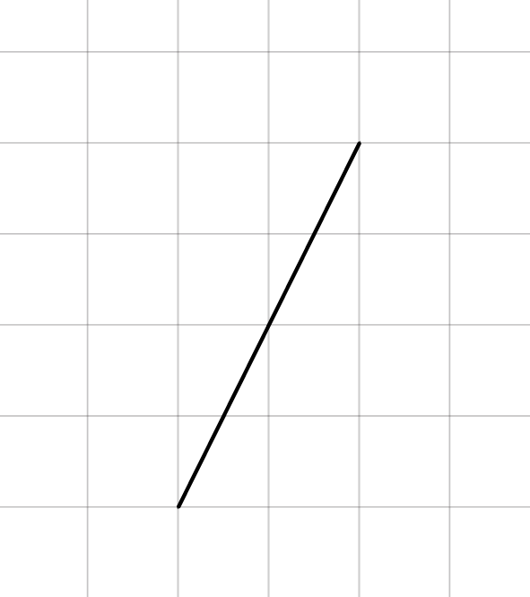
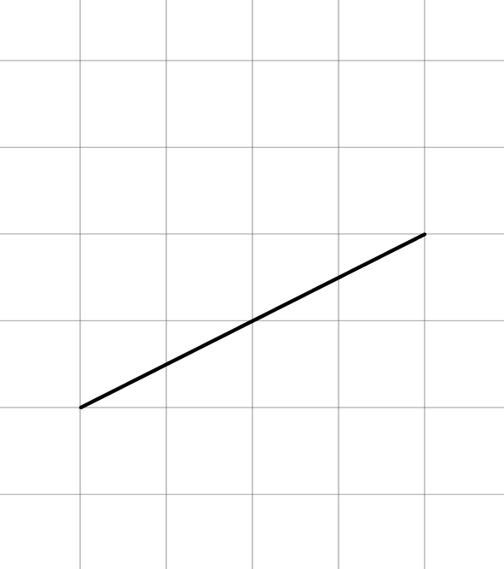
Comparing and calculating gradients
Which of the following has the steepest slope?
Calculate the gradient of each slope (each square counts as 1 unit).
Activity
A.
B.
C.

Slide 4
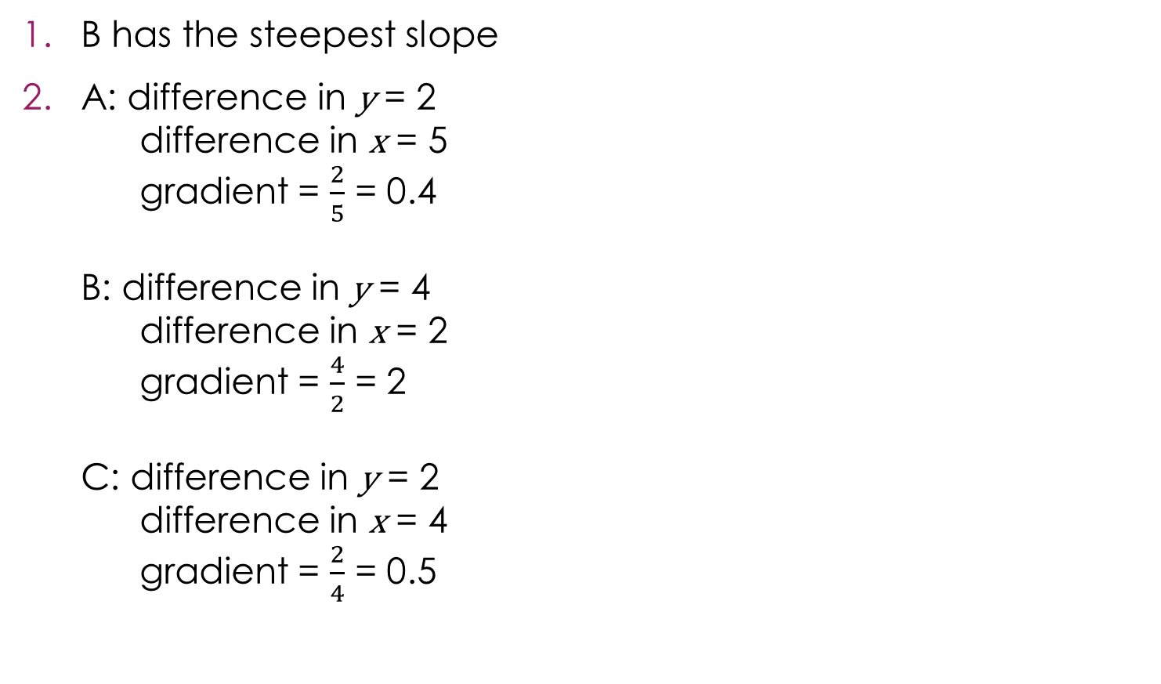
Comparing and calculating gradients – answers
B has the steepest slope
A: difference in y = 2
difference in x = 5
gradient = $\frac{2}{5}$ = 0.4
B: difference in y = 4
difference in x = 2
gradient = $\frac{4}{2}$ = 2
C: difference in y = 2
difference in x = 4
gradient = $\frac{2}{4}$ = 0.5
Answers

Slide 5
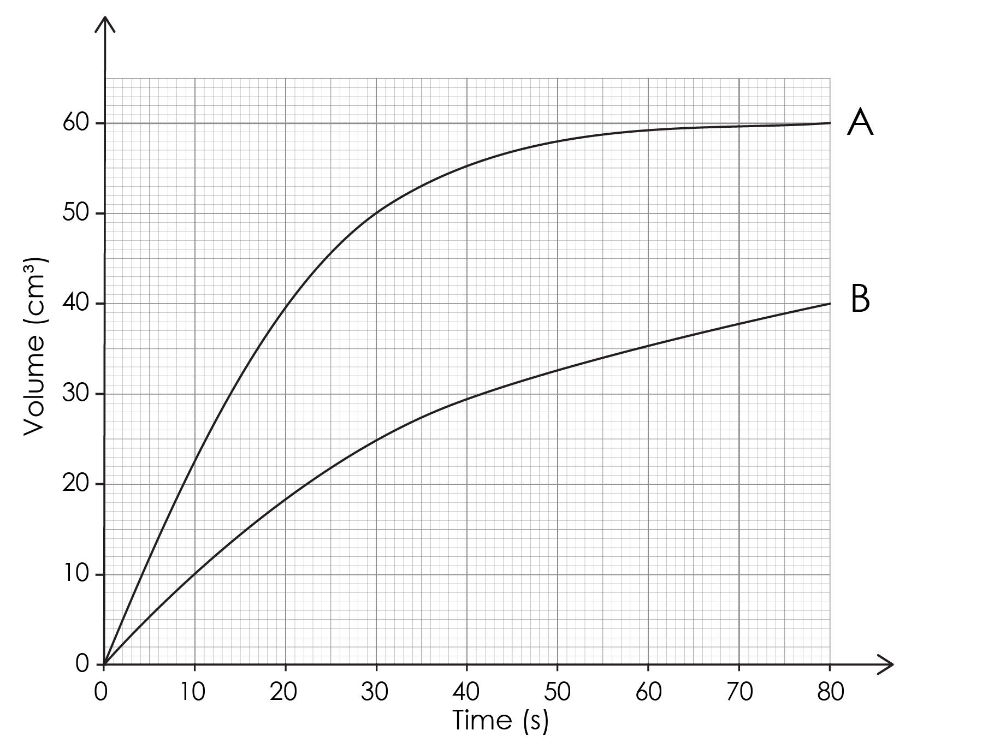
Calculating the gradient
Which reaction is faster? How do you know?
Calculate the mean rate of reaction between 0 and 30 seconds for reaction A and reaction B.
Activity

Slide 6
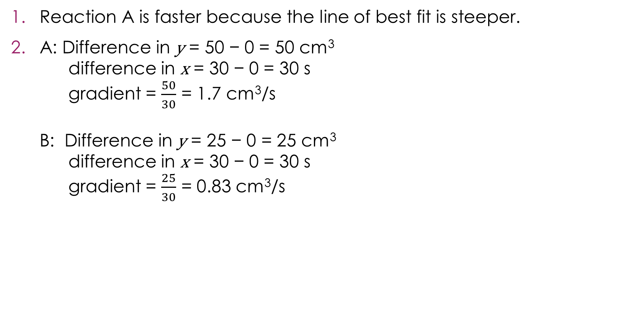
Calculating the gradient – answer
Reaction A is faster because the line of best fit is steeper.
A: Difference in y = 50 − 0 = 50 cm³
difference in x = 30 − 0 = 30 s
gradient = $\frac{50}{30}$ = 1.7 cm³/s
B: Difference in y = 25 − 0 = 25 cm³
difference in x = 30 − 0 = 30 s
gradient = $\frac{25}{30}$ = 0.83 cm³/s
Answers
Notes:
Alterative answers for question 1:
Reaction A is faster because the gradient is higher.
Reaction A is faster because less time is needed to collect the same volume of gas.
Reaction A is faster because more gas is collected in the same time.

Slide 7
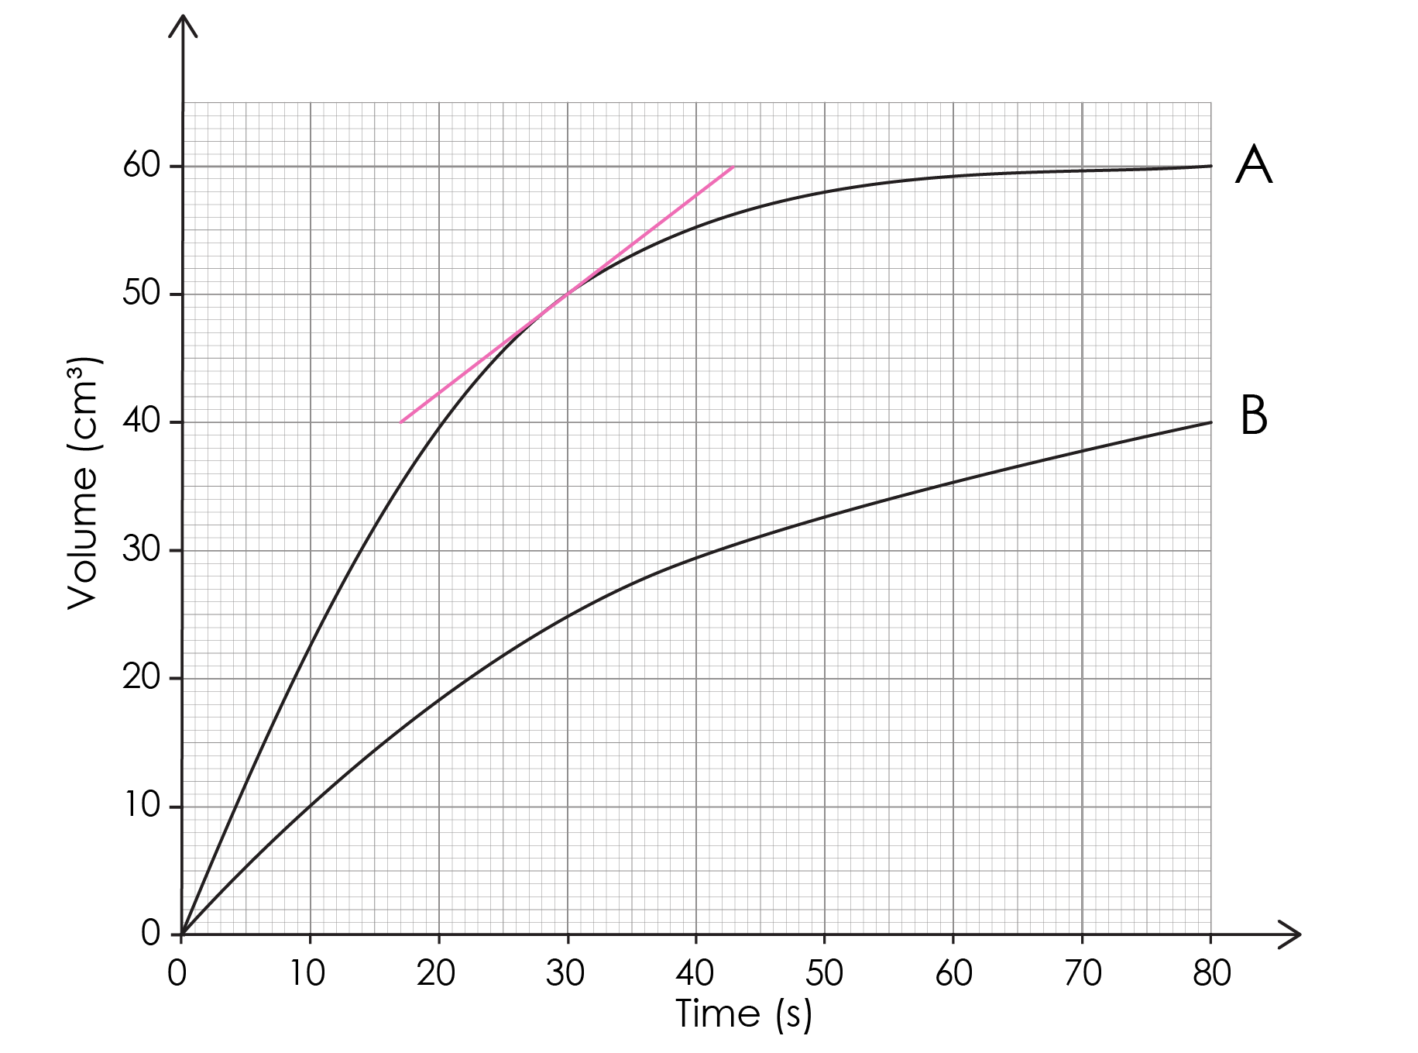
Calculating the gradient using a tangent
Determine the rate of reaction at 30 seconds for reaction A using the tangent.
Activity

Slide 8
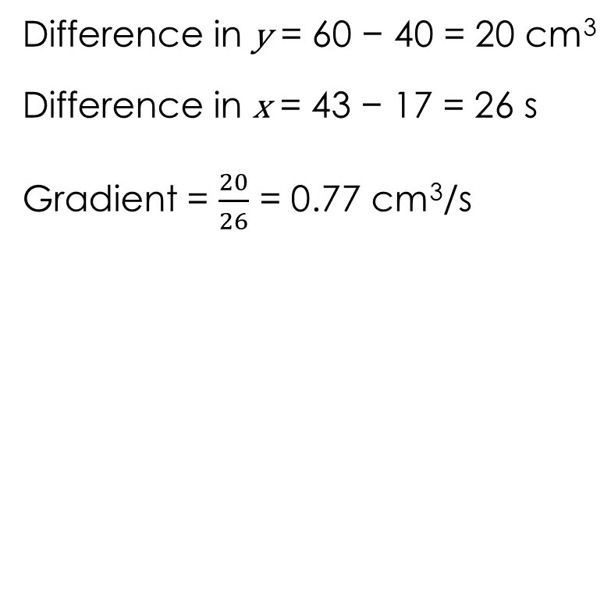
Calculating the gradient using a tangent – answer
Difference in y = 60 − 40 = 20 cm³
Difference in x = 43 − 17 = 26 s
Gradient = $\frac{20}{26}$ = 0.77 cm³/s
Answers
Notes:
Accept 0.8 cm³/s if learners have rounded.

