Slide 1

Stage 2
Creating graphs
Downloaded from: rsc.li/4gA2Lp7

Slide 2
Introduction
In this lesson we will cover the maths skills needed to answer two graph questions. The first focuses on calculating the gradient of a slope and the second on using a tangent to calculate the gradient of a curved line.
Learning objectives
Calculate the gradient of a slope.
Describe mathematical relationships between two variables.
Find the rate of a reaction.
Use a tangent to find the gradient at a point on a curve.
Introduction
Notes:
Explain that we will be covering these key maths skills in a chemistry context.

Slide 3
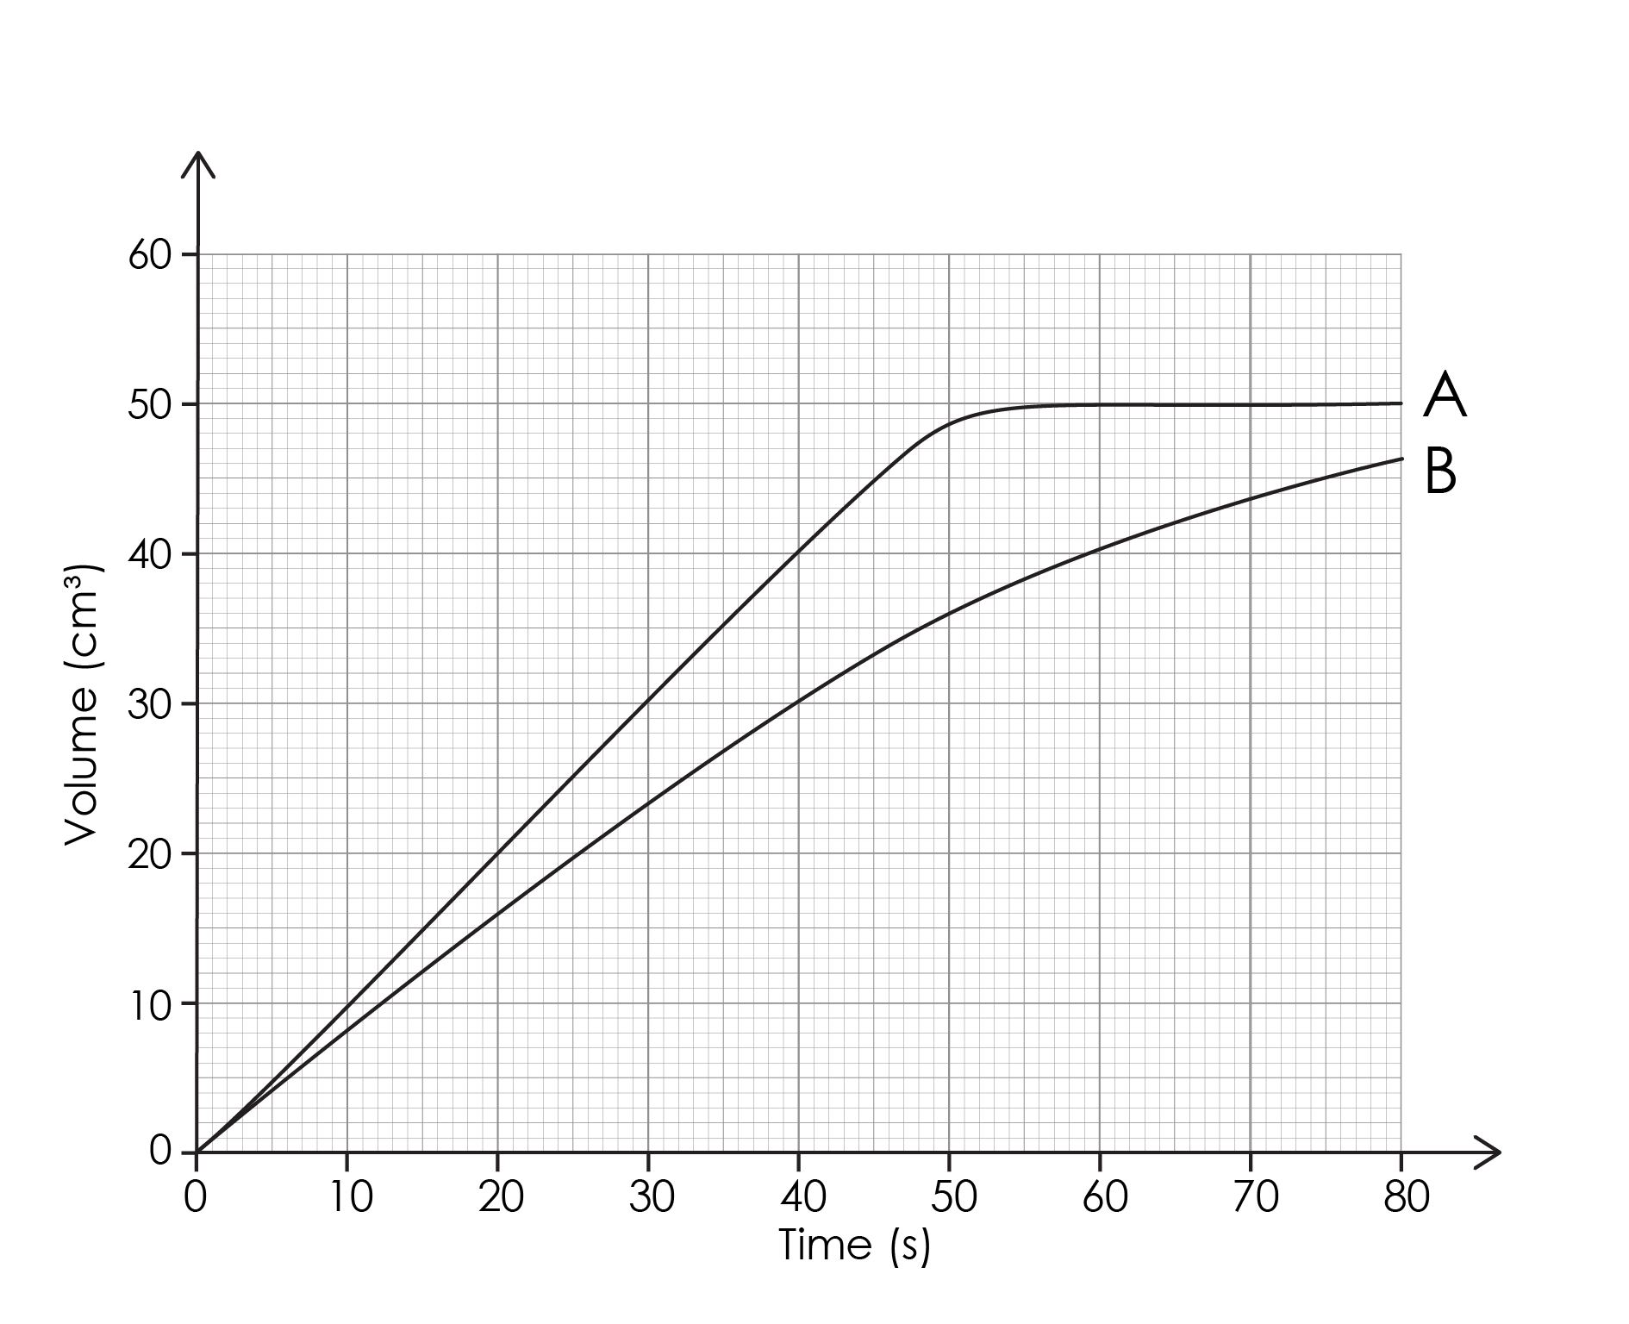
Lesson question 1
Lesson question
Imagine you are investigating the effect of changing the size of calcium carbonate lumps on the rate of the reaction with hydrochloric acid.
Compare the mean rate of reaction between 0 and 40 seconds for reaction A and reaction B.
Notes:
This slide introduces the first challenge question that learners will return to at the end of first section. Learners are not expected to attempt it at this point. Discuss the question and the key words that are in bold.
What do the terms ‘mean’ and ‘rate’ mean? The mean is the most commonly used measure of average. The rate is how quickly something happens.
What do they think ‘mean rate’ means? The mean rate (of reaction) is the average speed of a reaction over time.
Emphasise that we are only interested in the gradient between 0 and 40 seconds.

Slide 4
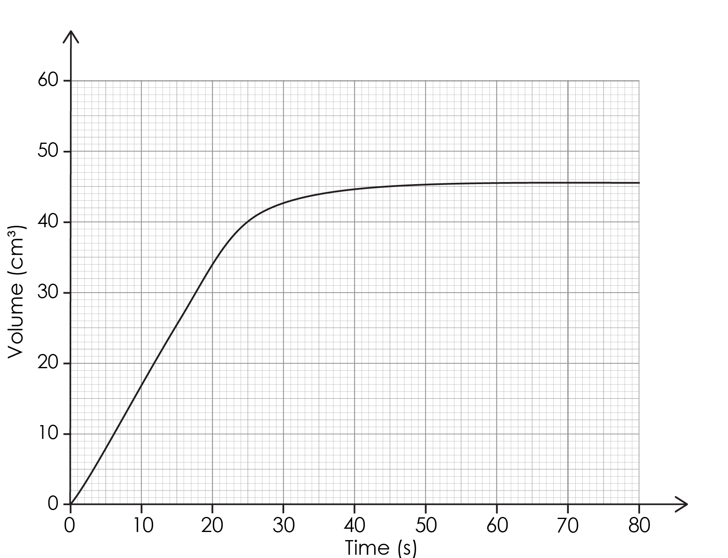
Lesson question 2
Lesson question
Let’s look at an example that involves finding the gradient of a curved line at a specific point:
Imagine you are investigating the effect of changing the size of calcium carbonate lumps on the rate of the reaction with hydrochloric acid.
Determine the rate of reaction at 25 seconds.
Notes:
This slide introduces the second challenge question that learners will return to at the end of the lesson. Learners are not expected to attempt it at this point. We will return to complete the question at the end of the session. Discuss the question and the key words that are in bold.
What do we mean by rate of reaction? The rate (of reaction) is how quickly something happens. In this example, the faster the rate, the higher the volume of gas produced per second.
Emphasise that we are only interested in the rate at 25 seconds.

Slide 5
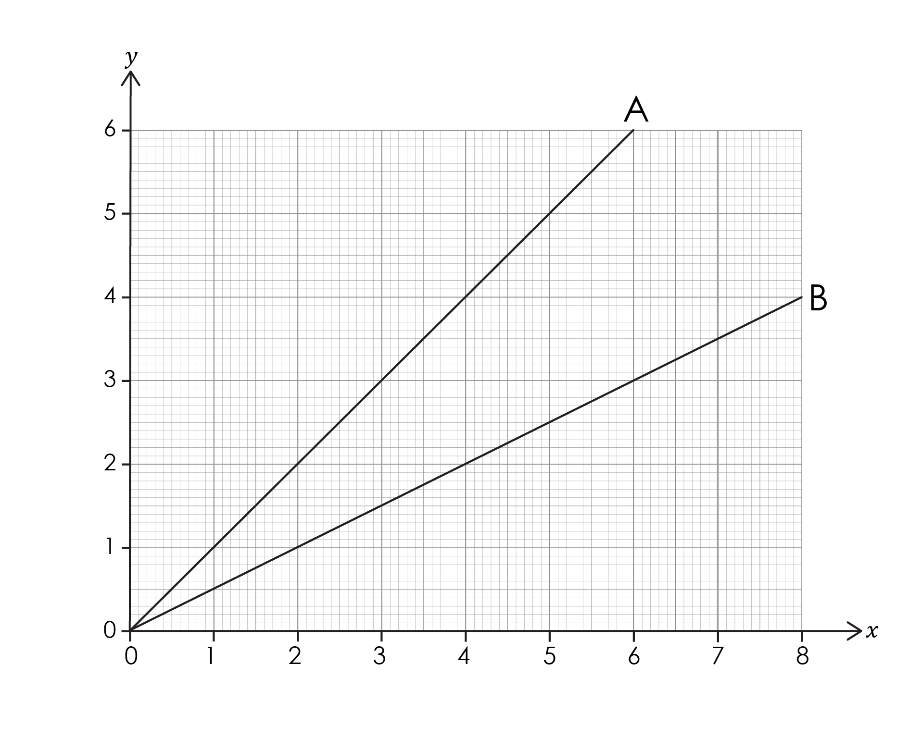
Describing the gradient of a slope
The gradient of a slope describes its steepness.
The greater a gradient, the steeper the slope.
A steeper slope means a faster rate.
Which of these lines has a higher rate?
Explain your answer.
Activity
Notes:
Discuss the link between gradient and steepness. Ask learners to answer the two questions on the slide.
What is the mathematical relationship between the two variables on this graph for line A? Learners should talk in terms of x and y.

Slide 6
Describing the gradient of a slope – answer
Anwers
Line A has the higher rate because the gradient is steeper.
As x increases y increases.

Slide 7
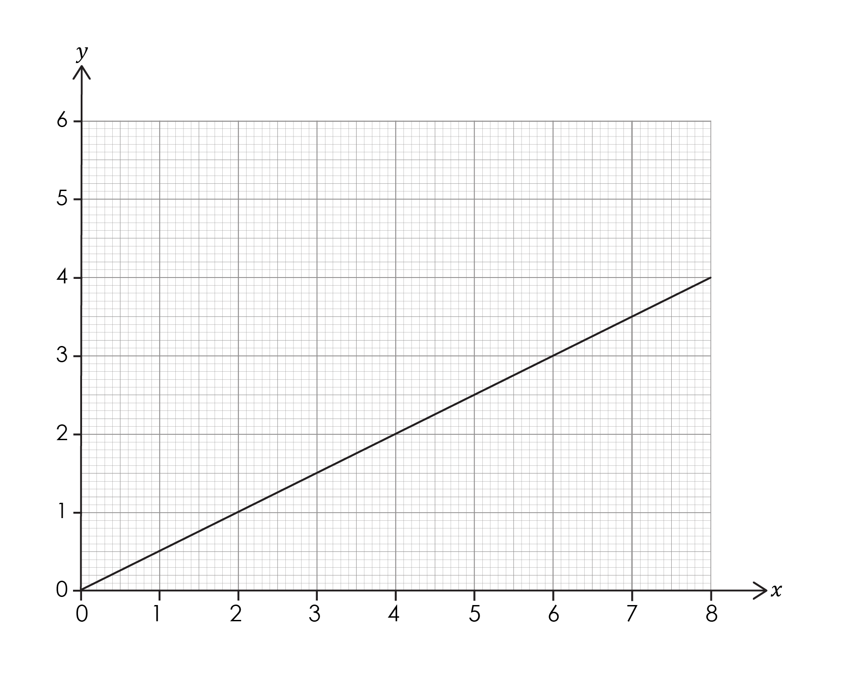
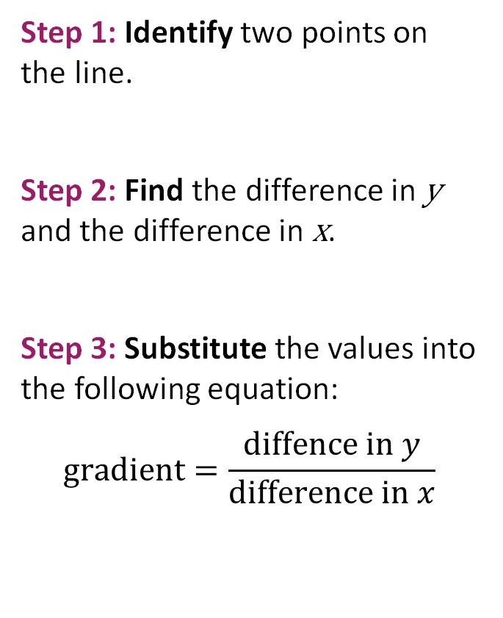
Calculating the gradient of a slope
Step 1: Identify two points on the line.
Step 2: Find the difference in y and the difference in x.
Step 3: Substitute the values into the following equation:
$$gradient=\frac{diffence in y}{difference in x}$$
Notes:
This method helps learners calculate the gradient of a slope. Each step is modelled on the following slides.

Slide 8
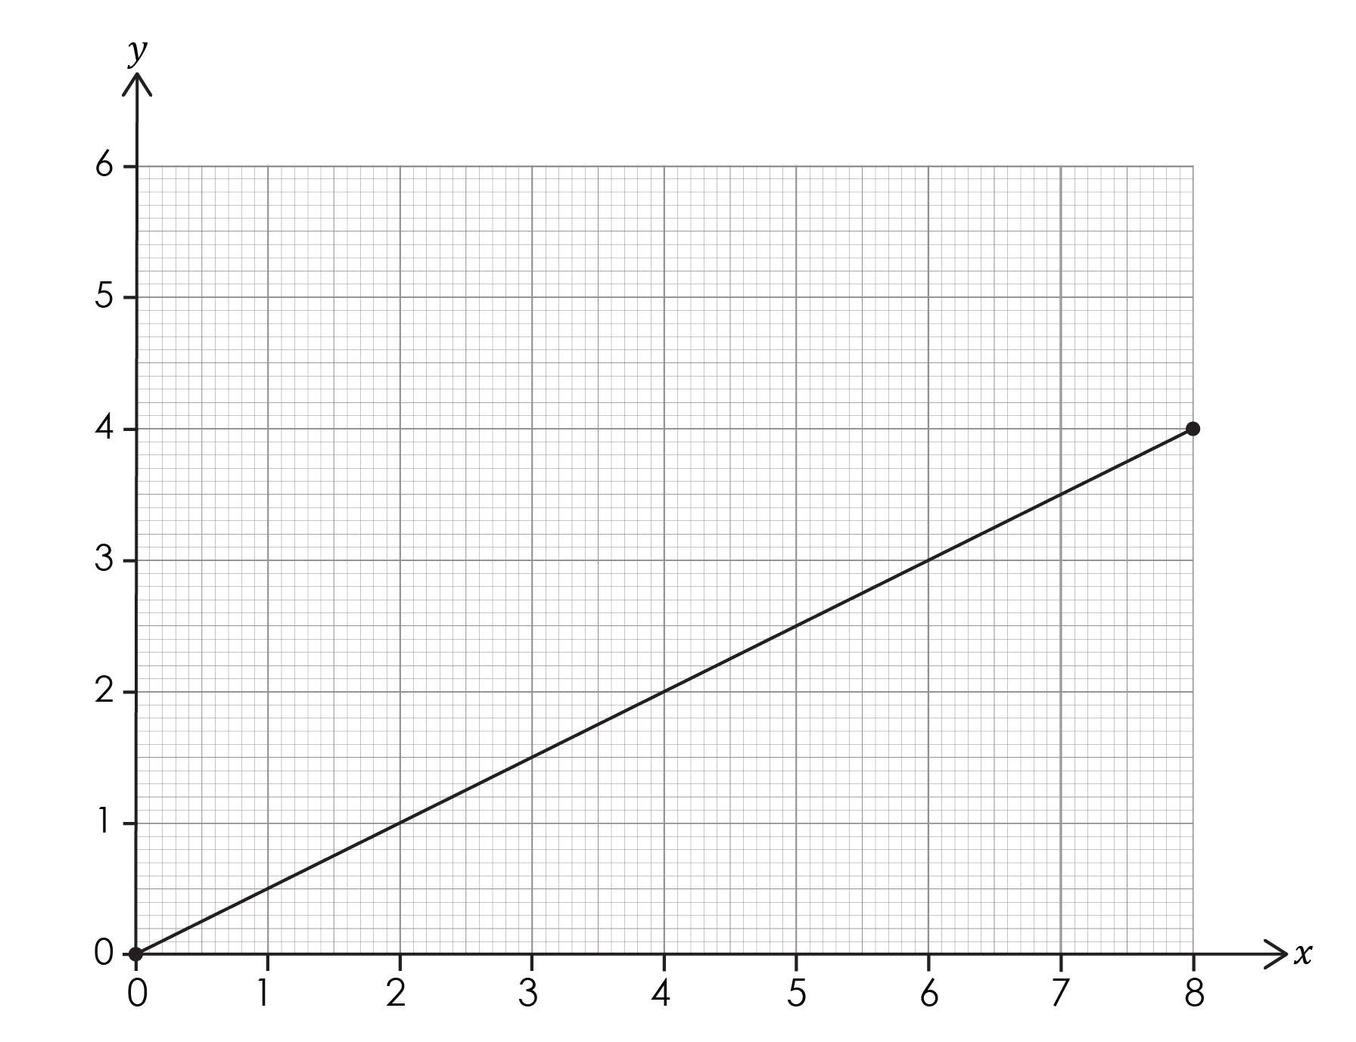
Calculating the gradient of a slope – step 1
Step 1: Identify two points on the line.
This works best if the numbers are whole numbers.
Here we have chosen the start and the end of the line.
Worked example
Notes:
Discuss step 1. Explain that we are going to draw a triangle under the line to help. Emphasise that it is best if the numbers involved are whole numbers.
Explain that it doesn’t matter which points they are as the line is straight, but some questions ask for the gradient to be taken at specific points along the line.

Slide 9
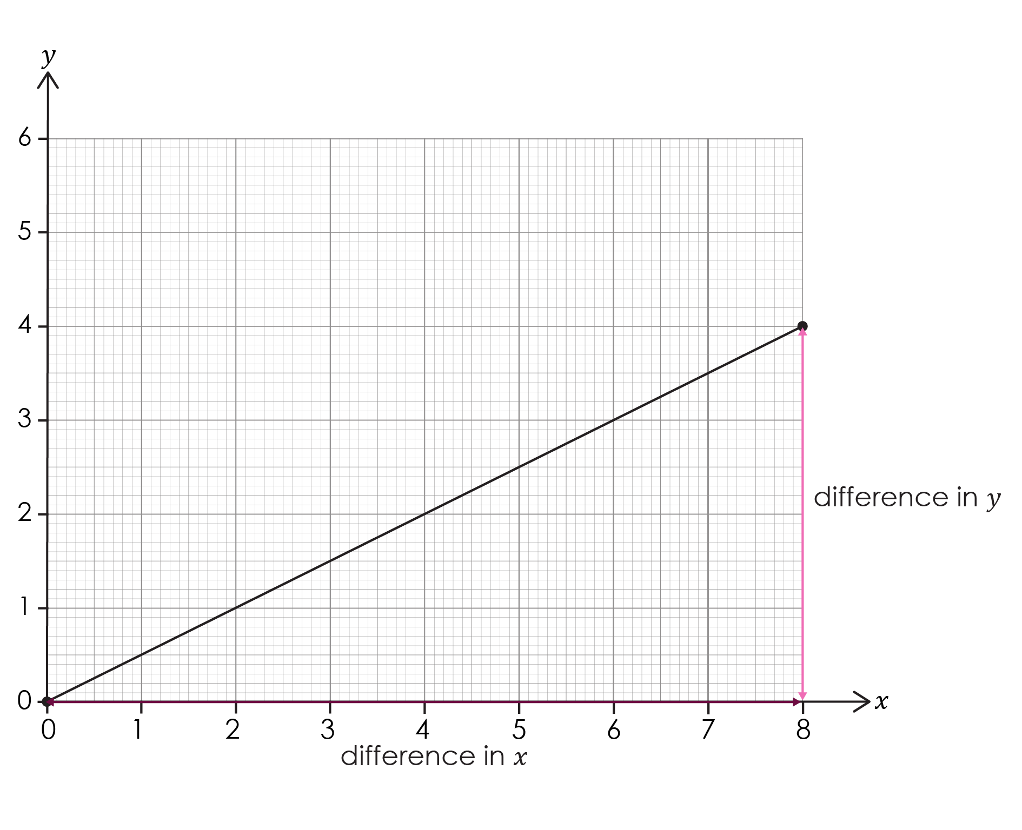
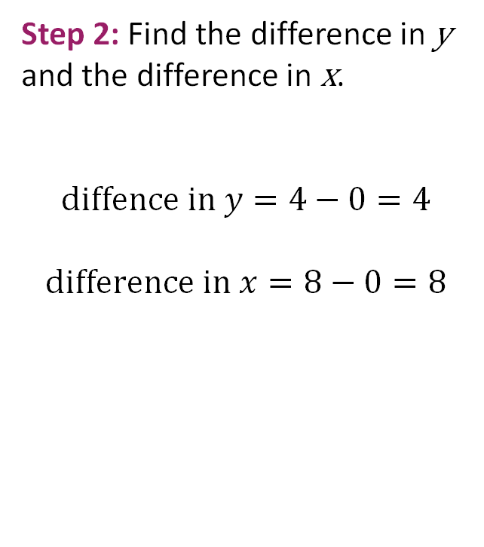
Calculating the gradient of a slope – step 2
Step 2: Find the difference in y and the difference in x.
$$diffence in y=4−0=4$$
$$difference in x=8−0=8$$
Worked example
Notes:
Discuss step 2. Explain the arrows which create a triangle under the graph, including how this relates to finding the difference in y and the difference in x.

Slide 10
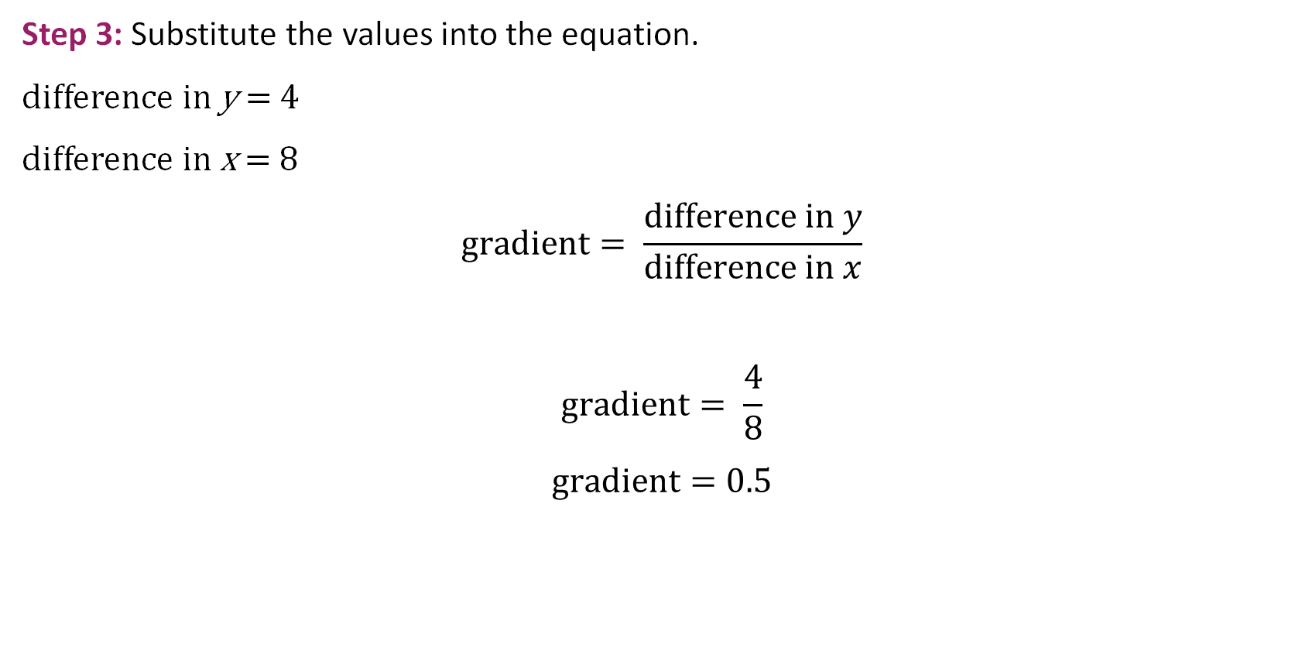
Calculating the gradient of a slope – step 3
Step 3: Substitute the values into the equation.
difference in y = 4
difference in x = 8
$$gradient= \frac{difference in y}{difference in x}$$
$$gradient= \frac{4}{8}$$
$$gradient=0.5$$
Worked example
Notes:
Discuss step 3: how to substitute values into an equation. Explain how this process also links to units i.e. units = y/x
You can return to the graph (slide 6) and ask learners to use different values from the line to show that the gradient is the same no matter which values they use on the line. This is because the line is straight.

Slide 11
Differences between mathematics and science
In maths you are expected to be able to:
interpret the gradient of a straight-line graph as a rate of change
calculate the gradient of a straight line
This is often carried out using the same method as we use in science, but you can find the gradient using coordinates on the line as well.
Let’s look at how this works.

Slide 12
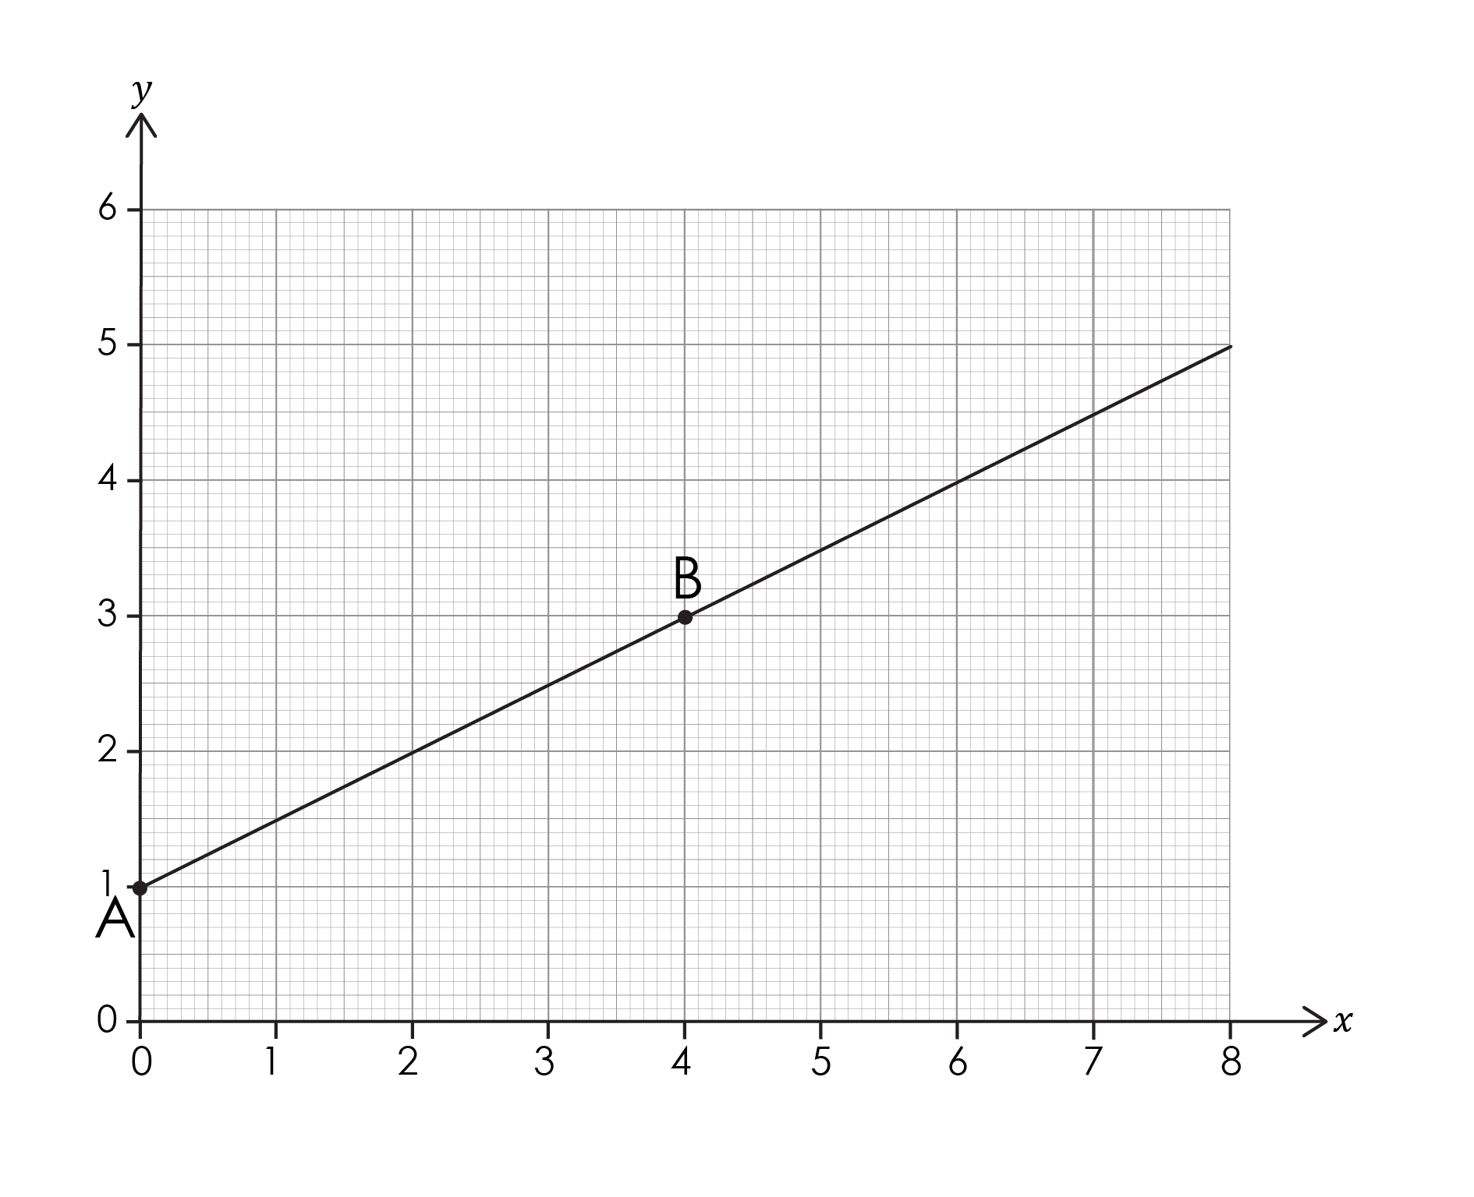
Finding the gradient using coordinates – step 1
Step 1: Choose two coordinates on the line.
Remember − any straight line has a constant gradient.
This means we can pick any two points, or coordinates, along its length to find the gradient.
A = (0, 1)
B = (4, 3)
Worked example

Slide 13
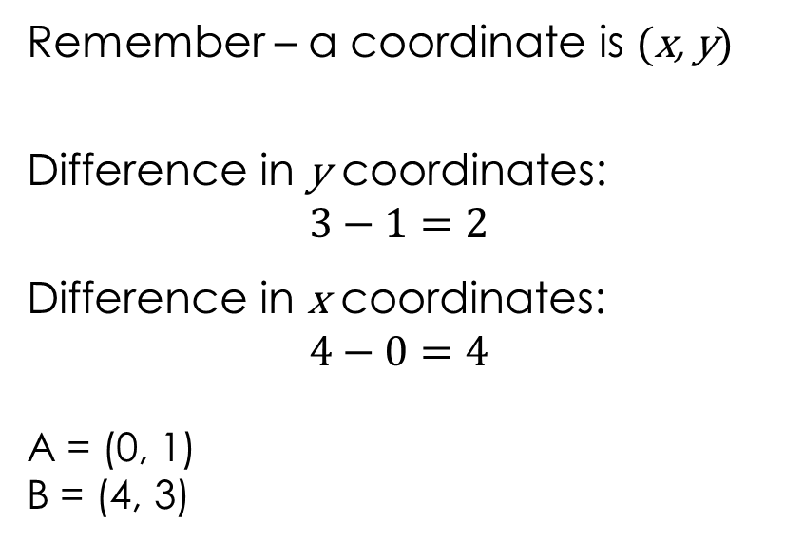
Finding the gradient using coordinates – step 2
Step 2: find the difference in the y coordinates and the x coordinates.
Worked example
Remember – a coordinate is (x, y)
Difference in y coordinates:
$$3−1=2$$
Difference in x coordinates:
$$4−0=4$$
A = (0, 1)
B = (4, 3)

Slide 14
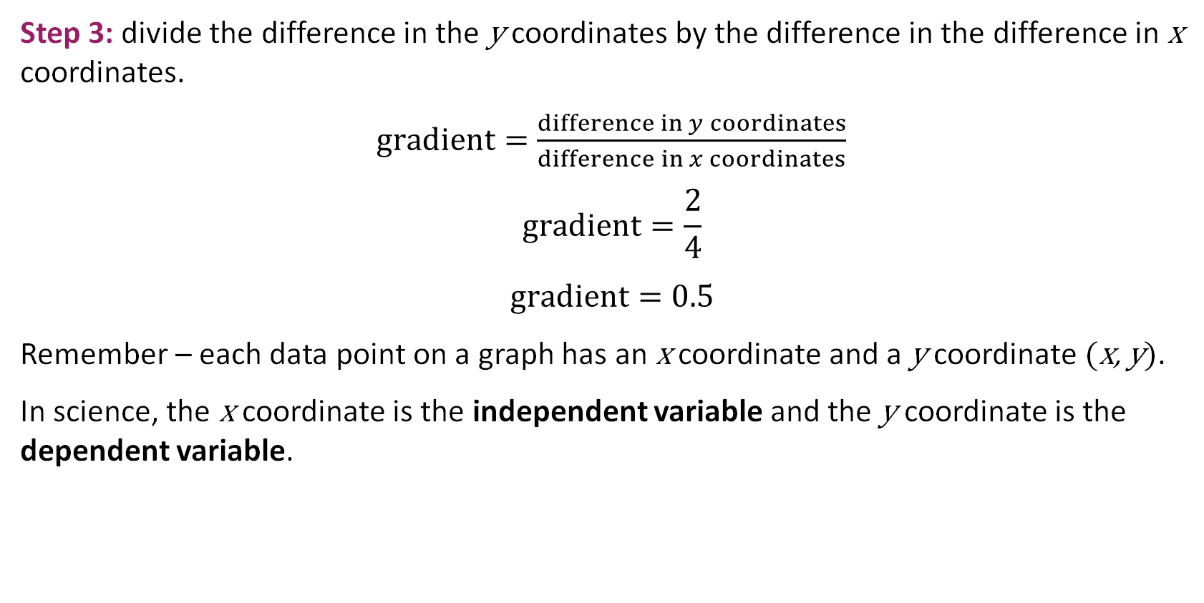
Finding the gradient using coordinates – step 3
Step 3: divide the difference in the y coordinates by the difference in the difference in x coordinates.
$gradient=\frac{difference in y coordinates}{difference in x coordinates}$
$$gradient=\frac{2}{4}$$
$$gradient=0.5$$
Remember – each data point on a graph has an x coordinate and a y coordinate (x, y).
In science, the x coordinate is the independent variable and the y coordinate is the dependent variable.
Worked example
Notes:
Independent variable – the variable changed by the investigator during the experiment.
Dependent variable – the variable being tested or measured during the experiment.

Slide 15
Returning to lesson question 1
Let’s go back to the example from the beginning of this lesson on calculating the gradient of a slope:
Imagine you are investigating the effect of changing the size of calcium carbonate lumps on the rate of the reaction with hydrochloric acid.
Compare the mean rate of reaction between 0 and 40 seconds for reaction A and reaction B.
Notes:
Now we are going to translate our learning back into a chemistry context. Explain that we are going to use the mathematical methods mentioned earlier to compare the two mean rates of reaction.

Slide 16
Describing the gradient of a slope – activity
Activity
Which reaction do you think is faster?
How do you know?
Notes:
Qualitative: Here the focus is on describing the relationship between the variables and describing the difference in the gradients in words.
Emphasise the use of comparative terms e.g. more, less, steeper, less steep etc.

Slide 17
Describing the gradient of a slope – activity –answer
Answer
Reaction A is faster because:
the line of best fit is steeper/the gradient is higher
less time is needed to collect the same volume of gas/more gas is collected in the same amount of time.

Slide 18
Calculating the gradient of a slope – activity
Calculate the mean rate of reaction between 0 and 40 seconds for:
reaction A
reaction B
Activity
Notes:
Quantitative: Here we are developing the relationship from qualitative to quantitative.
Explain that we are going to calculate the mean rate of reaction for reaction A together (modelling) and then learners will individually calculate the rate of reaction B using the same method. They will then compare the rates of reaction.
The next slides model how to complete the calculation for reaction A. Complete reaction B together (slide 20).

Slide 19
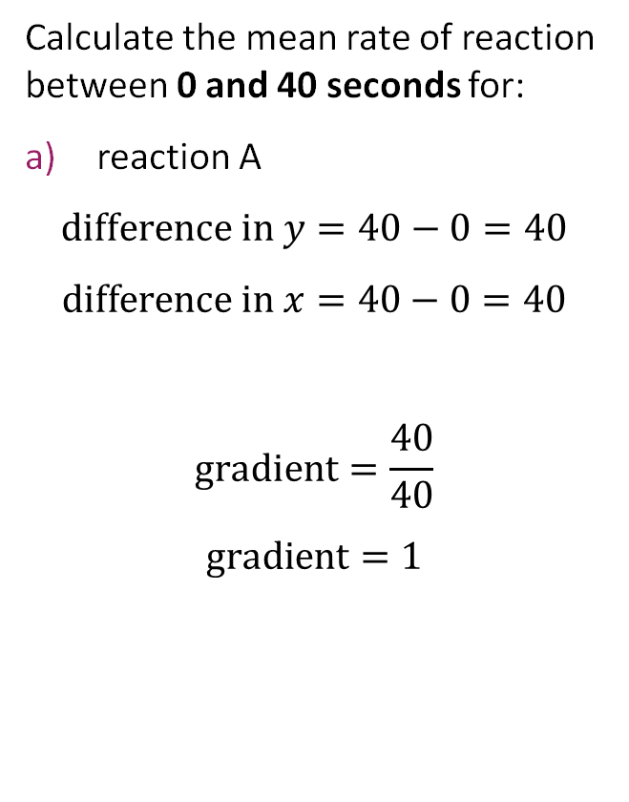
Calculating the gradient of a slope – answer a
Answer
Calculate the mean rate of reaction between 0 and 40 seconds for:
reaction A
$$difference in y=40−0=40$$
$$difference in x=40−0=40$$
$$gradient=\frac{40}{40}$$
$$gradient=1$$
Notes:
Quantitative: Here we are developing the relationship from qualitative to quantitative.
Explain that we are going to calculate the mean rate of reaction for reaction A together (we do) and then learners will individually (you do) calculate the rate of reaction B using the same method. They will then compare the rates of reaction.
Explain why the arrows are drawn between 0 and 40 seconds.

Slide 20
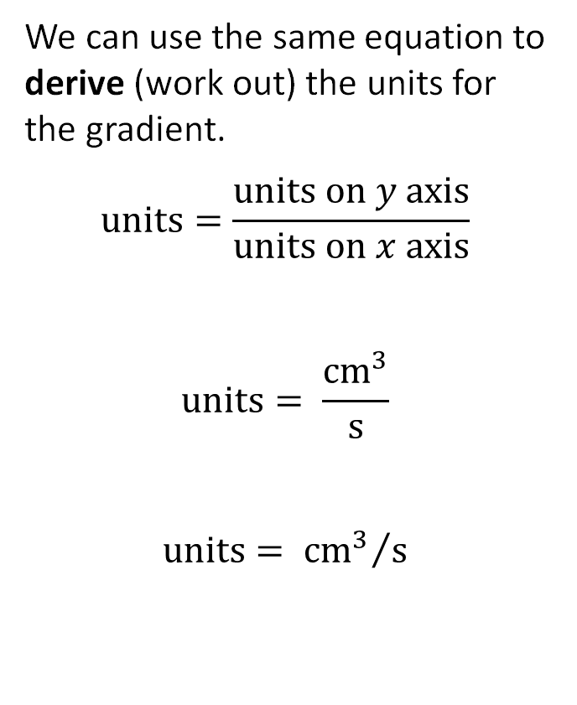
Deriving the units – answer a continued
Answer
We can use the same equation to derive (work out) the units for the gradient.
$$units=\frac{units on y axis}{units on x axis}$$
$$units= \frac{{cm}^{3}}{s}$$
$$units= {{cm}^{3}}/s$$
Notes:
Quantitative: Here we are developing the relationship from qualitative to quantitative.
Discuss where the units have come from.

Slide 21
Calculating the gradient of a slope – part b
Calculate the mean rate of reaction between 0 and 40 seconds for:
reaction A: 1 cm³/s
reaction B
Activity
Notes:
Quantitative: Here we are developing the relationship from qualitative to quantitative.
Putting the calculations from slide 18 and slide 19 together, the answer for reaction A is therefore 1 cm³/s.
Ask learners to individually calculate the rate of reaction B using the same method.

Slide 22
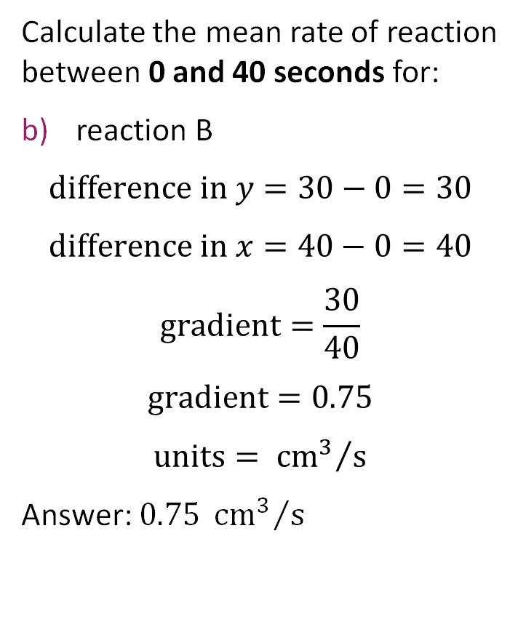
Calculating the gradient of a slope – answer b
Answer
Calculate the mean rate of reaction between 0 and 40 seconds for:
reaction B
$$difference in y=30−0=30$$
$$difference in x=40−0=40$$
$$gradient=\frac{30}{40}$$
$$gradient=0.75$$
$$units= {{cm}^{3}}/s$$
Answer: $0.75 {{cm}^{3}}/s$

Slide 23
Comparing the mean rates of reaction
Compare the mean rate of reaction between 0 and 40 seconds for reaction A and reaction B.
Which line represents the reaction with larger lumps of sodium carbonate?
Why do you think this is the case?
Activity
Notes:
Conceptual
Here we link the mathematical operations to the underlying chemistry that explains the relationship.
Ask learners to compare the two rates of reaction using the information they have so far (reaction A has a rate of reaction of 1 cm³/s in the first 40 seconds, reaction B has a reaction rate of 0.75 cm³/s in that same time). Explain what this means, i.e. reaction A produces 1 cm³ of gas every second for the first 40 seconds, whereas reaction B only produces 0.75 cm³ of gas every second for 40 seconds.
Give learners the opportunity to discuss which line they think represents the reaction with large lumps of calcium carbonate and which with small lumps. Can they explain why they think this is the case? Use this opportunity to elicit any misconceptions or misunderstandings learners have.
Ask learners to sketch the line of best fit they think powdered calcium carbonate would give. Emphasise that the temperature, concentration of HCl, volume of HCl and the mass of calcium carbonate is the same for each of these experiments.

Slide 24
Comparing the mean rates of reaction – answers
Answers
Reaction A has a faster rate of reaction between 0 and 40 seconds than reaction B. Reaction A has a rate of reaction of 1 cm³/s in the first 40 seconds, Reaction B has a reaction rate of 0.75 cm³/s in that same time. The steeper the slope, the faster the reaction.
Line A represents the reaction with smaller lumps; line B represents the reaction with larger lumps.
The smaller lumps will have a faster rate of reaction because they have a larger surface area, so the line is steeper.
Notes:
c) The line for powdered calcium carbonate would be steeper than the other two lines and would level off earlier at 50 cm³. (This is because the reaction will be faster as powder has a larger surface area, so the line is steeper. The maximum volume of gas would be 50 cm³ because the mass of calcium carbonate and concentration and volume of HCl is the same. The reaction stops when one of the reactants – normally this would be the HCl – is used up. The reactant that is not used up is said to be in excess, the reactant that is used up is the limiting factor).

Slide 25
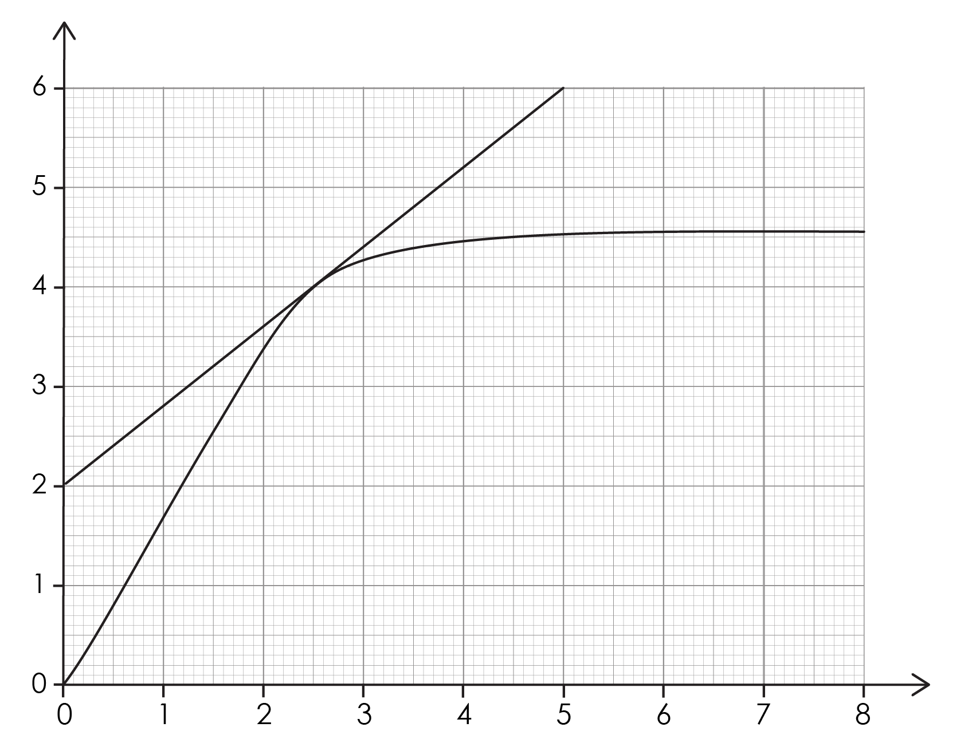
Drawing a tangent to a curve
The gradient of a slope describes its steepness.
A tangent can be used to find the gradient of a curve at a specific point.
A tangent is a straight line that follows the general direction of the curve at that point.
Notes:
Discuss the link between gradient and steepness. Explain what a tangent is and how to draw one. Remind learners to look for where the tangent will give whole numbers, to make it easier to read off the scale and carry out calculations.

Slide 26
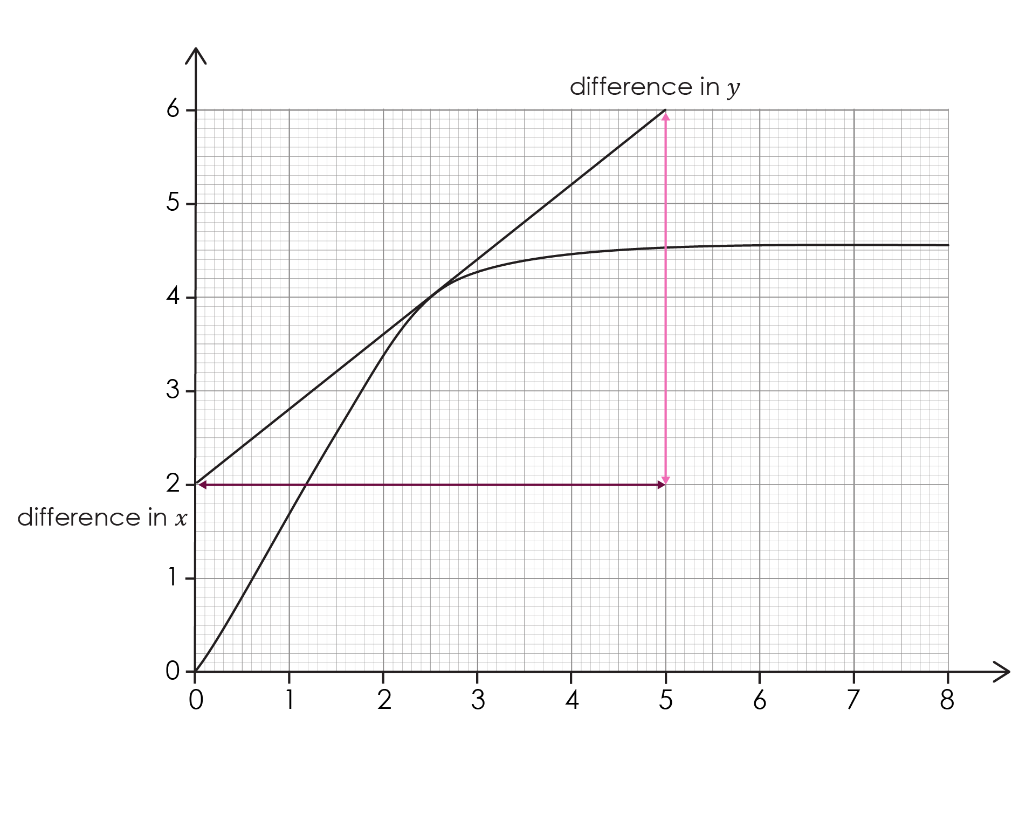
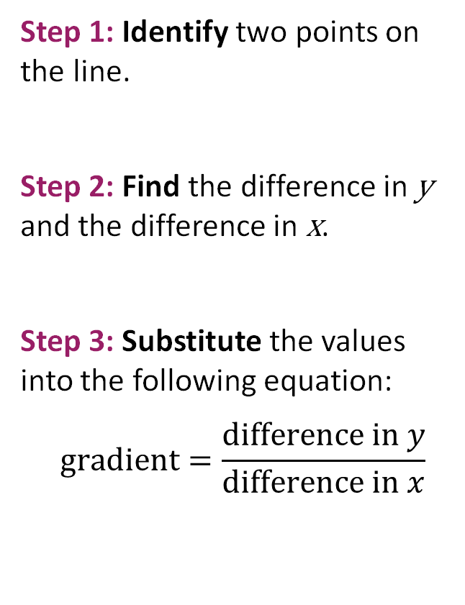
Calculating the gradient of a tangent
Step 1: Identify two points on the line.
Step 2: Find the difference in y and the difference in x.
Step 3: Substitute the values into the following equation:
$$gradient=\frac{difference in y}{difference in x}$$

Slide 27
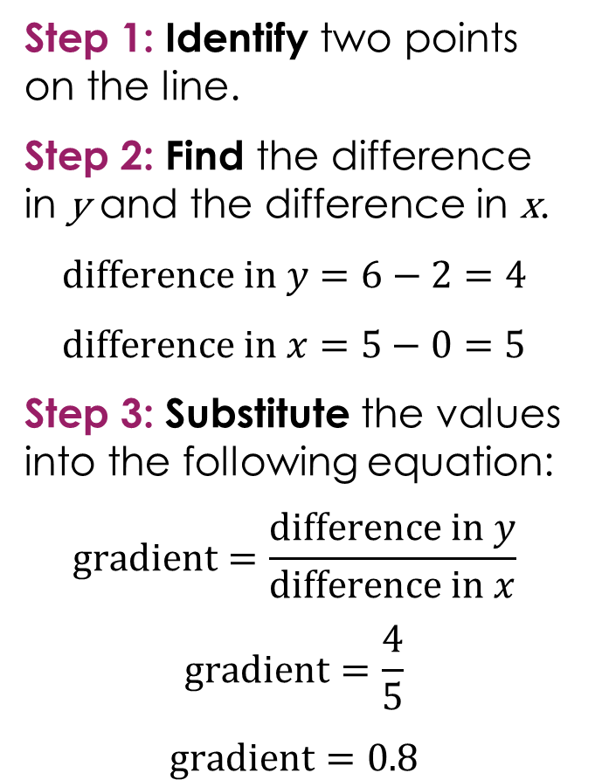
Calculating the gradient of a tangent – example
Step 1: Identify two points on the line.
Step 2: Find the difference in y and the difference in x.
$$difference in y=6−2=4$$
$$difference in x=5−0=5$$
Step 3: Substitute the values into the following equation:
$$gradient=\frac{difference in y}{difference in x}$$
$$gradient=\frac{4}{5}$$
$$gradient=0.8$$
Worked example
Notes:
Explain the arrows under the tangent, including how this relates to finding the difference in y and the difference in x.

Slide 28
Returning to lesson question 2
Let’s go back to example we looked at on slide 24:
Imagine you are investigating the effect of changing the size of calcium carbonate lumps on the rate of the reaction with hydrochloric acid.
Determine the rate of reaction at 25 seconds.
Notes:
Now we are going to translate our learning back into a chemistry context. Explain that we are going to use the mathematical methods mentioned earlier to find the rate of reaction at 25 seconds.
Explain that we need to find the gradient of the slope at 25 seconds. To do this, we need to draw a tangent to the line at 25 seconds. Explain that the tangent line should just touch the curve at the point at 25 seconds and should match the slope of the curve at that point. Place a ruler on the point being studied and adjust its position so the space on either side of the point between the ruler and curve are approximately equal. The line should be extended as far as is convenient to take readings for the calculations.

Slide 29
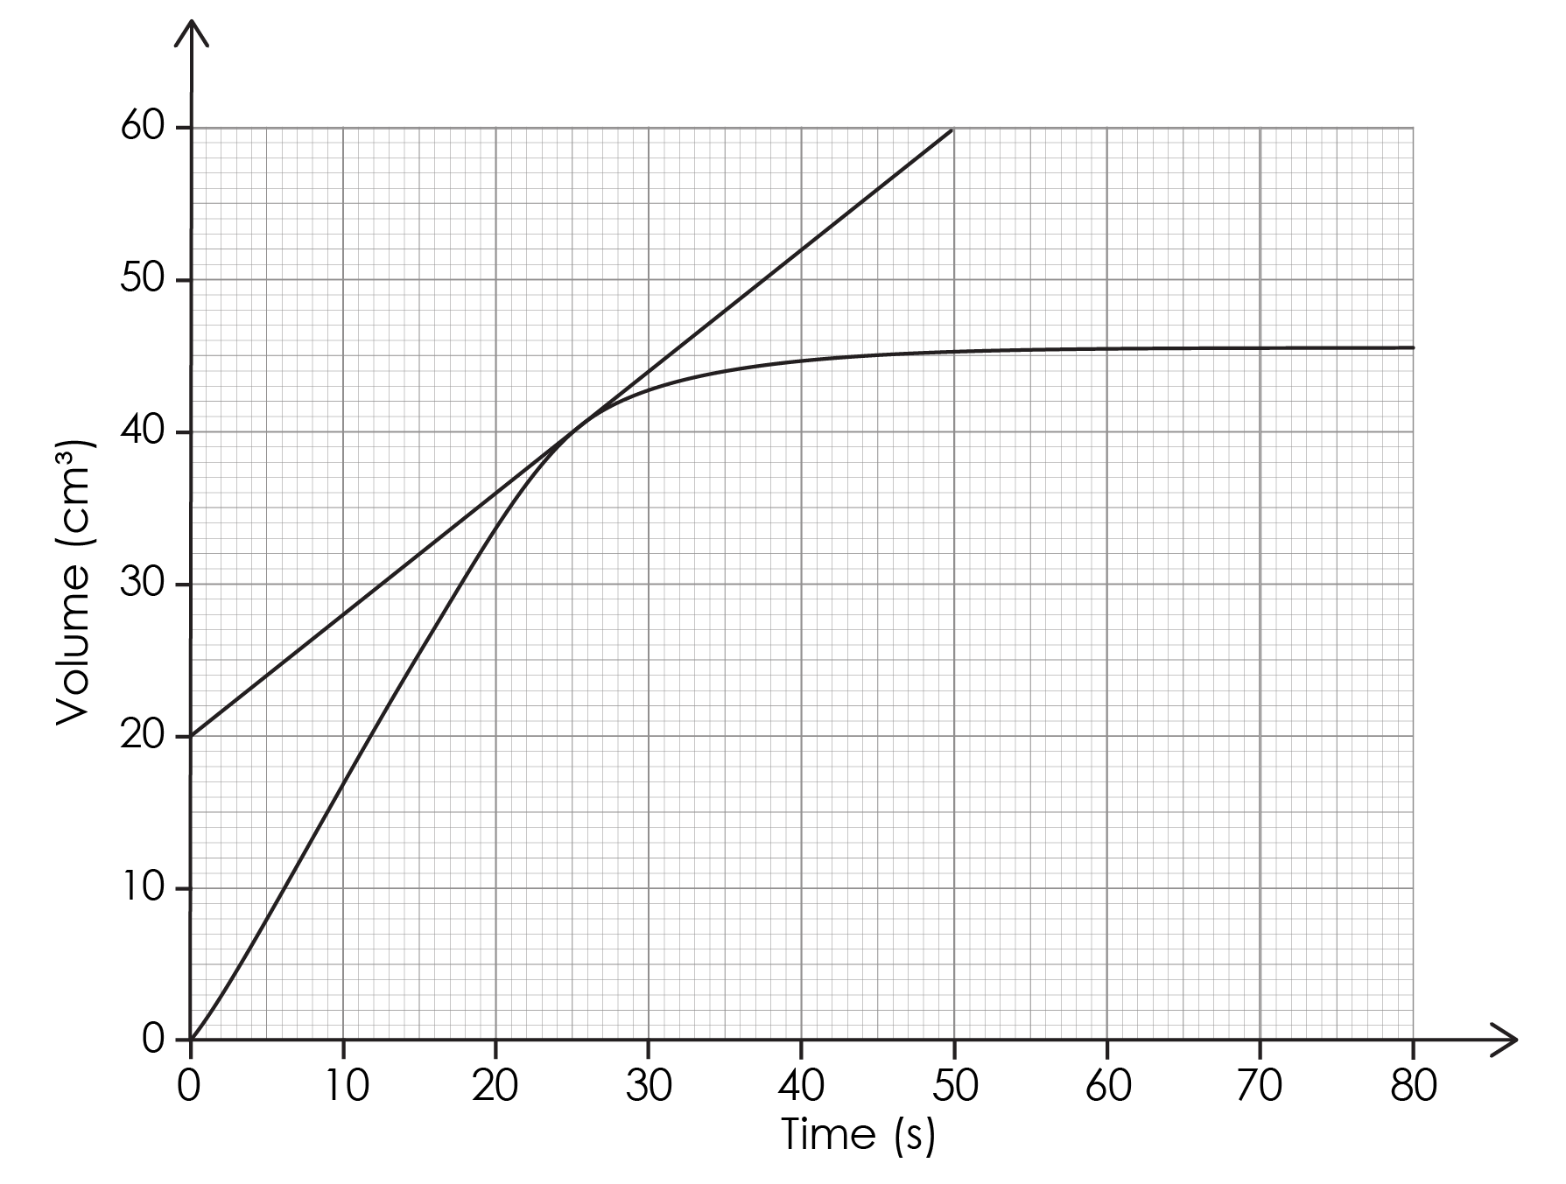
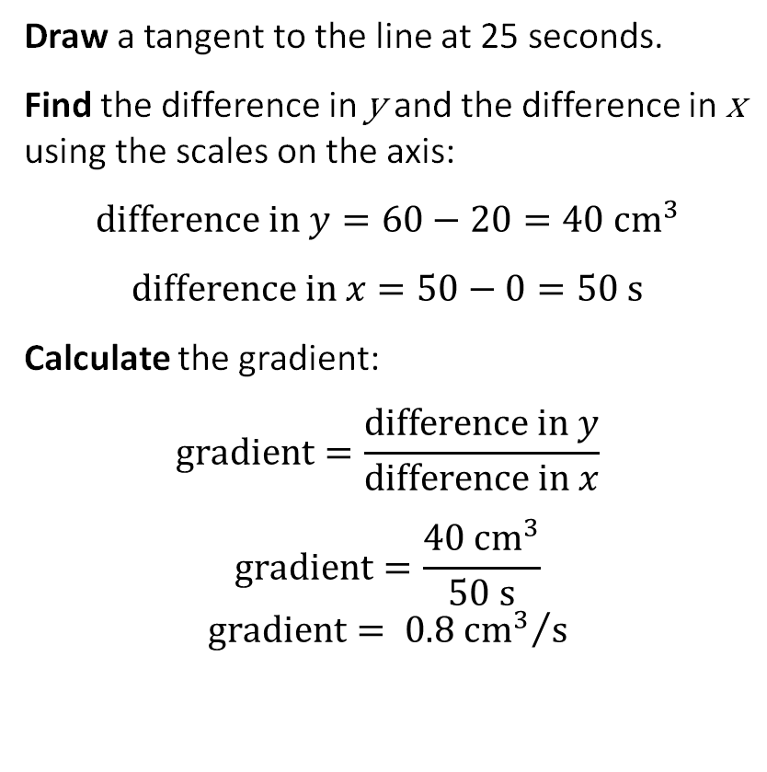
Calculating the gradient using a tangent
Answer
Draw a tangent to the line at 25 seconds.
Find the difference in y and the difference in x using the scales on the axis:
$$difference in y=60−20=40{ cm}^{3}$$
$$difference in x=50−0=50 s$$
Calculate the gradient:
$$gradient=\frac{difference in y}{difference in x}$$
$$gradient=\frac{40 {cm}^{3}}{50 s}$$
$$gradient= {0.8{ cm}^{3}}/s$$
Notes:
Explain that we are going to calculate the mean rate of reaction using the tangent. Explain why the arrows under the tangent are drawn between 0 and 50 seconds.

