Slide 1

Stage 1
Interpreting graphs
Downloaded from: rsc.li/3l0g6sR

Slide 2
Introduction
In this lesson we will cover the maths skills used to answer a graph question.
Learning objectives
Describe and compare patterns and trends in data.
Understand how the variables are related to each other.
Use data to draw conclusions about chemical reactions.
Introduction
Notes:
Discuss with students where they might have done something like the learning objectives before.
In science at the primary phase:
they will have carried out experiments and recorded data in a table
drawn bar charts, scatter graphs and line graphs from experiments and made decisions about which category was the highest or lowest
used results to make simple conclusions, make predictions and suggest improvements.
In maths at primary phase:
students will have presented data and interpreted it in tables and bar charts
they will have used these visuals to make decisions on how many more of x there is than y for example.
In maths at secondary phase:
students construct and interpret tables, bar charts, pie charts and pictograms for categorical data and vertical line charts for grouped or ungrouped data
they are used to describing simple mathematical relationships between two variables using scatter graphs.

Slide 3
Why does data analysis matter?
Data on its own does not provide much information.
Chemists analyse the data to see if there are any patterns or trends. This can help us to understand more about what is happening during a reaction.
Data analysis is used to make conclusions about the chemical processes and reactions.
The skills used in chemistry are the same as those we use in mathematics.
The main difference between maths and chemistry is that the data we analyse in chemistry will be from experiments and so it is not always perfect.
Why might data in chemistry not be perfect?
Introduction
Notes:
Data is collected via measurements or through observations. Discuss the differences between these two, to remind students that in chemistry we use qualitative methods too, such as colour changes.
Discuss with learners what data not being perfect means.
Why might the data not be perfect?
What is meant by the true value?
What can you do to improve the quality of data collected?
How likely is it that students will achieve the true value in a school laboratory?
Perfect data would be completely accurate measurements with no errors at all. No data is ever perfect – there are always small differences between what you measure and the true value. If we measure the temperature of boiling water, you might get 99.2°C, 100.1°C, or 99.8°C in different attempts, even though pure water boils at exactly 100°C under controlled conditions such as environmental temperature and pressure.
Possible reasons for data not being perfect:
zero error
random errors
equipment limitations – e.g. lack of precision in measuring instruments or they are not calibrated correctly
environmental limitations – room temperature fluctuations, heat loss to the surroundings, impurities in the chemicals used
method limitations – reactions happen too fast to measure accurately, variables not controlled well
Learners can improve the quality of data by:
repeating measurements and calculating the mean
spotting and removing any anomalies
using equipment with more precision e.g. a digital balance or digital thermometer rather than analogue versions
using as large a sample size as possible
using larger quantities where it is safe and possible to do so
Are we likely to achieve true value data? No, because:
school equipment is less precise than research laboratory equipment
chemicals used in school experiments are likely to be less pure
But we can achieve results close to the true value by getting results which are consistent and repeatable.

Slide 4
Lesson question
Imagine you are investigating how the concentration of hydrochloric acid affects the volume of carbon dioxide gas produced when it reacts with marble chips over 60 seconds.
Here are the results:
Lesson question
Concentration (mol/dm³) | Volume of gas (cm³)
0.5 | 15
1.0 | 30
1.5 | 45
2.0 | 60
Plot a graph of the bivariate data.
Describe the pattern seen.
What is the relationship between the variables?
Write a conclusion for this investigation.
Notes:
This slide introduces the challenge question that learners will return to at the end of the lesson. Learners are not expected to attempt it at this point. We will return to complete the question at the end of the session.
Discuss the question and the words in bold, which are in bold. Learners should recognise the terms but, if not, help them problem-solve the meaning: bi means two such as bicycle, bilingual, bilateral, bisect, bifold, binoculars. What does the term variate sound a bit like? Variable – a variable is something which changes or varies.
Bivariate data is data which involves two variables.
A pattern is seen when data repeats in a predictable way.
Variables are anything in an experiment which can be measured and changed. Make sure learners understand the different types.
A conclusion summarises what has been found out during the investigation.

Slide 5
Bivariate data
In maths, data can be described as univariate or bivariate.
Univariate means there is one variable. If we measured the travel time for teachers to get to school, the variable is travelling time.
Bivariate data means two variables, so there are two sets of data.
For example, we could investigate how stirring affects how quickly salt dissolves in water. We would change the number of stirs and measure how long it takes for the salt to disappear.
In science, we use the terms independent and dependent variables.
What do these terms mean?
What are the independent and dependent variables in the example given above?
Notes:
In science, the term bivariate data is not commonly used.
Independent variable is the variable which the scientists choose. This is the number of stirs.
The dependent variable is the dissolving time.
Extend the discussion by asking: what would need to be controlled in this experiment to make sure that the answer was close to the true value? Suitable answers: volume of water, temperature of water, mass of salt, stirring implement.
Use the key terms list available from: rsc.li/4wypuqq to further support pupils with maths vocabulary.

Slide 6
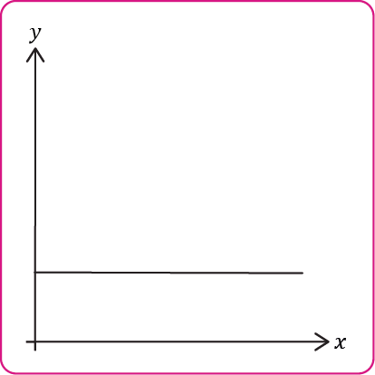
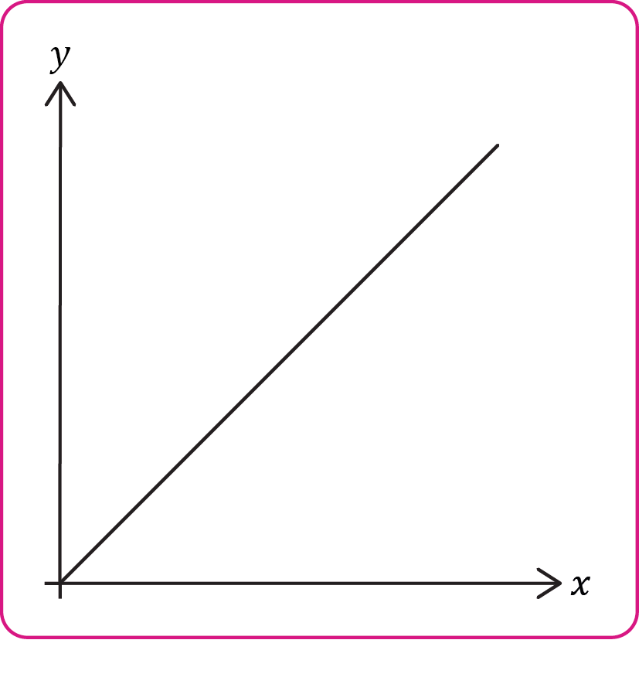
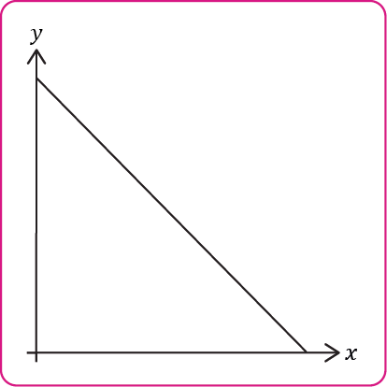
Relationship between variables
Use the words listed below to describe the relationship between the variables in these examples:
positive linear relationship
negative linear relationship
no relationship
Activity
A.
B.
C.
Notes:
Discuss what the terms mean before linking to the correct example.
A linear relationship is one which forms a straight line.
Positive linear relationship means as one variable increases, so does the other variable. We look for an upward trend in the data.
If the relationship between the variables produces a straight line or is very close to being a straight line, then we can say it is a positive linear relationship (if it slopes upwards to the right) or a negative linear relationship (if it slopes downwards towards the right).
Negative linear relationship means as one variable increases the other decreases and so we look for a downward trend in the data.

Slide 7
Relationship between variables – answers
No relationship: as A increases B does not change. The variables are not linked to each other.
Positive linear relationship: As A increases so does B at a constant rate forming a straight line.
Negative linear relationship: As A increases B decreases at a constant rate forming a straight line.
A.
Answers
B.
C.
Notes:
Ask learners how they could describe a curved line. This would be a non-linear relationship (not a straight line but there is a relationship between the variables).

Slide 8
Patterns in data
What is a pattern?
A pattern is when we notice that things happen in a repeatable and predictable way.
Patterns can show up as:
things which repeat regularly
relationships between variables
trends over time
Notes:
Discuss the term pattern and its definition. What patterns have learners noticed in chemistry?

Slide 9
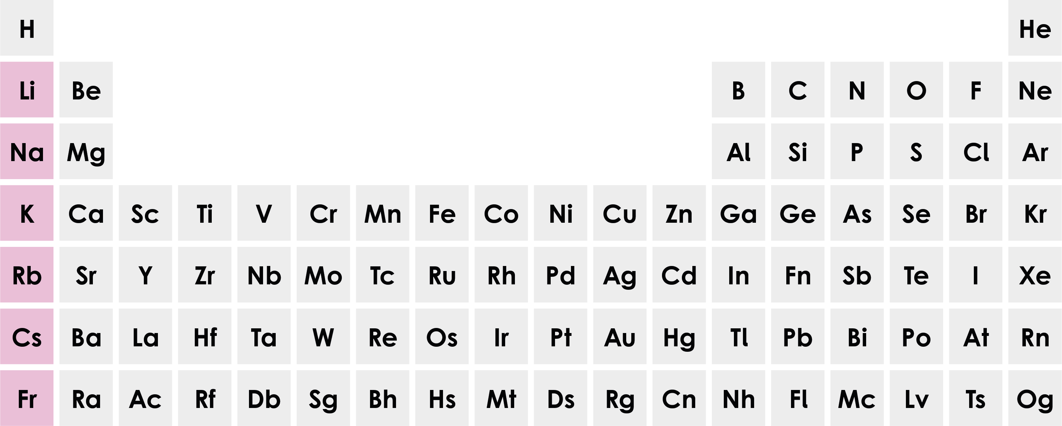
Patterns in data 2
We know that group 1 metals all react with water. This reactivity is a pattern which repeats as we go down group 1.
Lithium
Sodium
Potassium
Rubidium
Caesium
We would probably see a repeatable pattern occur if we measured the temperature of the air in the classroom at 8 am each morning and again at 2 pm over 5 days.
What pattern might we notice?
reactivity
Notes:
Show students a periodic table and remind them where group 1 is and how lithium, potassium and sodium react with water. You can even demonstrate this or show learners a short video clip.
Ask, what do we predict would happen if francium was added to water? We know what would happen because we have identified a pattern.
If we measured the air temperature in the morning at 8am for five days and then again at 2 pm, we might notice that the air temperature is always warmer in the afternoons. It is a predictable pattern which repeats itself. As scientists we can then seek to understand why this pattern may occur. Ask learners for their ideas.
You can also ask a more challenging question, such as: if we add alkaline sodium hydroxide solution drop by drop to hydrochloric acid what will happen to the pH over time? The pH will increase as more sodium hydroxide is added.

Slide 10
Trends
What is a trend?
A trend is the general direction that data is moving in over time.
When we analyse data, we notice if the data is generally increasing, decreasing or staying the same.
If we heat a beaker of water with a Bunsen burner, we know that the temperature of the water will increase over time. This is an upward trend.
If we place a hot beaker of water in a fridge, we know that the temperature of the water will decrease over time. This is a downward trend.
Looking for patterns and trends in our data helps us understand what is happening in chemical reactions.

Slide 11
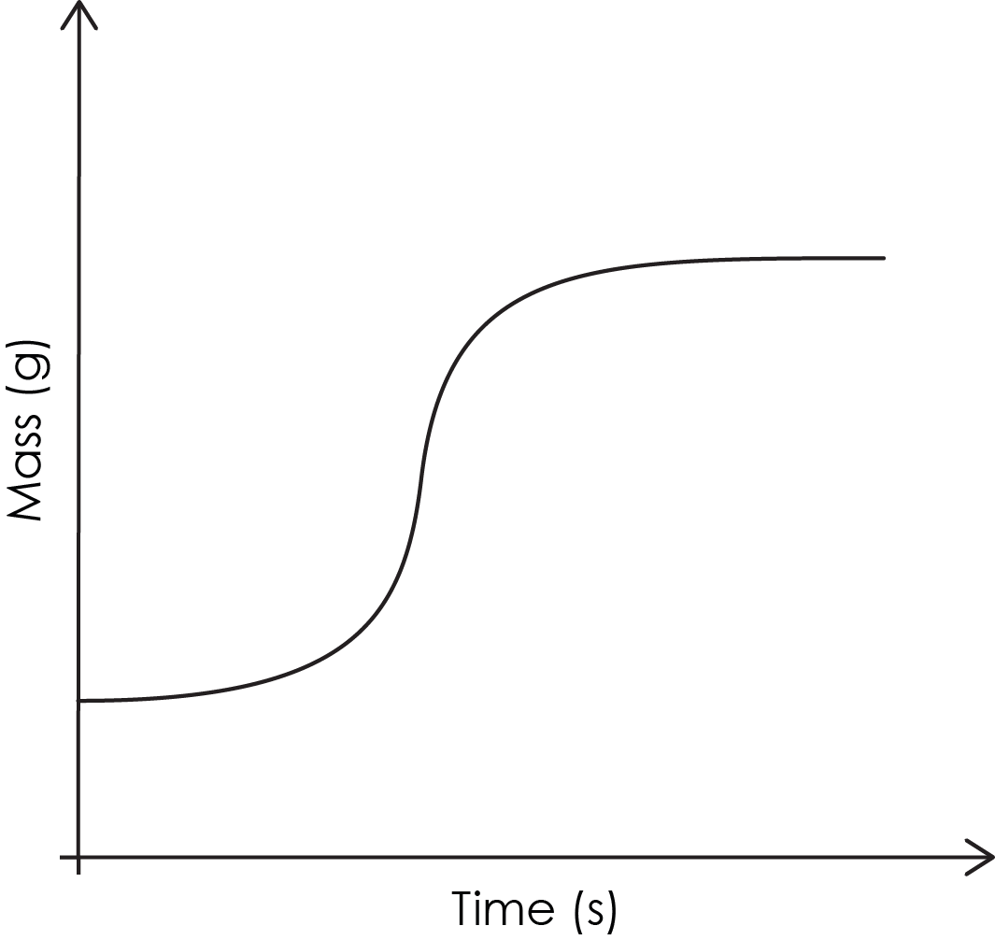
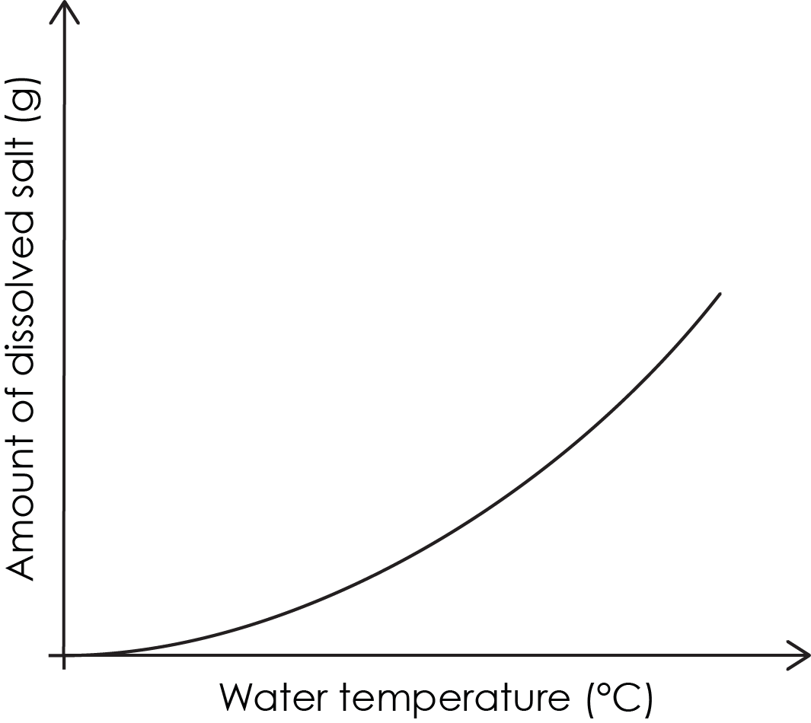
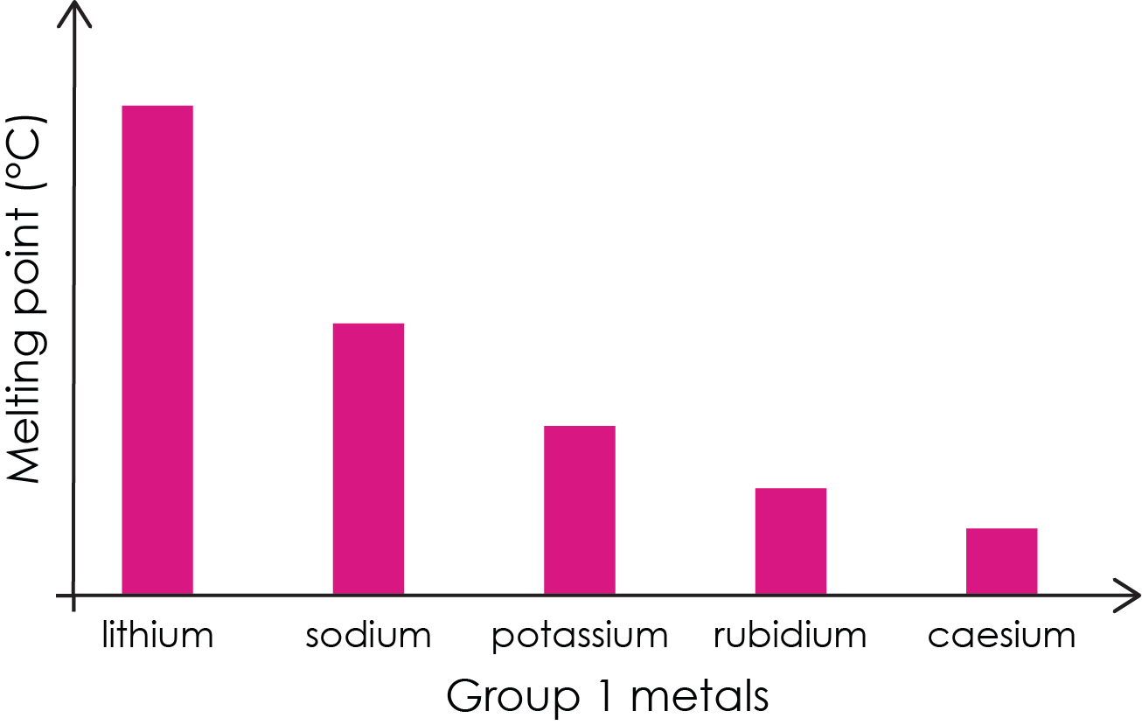
Pattern or trend?
Look at each graph. Decide if it shows:
a pattern
a trend
both
Activity
A.
B.
C.
Notes:
These are qualitative graphs, which means they show the relationship between the variables without numbers.

Slide 12
Pattern or trend? Answers
It is a trend because it is happening over time.
It is a pattern but not a trend. It is a consistent relationship between the melting point and group 1 metals.
It is a pattern but not a trend. It shows a clear relationship between the two variables – water temperature and solubility.
Answers
.
Notes:
B. Melting point decreases down group 1. This is predictable behaviour. Ask learners why this is not a trend. It is not a trend because there is no change over time. The data is categorical data and not a sequence changing over time.
C. The graph shows that as water temperature increases, more sucrose can be dissolved. This is predictable behaviour. Ask learners what they think might happen to the line as water temperature increases further.
Learners may find this distinction tricky as these words are often used interchangeably in everyday language. If learners find the terminology tricky, use our key terms list and accessible glossary to support their understanding: rsc.li/4wypuqq.

Slide 13
Variables and tables
A variable is something that can change or be measured in an experiment.
Identify the different types of variable in this experiment:
A student investigates how the temperature of water affects how much salt can be dissolved in it.
What is the independent variable?
What is the dependent variable?
What variables should be controlled?
Design a suitable table to record the results for this experiment.
Activity
Notes:
Discuss the definitions of the different types of variable.
An independent variable is the thing that the student decides to change. This is the temperature of the water.
The dependent variable is the thing that the student will measure and record. This is the amount of salt which dissolves at each different temperature.
Control variables can affect the results so they should be kept the same throughout. These could be the volume of water and the type of salt used.
Answer
A suitable table would have ‘temperature’ and the correct units in the first column header and ‘amount of salt dissolved ($g$)’ in the second column. Best practice would have additional columns for repeats and calculating a mean.

Slide 14
From table to graph
In maths we record data in tables. This data forms coordinates or ordered pairs which are plotted onto a graph to see if there are any trends or patterns.
Data table Ordered pair Plotting
Temperature (°C) | Amount of salt dissolved (g /100 g of water)
20 | 32
40 | 44
60 | 61
80 | 83
Each row forms an (x, y) coordinate
Plot the x value (20) on the x-axis. Plot the y value (32) on the y-axis.
(20, 32)
(40, 44)
?
?
What are the missing coordinates?
Notes:
In science, we don’t often talk about (x, y) coordinates or ordered pairs. This might be something learners are familiar with from maths. Discuss these with learners and ask them how we would describe these numbers in science. We describe them as variables. In the ordered pair (20, 32) the 20 would be the independent variable and the 32 is the dependent variable. In science, we also often have more than two columns because of repeats, so it is not always as easy to see the ordered pair.
Answer: the missing coordinates are (60, 61) and (80, 83).

Slide 15
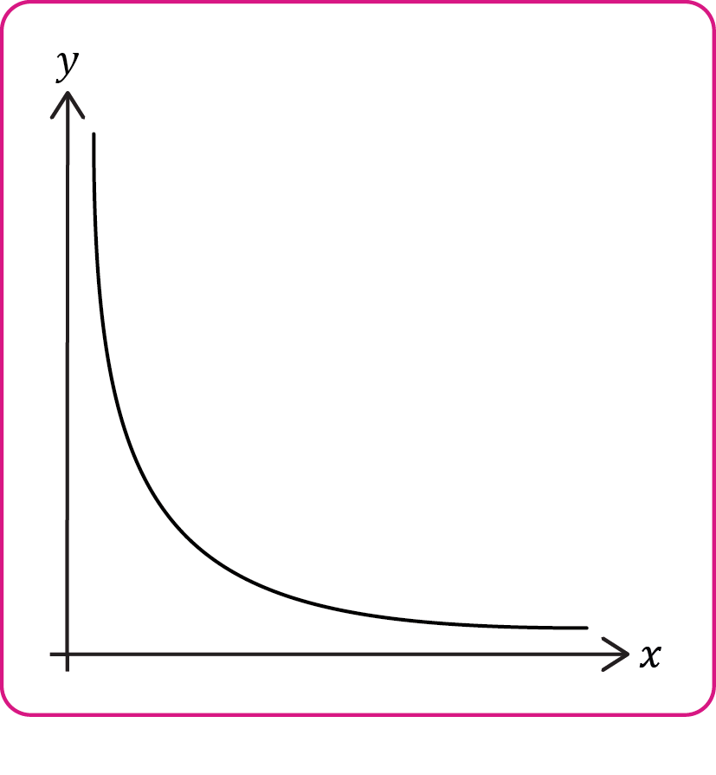
Proportional
In maths, we can describe relationships between variables as directional proportional or inversely proportional.
Directly proportional
The variables move in the same direction at a constant rate.
As one variable increases then the second variable will also increase proportionally. If one variable doubles, then the other will also double.
On a graph, this is a straight line passing through the origin.
Inversely proportional
As one variable increases, the other variable will decrease in a specific way. If one variable doubles then the other will halve.
The data will form a curve rather than a straight line which never touches the axes.
Notes:
Inversely proportional graphs may be challenging for most learners in this phase. You can choose not to include this section. You can also use our accessible glossary: rsc.li/4wypuqq to further support learner understanding of these terms.
Ask students what will happen in an inverse relationship if one variable triples? The other variable will be divided by three.

Slide 16
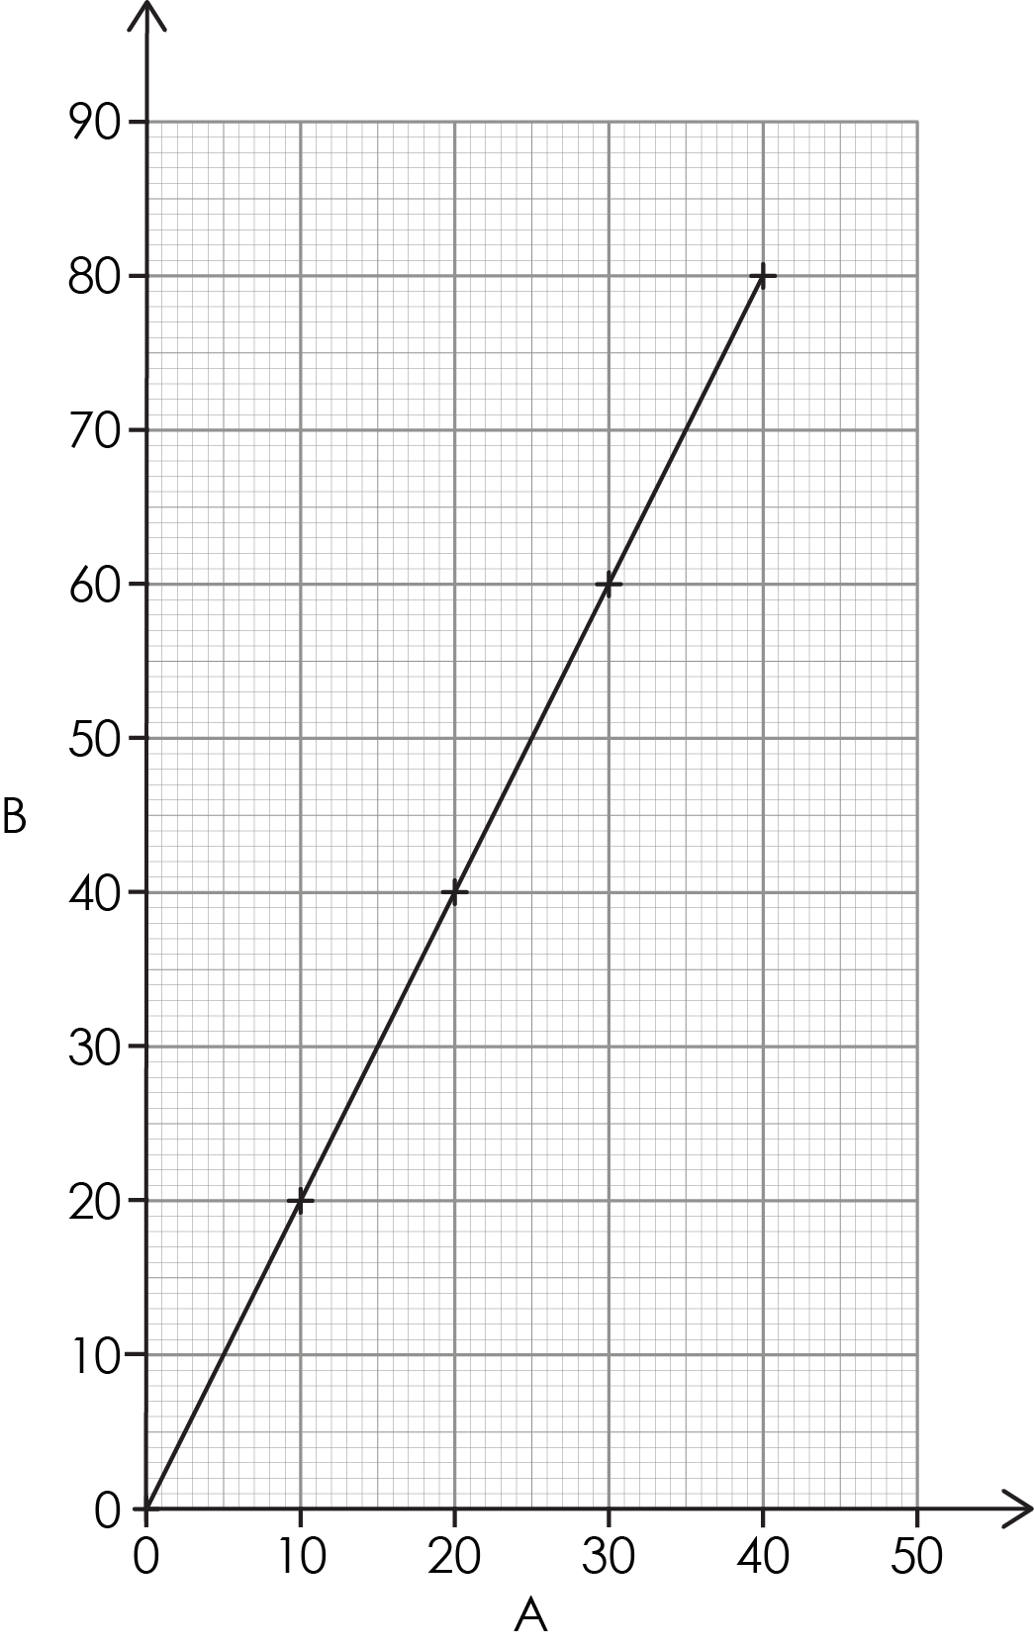
Relationships between the variables 1
Describe what you see.
Activity
Notes:
Ask learners to talk to each other and describe what they see.
For those who are struggling to get started use sentence starters such as:
As A increases, B ____________
The line is ___________________
The line passes through the _____________
Possible responses may be:
The line goes up.
The line is straight.
Encourage learners to use the variables A and B in their answer to highlight the relationship between the variables in words. They might need to unpack what the variables are: A and B.

Slide 17
Relationships between the variables 1 – answers
As A increases, so does B.
There is a positive correlation between A and B.
The variables are directly proportional because it is a straight line passing through the origin.
This is a linear relationship.
Answers

Slide 18
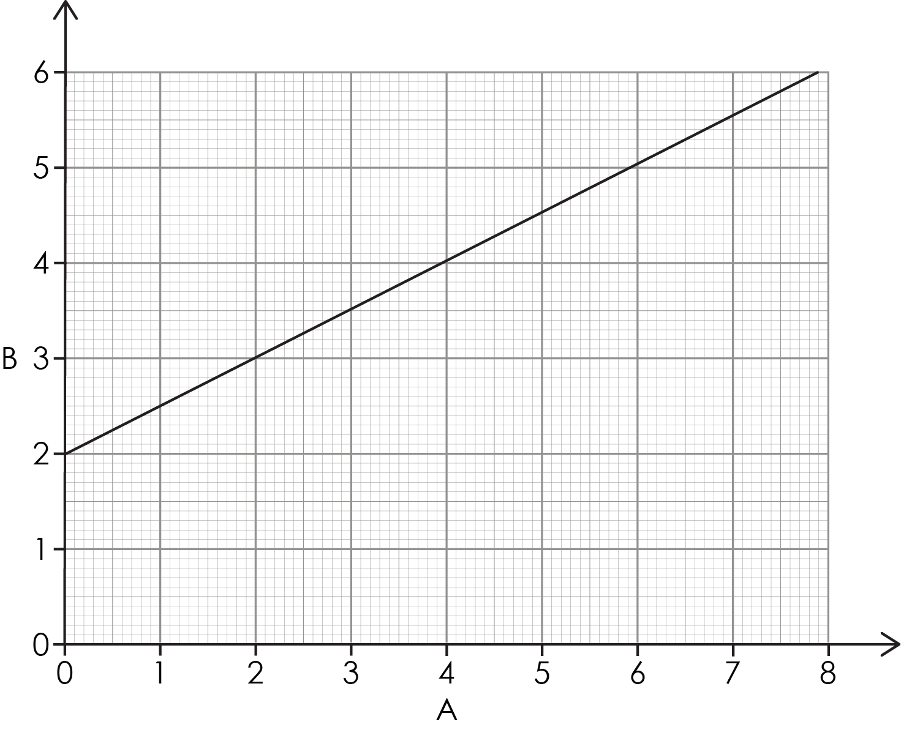
Relationships between the variables 2
Describe what you see.
Activity
Notes:
Ask learners to talk to each other and describe what they see.
Possible responses which need more description may be:
The line goes up.
The line is straight.
For those who are struggling to get started use sentence starters such as:
As A increases, B ____________
The line is ___________________
The line passes through the _____________
Encourage students to use the variables A and B in their answer. They might need to unpack what the variables are: A and B.

Slide 19
Relationships between the variables 2 – answers
Both variables increase.
As A increases so does B.
There is a positive correlation between A and B because there is an upward trend.
This is a linear relationship because an equal change in one variable corresponds to an equal change in the other variable.
Answers
Notes:
The relationship is not proportional or directly proportional, as it does not pass through the origin (0,0). In maths, sometimes we say ‘proportional’, but it means the same as ‘directly proportional’. It is good practice to say ‘directly proportional’ to avoid confusion when we talk about ‘inversely proportional’.

Slide 20
Relationships between variables 3
Look at the table of data.
Is this bivariate data?
What is the trend being shown?
What happens to B when A increases?
Is this a linear or non-linear relationship?
Between A = 4 and A = 8, the value for B drops by 30. What happens to the value of B between A = 20 and A= 24?
What type of relationship is shown here?
Variable A | Variable B
4 | 60
8 | 30
12 | 20
16 | 15
20 | 12
24 | 10
40 | 6
Activity
Notes:
This is potentially challenging as there is a lot to consider. Break it down more slowly by looking at each question on its own. The slide is animated so you can look at each question in turn.
If learners need to be able to visualise the pattern more easily, they can plot this as a line graph. You can also do this as a modelling exercise on the white board or under a visualiser while thinking aloud.
Use 'think aloud' strategies to model the strategy you would use to answer the question. Discuss how learners can tell that this is not a linear relationship if they have not plotted the graph.
Look at the differences in variable B as variable A increases by 4 units each time. If this was a linear relationship, B would decrease by the same amount each time.
When A increases from 4 to 8, B drops by 30.
When A increases from 8 to 12, B decreases by 10.
When A increases from 12 to 16, B decreases by 5.

Slide 21
Relationships between variables 3 – answers
Look at the table of data.
Yes – there are two variables (A and B).
B decreases rapidly at first, then more slowly.
Downward/decreasing trend.
Non-linear – the points form a curve, not a straight line.
B drops by 2 (much less than the 30 at lower values).
Inversely proportional – when A doubles, B halves.
Variable A | Variable B
4 | 60
8 | 30
12 | 20
16 | 15
20 | 12
24 | 10
40 | 6
Answers
Notes:
(f) For example: A = 4, B = 60 → A = 8, B = 30
A = 20, B = 12 → A = 40, B = 6

Slide 22
Writing a conclusion
After we have analysed the data from an experiment we write a conclusion.
A good conclusion will:
describe any pattern or trend clearly
state the relationship between the variables
include actual data
explain what has happened.
Write a conclusion for this bivariate data.
Draw a graph.
Is there a pattern?
Is it a linear or curved relationship?
Why does this pattern occur?
Temperature (°C) | Amount of salt dissolved (g/100g of water)
20 | 32
40 | 44
60 | 61
80 | 83
Notes:
This session is not about substantive knowledge, so the explanation of the results is not a focus.

Slide 23
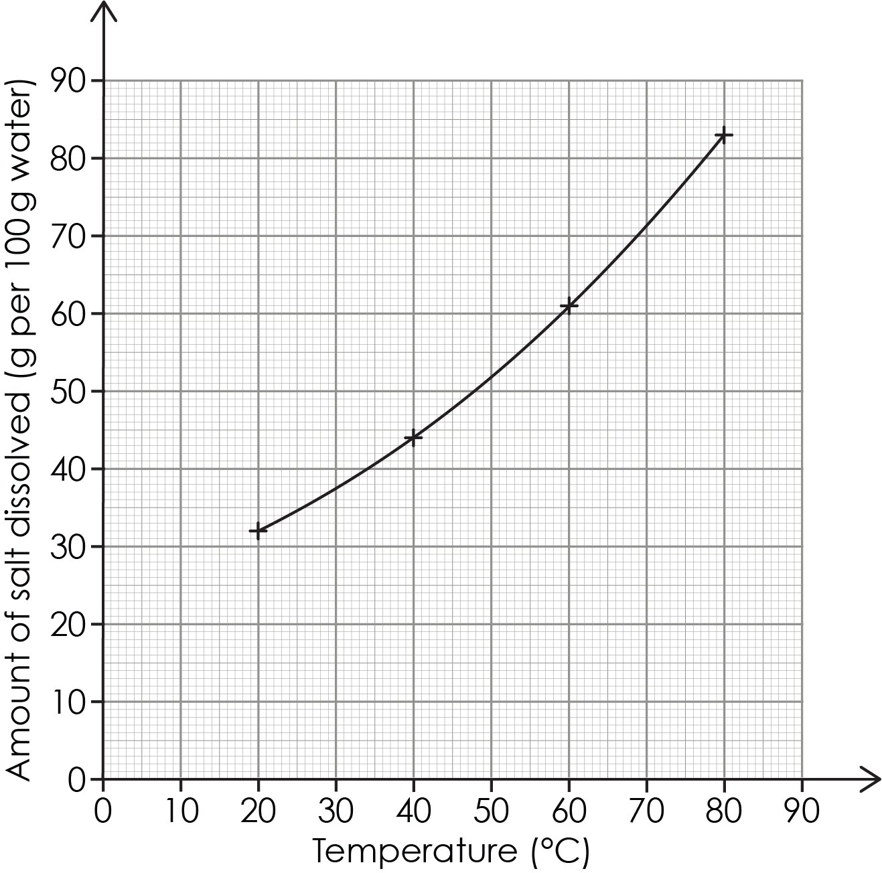
Writing a conclusion – example graph
Write a conclusion for this bivariate data.
Draw a graph.
Is there a pattern?
Is it a linear or curved relationship?
Why does this pattern occur?
Temperature (°C) | Amount of salt dissolved (g/100g of water)
20 | 32
40 | 44
60 | 61
80 | 83
Answer

Slide 24
Writing a conclusion – writing frame
The graph shows that as ____________ increases, ____________ also increases.
This is a linear/nonlinear relationship. The points form a ____________ showing the increase in amount dissolved was not ______________.
Answer
Notes:
If learners require additional scaffolding, use a writing frame (example on the slide).

Slide 25
Conclusion
The graph shows that as temperature increases, the amount of salt dissolved also increases.
This is a nonlinear relationship. The points form a curved line, showing the increase was not at a constant rate.
Answer
Notes:
The pattern: as temperature increases, the amount of salt dissolved also increases.
The relationship: the points form a curved line, so the relationship is not linear. The increase in amount which can be dissolved is not happening at a constant rate.
Extension
You can ask learners to include an explanation of the results. For example, at 20°C, about 32 g of salt dissolves, while at 80°C, about 83 g dissolves. This happens because warmer water has more energy, which helps it dissolve more salt. As the temperature gets higher, the water becomes better at dissolving salt, so more salt can dissolve.

Slide 26
Returning to the lesson question
A learner carried out an investigation to see how the concentration of hydrochloric acid affected the volume of gas collected in 60 seconds during a reaction.
Here are the results:
Lesson question
Concentration (mol/dm³) | Volume of gas (cm³)
0.5 | 15
1.0 | 30
1.5 | 45
2.0 | 60
Plot a graph of the bivariate data.
Describe the pattern seen.
What is the relationship between the variables?
Write a conclusion for this investigation.
Notes:
This is the original question from the beginning of the lesson.

Slide 27
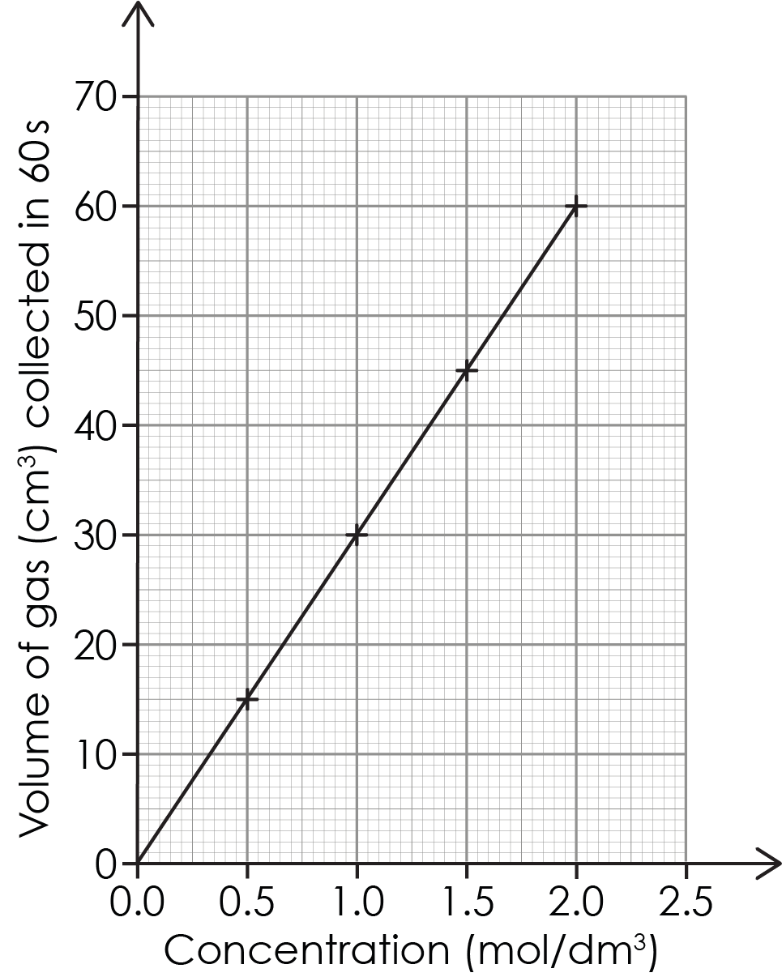
Returning to the lesson question – answer a
Answers

Slide 28
Returning to the lesson question – answers b–d
As concentration increases the volume of gas increases. When the concentration doubles then the volume of gas doubles.
The relationship is linear because the points form a straight line. It is directly proportional because the line passes through the origin.
The volume of gas produced is directly proportional to the concentration of acid used. When concentration doubles from 0.5 to 1.0 mol/dm³ the volume of gas doubles from 15 cm³ to 30 cm³.
Answers

