Slide 1

Stage 1
Interpreting data
Downloaded from: rsc.li/3l0g6sR

Slide 2
Introduction
Chemists often receive information in the form of tables of data. Being able to identify, describe and compare patterns can provide useful information about the relationship between the variables. It can help chemists to predict how other substances may react.
Learning objectives
Describe and compare patterns and trends in data.
Understand how the variables are related to each other.
Use data to draw conclusions about chemical reactions.
Introduction

Slide 3
Patterns and trends in data
In chemistry, using a graph displays the data visually so that it is easier to observe patterns or trends. A pattern in the data is seen when the data repeats itself in a predictable way. A trend in the data shows the general direction of the data over time.
A learner investigated how changing the concentration of hydrochloric acid affected the final volume of hydrogen gas collected in a reaction.
Activity
Concentration of hydrochloric acid (mol/dm³) | Final volume of hydrogen gas collected (cm³)
0 | 0
0.1 | 10
0.2 | 20
0.3 | 30
0.4 | 40
Plot a line graph and draw a suitable line of best fit.
Describe the trend.

Slide 4
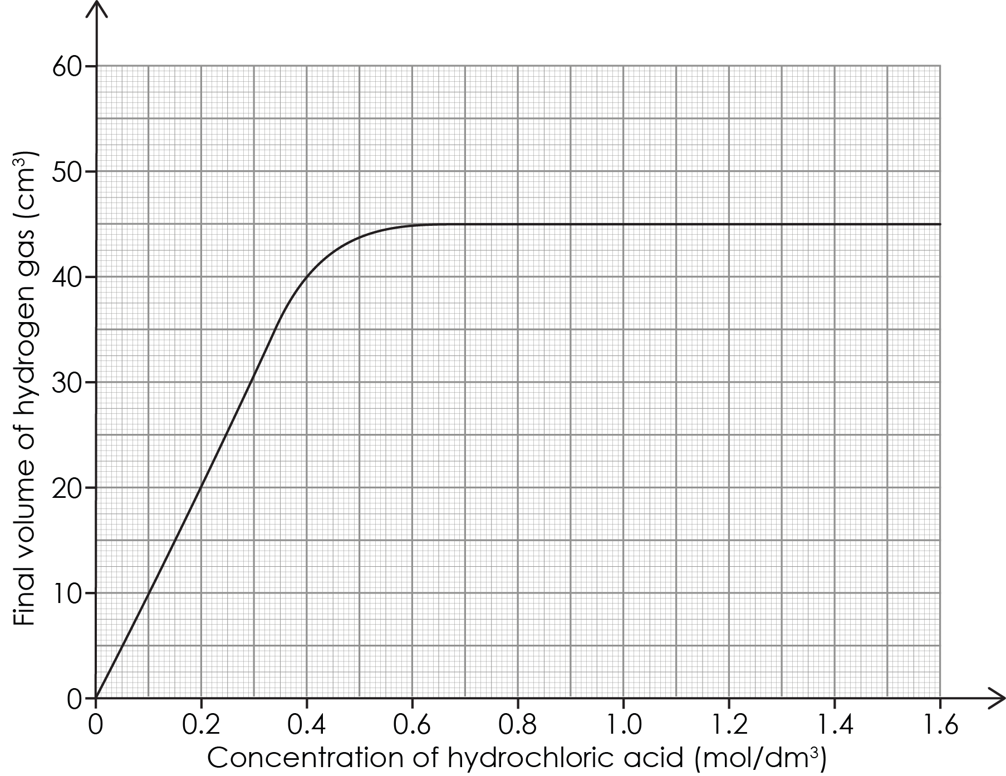
Patterns and trends in data – example graph
Answers
Notes:
Here is an answer graph for the question on slide 3: patterns and trends in data. Display this to learners if time is not available for plotting the graph.
Provide scales if learners are not confident in this area. The x-axis is labelled ‘Concentration of hydrochloric acid (mol/dm³)’ and the scale should increase in intervals of 0.1 or 0.2 units. The y-axis is labelled ‘Final volume of hydrogen collected (cm³)’ and the scale should increase with suitable intervals of 10 or 20 units. Learners should plot the points correctly and draw a straight line of best fit. Remind learners to look at their plotted points by holding the paper to their eye to see if it looks as if it is a straight line or a curve.

Slide 5
Patterns and trends in data – describing the trend
b) As concentration increases the final volume of hydrogen gas also increases. This is a positive linear relationship because it goes upwards towards the right and is a straight line.
Answer

Slide 6
Identifying a pattern using the periodic table
Chemists use the periodic table to help identify patterns. They can predict how new elements may behave and react.
Describe any patterns you notice in the data.
Predict the approximate missing values for silicon.
Complete the sentence about the relationship between the number of protons and atomic mass:
The greater the number of protons …
Element | Number of protons | Atomic mass | Metal/non- metal
Sodium | 11 | 22.99 | metal
Magnesium | 12 | 24.31 | metal
Aluminium | 13 | 26.98 | metal
Silicon | ? | ? | ?
Phosphorus | 15 | 30.97 | non-metal
Sulfur | 16 | 32.07 | non-metal
Chlorine | 17 | 35.45 | non-metal
Argon | 18 | 39.95 | non-metal
Activity
Notes:
Show learners a periodic table and check they understand what a period is. Highlight period 3 to them.
For additional scaffolding, ask:
Look at the number of protons – what pattern do you see?
Look at the atomic masses – what pattern do you notice?

Slide 7
Identifying a pattern using the periodic table – answer a
Pattern 1: The atomic numbers increase by one each time as you move across the period from left to right. They go up in order: each element has one more proton than the element before it.
Pattern 2: The atomic masses increase as you go across the period from left to right. The mass goes up from 22.99 (sodium) to 39.95 (argon). The pattern shows that elements get heavier as the atomic number increases.
Pattern 3: The period starts with metals on the left (sodium, magnesium, aluminium), then it changes to non-metals on the right (phosphorus, sulfur, chlorine, argon). Argon is also a noble gas.
Answers

Slide 8
Identifying a pattern using the periodic table – answers b–c
Silicon has 14 protons and an atomic mass of approximately 28 units. It is a metalloid which has properties of both metals and non-metals.
The greater the number of protons the greater the atomic mass. This is a positive relationship.
Answers
Notes:
c) Some learners may also notice that the relationship is positive but not consistent each time.

Slide 9
Using data
Time (s) | Mass (g)
0 | 50.00
10 | 49.82
20 | 49.65
30 | 49.51
40 | 49.33
50 | 49.18
60 | 49.02
70 | 48.86
80 | 48.71
90 | 48.53
100 | 48.38
A learner is investigating the reaction between calcium carbonate chips and hydrochloric acid.
They place a conical flask containing the calcium carbonate chips and hydrochloric acid onto a digital balance.
As the reaction occurs carbon dioxide gas is released and escapes into the air. The learner records the mass of the flask and its contents every 10 seconds.
Plot the data from the table onto a graph.
Describe the relationship between the variables.
Predict the mass of the conical flask and its contents at 55 seconds.
Notes:
Explain to learners that calcium carbonate chips are like small stones. You can opt to demonstrate the reaction and learners can record data from the demonstration.

Slide 10
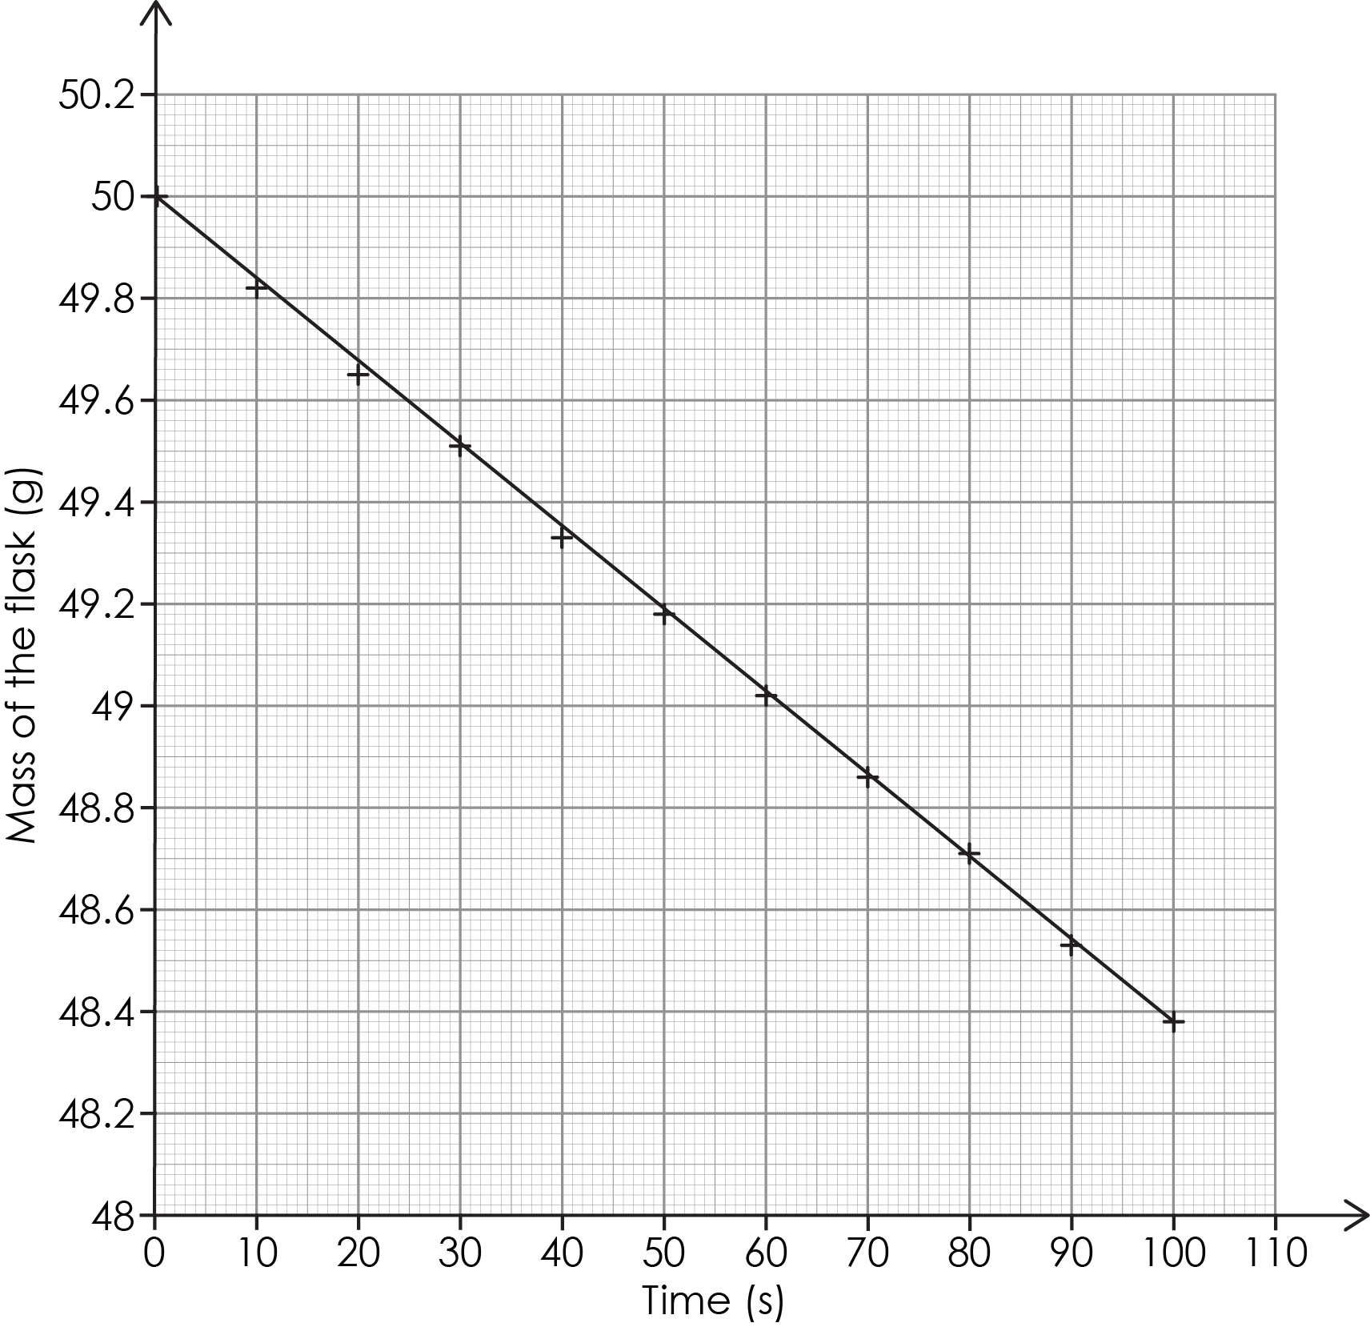
Using data – example graph
Answers
Notes:
a) Time (s) is plotted on the x-axis and mass (g) on the y-axis. The line of best fit should be a straight line showing a negative linear relationship.
Here is an answer graph for the question on slide 9: using data. Display this to learners if time is not available for plotting the graph.

Slide 11
Using data – answers b–c
As time increases, the mass of the flask and contents decreases. There is a negative linear relationship between the variables.
The mass at 55 seconds is 49.10 g (accept 49.05 to 49.15 g).
Answers
Notes:
c) Demonstrate, using the answer graph, how to interpolate to find this figure. Draw a line upwards from 55 seconds until it hits the line of best fit and then draw a horizontal line to the y-axis and read off the figure.

Slide 12
Use data to draw conclusions
Students investigated the reaction between different hydrochloric acid concentrations and marble chips. The 3 mol/dm³ hydrochloric acid is the most concentrated. They measured the volume of carbon dioxide gas produced.
Activity
Time (minutes) | Gas produced using 1 mol/dm³ acid (cm³) | Gas produced using 2 mol/dm³ acid (cm³) | Gas produced using 3 mol/dm³ acid (cm³)
0 | 0 | 0 | 0
1 | 15 | 30 | 45
2 | 25 | 50 | 75
3 | 32 | 64 | 95
4 | 36 | 72 | 100
5 | 38 | 76 | 100
Compare all the trends in the data. What similarities and differences do you notice?
Write a conclusion for the investigation.
Notes:
You can decide whether this data is too complex for your learners. Remove a set of data to make this simpler. Learners can plot this graph, or you can give them two of the three concentration data sets pre-plotted to save time. Slide 13 has a copy of the full graph. Slide 14 provides an example with just two of the three data sets plotted. Similarities and difference are available on slide 15. An example conclusion is available on slide 16.
Encourage learners to discuss what they see in the table and/or in the graph before answering the question independently.
Some learners may need sentence starters to help them unpack this data.
Ask learners – how would we know that the reaction had finished?
Answer: the volume of gas produced levels off and does not increase much as time continues. Using 3 mol/dm³ acid we can see the reaction finished at 4 minutes because the volume is the same at 5 minutes.
Remind students that a conclusion should:
describe any pattern or trend clearly
state the relationship between the variables
include actual data
explain what has happened (this is not the focus for the session however).

Slide 13
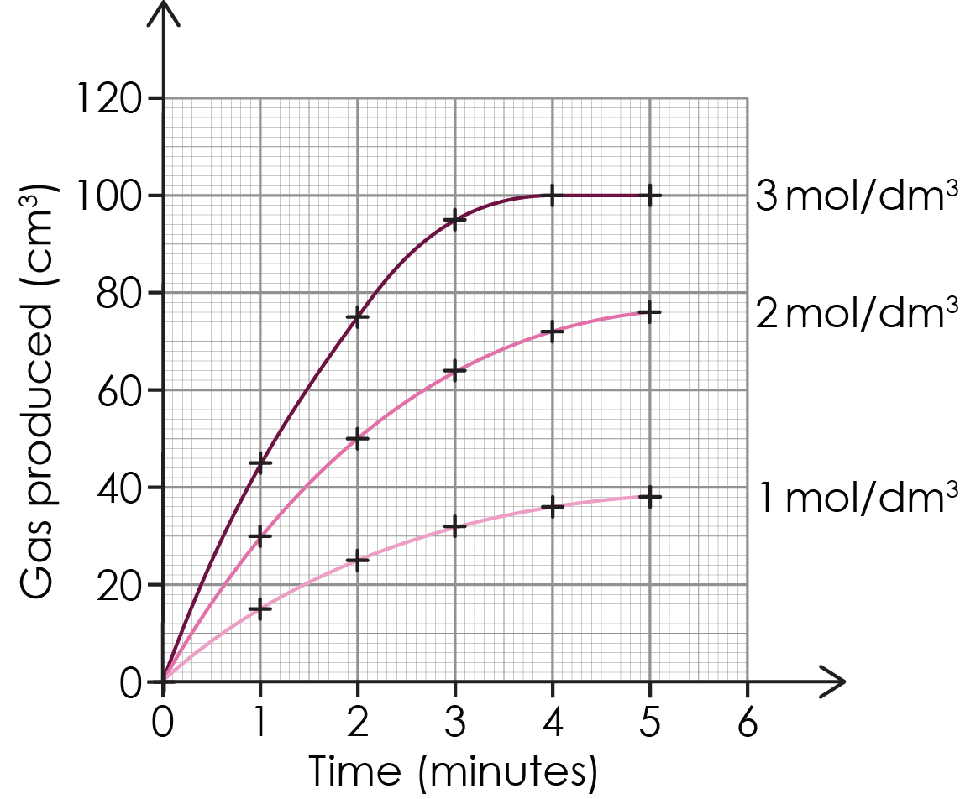
Use data to draw conclusions: three data sets
Answers
Notes:
Here is a model graph for the question on slide 12: using data to draw conclusions. Display this to learners if time is not available for plotting the graph.

Slide 14
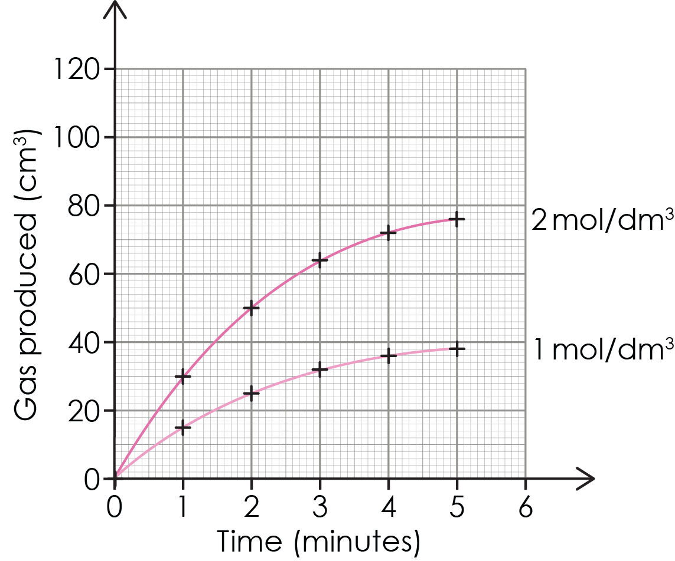
Using data to draw conclusions: two data sets
Answers
Notes:
Here is a scaffolded model graph for the question on slide 12 for you to with learners. They can plot the final set: 3 mol/dm³.

Slide 15
Using data to draw conclusions – answer a
Similarities
All three reactions start at 0 cm³.
All reactions show gas production that increases over time then levels off.
All reactions follow a similar curve pattern.
All reactions eventually stop producing gas (reach a plateau).
Differences
The 3 mol/dm³ acid produces gas fastest (steepest initial slope).
The 1 mol/dm³ acid produces gas slowest (gentlest slope).
Different total volumes of gas are produced.
The reactions finish at different times.
Answers
Notes:
Above are a selection of possible responses. Learners may have recorded some but not all.
Differences expanded:
Different total volumes of gas are produced: 3 mol/dm³ produces most (100 cm³), 2 mol/dm³ produces 76 cm³, 1 mol/dm³ produces least (38 cm³).
The reactions finish at different times: 3 mol/dm³ finishes first, 1 mol/dm³ finishes last. 1 mol/dm³ and 2mol/dm³ may not actually have finished reacting yet but are very close to it.

Slide 16
Using data to draw conclusions – answer b
This investigation shows a clear pattern between acid concentration and gas production. It shows a positive relationship between acid concentration and the total amount of gas produced.
The data also shows that doubling the concentration roughly doubles the volume of gas released. When we look at each concentration over time, all three show a similar trend: gas production increases rapidly at first, then slows down and eventually levels off when the reaction finishes.
There is also a pattern in the reaction speeds: higher concentrations react faster.
Answer
Notes:
Further detail learners may include:
As the concentration of acid increased from 1 mol/dm³ to 3 mol/dm³, the volume of gas produced also increased. The 1 mol/dm³ acid produced 38 cm³ of gas, the 2 mol/dm³ acid produced 76 cm³, and the 3 mol/dm³ acid produced 100 cm³.
The 3 mol/dm³ acid produced gas the fastest and finished at 4 minutes, while the 1 mol/dm³ acid was slowest and had nearly finished at 5 minutes.

