Slide 1

Stage 2
Interpreting graphs
Downloaded from: rsc.li/3l0g6sR

Slide 2
Introduction
In this lesson we will cover the maths skills needed to answer a graph question.
Learning objectives
Interpret graphs to describe the relationship between data.
Describe the trend on rates of reaction graphs.
Explain the trend on rates of reaction graphs.
Introduction
Notes:
Explain that we will be covering these key maths skills in a chemistry context.

Slide 3
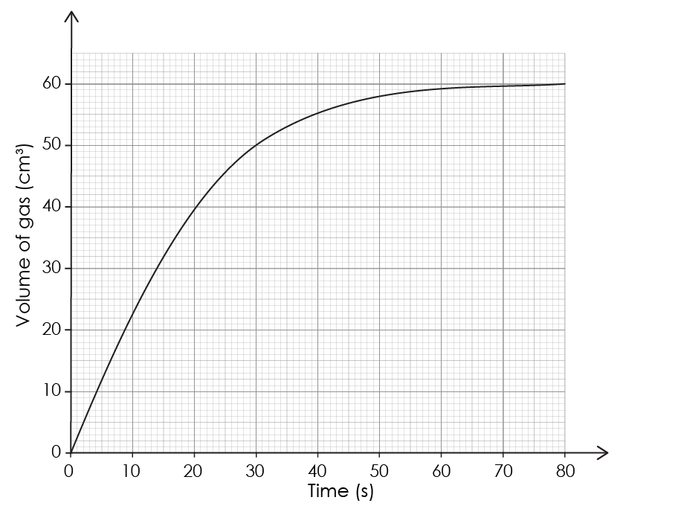
Lesson question
Lesson question
Imagine you are investigating the reaction between hydrochloric acid and magnesium.
Describe and explain how the rate of reaction changes over time.
Notes:
This slide introduces the challenge question that learners will return to at the end of the lesson. Learners are not expected to attempt it at this point. We will return to complete the question at the end of the session.

Slide 4
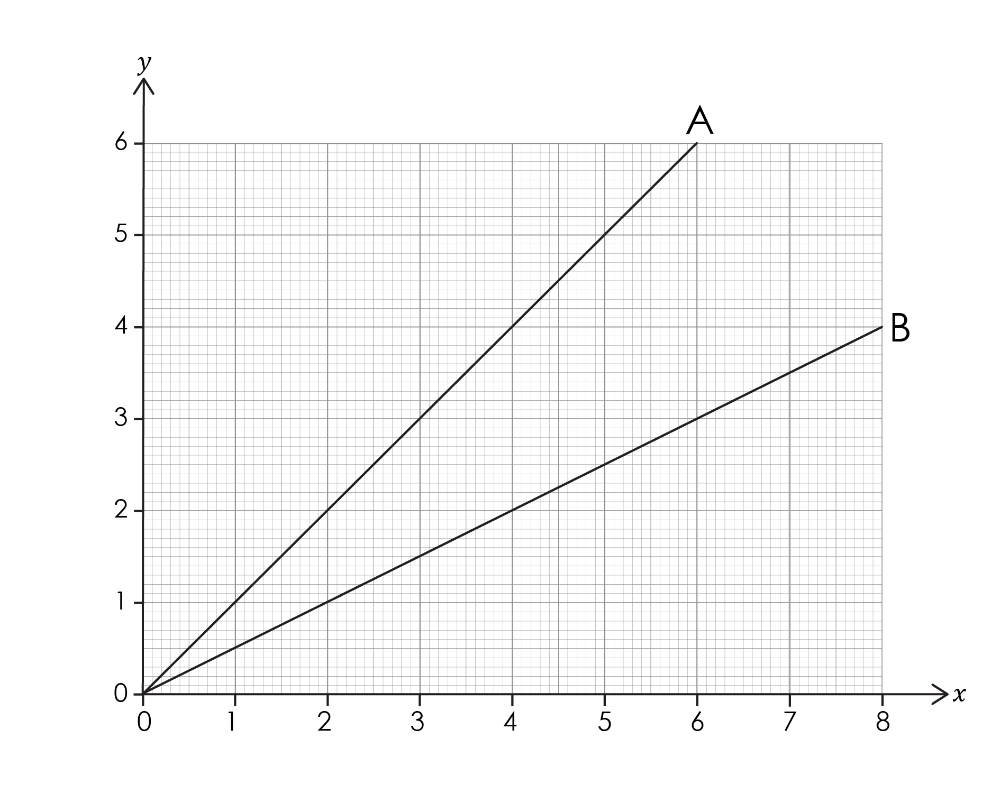
Learning from stage 1
In creating graphs, we learned how to compare the gradient of two lines:
The gradient of a slope describes its steepness.
The greater a gradient the steeper the slope.
A steeper slope means a faster rate.
Which of these lines has a higher rate?
Explain your answer.
Notes:
In the creating graphs stage 2 resource set, learners describe the gradient of a slope, calculated the gradient of a slope and calculated the gradient of a tangent. If your learners need to revisit any of these skills, the teacher-led presentation can be found here: rsc.li/4gA2Lp7.
Answer: Line A has the higher rate because the gradient is steeper.​ As x increases y increases.​

Slide 5
Describing the trend or pattern
Describing the trend or pattern in a graph involves ‘saying what you see’. When we describe the trend in a graph, we:
start by looking at the labels on the axes
describe the overall trend or pattern.
A trend is a pattern in a set of results. We:
use the labels on the axes to describe the overall trend
highlight any significant differences in the overall trend.
We can also use data to help describe the trend.
Let’s look at an example.
Notes:
If your learners need to revisit the different between the trend or pattern or the definitions, this is available in the level 1 teacher-led presentation of this set: https://rsc.li/3l0g6sR.

Slide 6
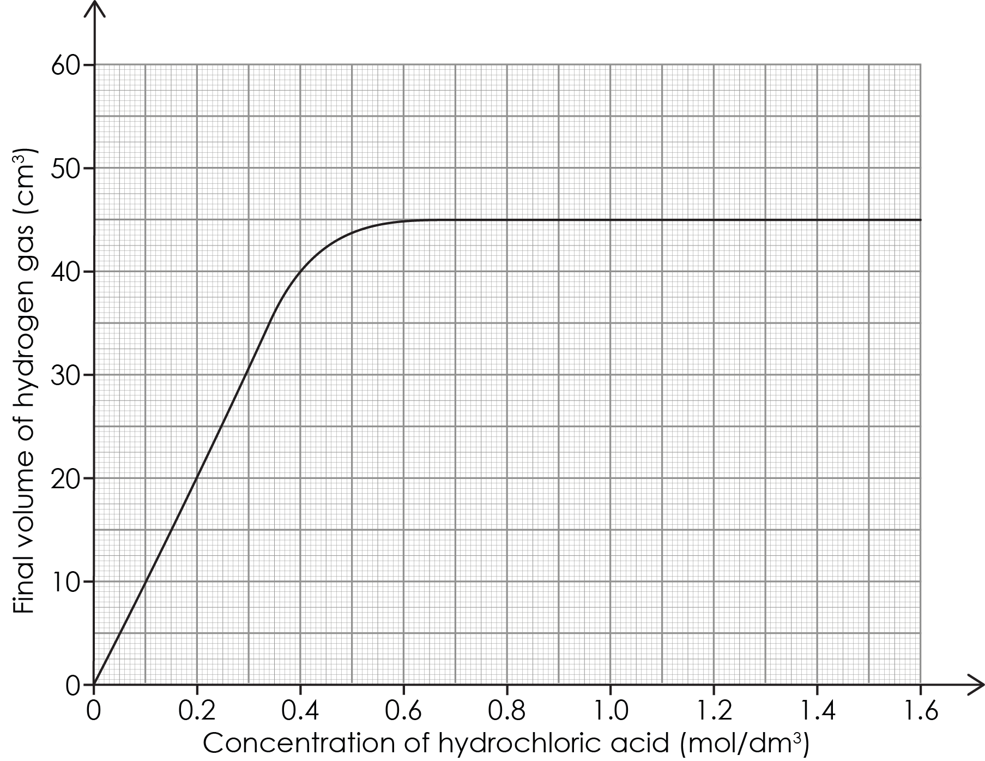
Describing the pattern
Describe the overall pattern
Describe any significant differences (using data)
Activity
Notes:
Explain that when we are talking about bivariate data, we can use the independent and dependent variables to describe the overall trend:
As the [independent variable] increases the [dependent variable] increases/decreases.
Emphasise that we are using the entire label on each axis to describe the overall trend. Discuss the meaning of linear relationship.

Slide 7
Describing the pattern – answers
As the concentration of hydrochloric acid increases the final volume of hydrogen gas increases.
At low concentrations below 0.4 mol/dm³ there is a linear relationship between concentration of hydrochloric acid and the final volume of hydrogen gas. After 0.6 mol/dm³ the maximum volume of hydrogen gas remains steady at 45 cm³.
Answers

Slide 8
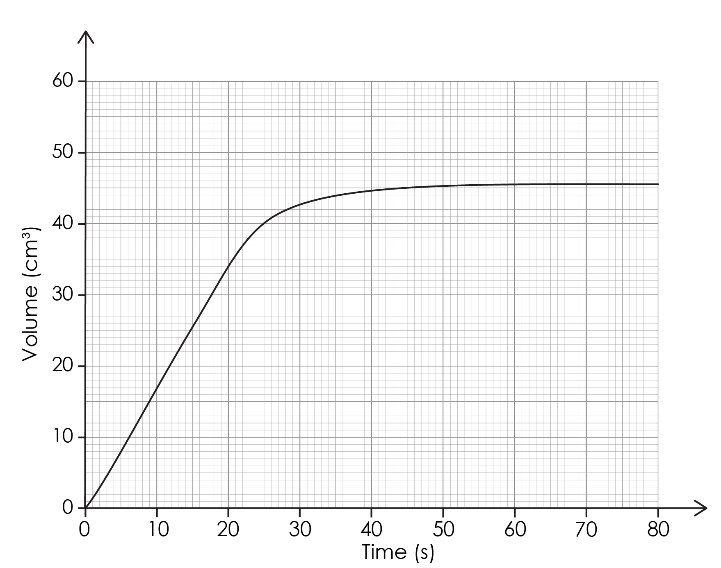
Describing the trend – time series graphs
A time series graph shows how a variable changes over time.
The rate of reaction can be found by finding the gradient of the slope.
Describe the overall trend.
Describe any significant differences (using data).
Activity
Notes:
Explain that in a time series graph, time is plotted on the x-axis, and the measured variable is plotted on the y-axis. Activities on how to find the gradient of a slope (with or without a tangent) can be found in creating graphs stage 2 resources: rsc.li/4gA2Lp7. Revisit this with your learners if they need to practice finding the gradient of a slope.
Discuss how the trend statement is different to that of the previous graph:
The [dependent variable] increases/decreases over time.

Slide 9
Describing the trend – time series graphs – answers
The volume of gas increases over time.
The rate of reaction is fastest between 0 and 20 seconds. The rate slows between 20 and 55 seconds. After 55 seconds the reaction stops.
Answers
Notes:
(b) Emphasise how the description has been divided into three separate parts – describing the changes in the trend over time.
Ask learners how they know that the rate is lower between 20 and 55 seconds. Answer: The slope is less steep. Discuss how they could find the rate of reaction between 0 and 20 seconds and how they could find the rate at 25 seconds (using a tangent).

Slide 10
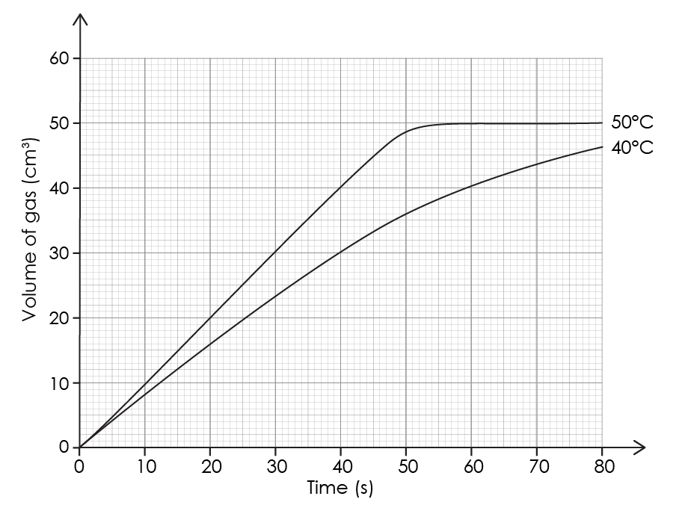
Graphs with multiple lines of best fit
This time series graph has two lines of best fit.
We can describe how the variable affects the rate of reaction:
as the temperature increases the rate of reaction increases.
How do we know the rate of reaction is faster at the higher temperature?
Activity
Notes:
Explain that some time series graphs in science have multiple lines of best fit – each line represents a change in the variable.
Explain that we can describe each time separately, as we would any time series graph. The important point is to look at the variable of temperature and to work out how temperature affects the rate of reaction. Explicitly describe the link between rate of reaction and the steepness of each line.
Ask learners: how do we know the rate of reaction is faster at the higher temperature?

Slide 11
Graphs with multiple lines of best fit – answer
Answer
The gradient of the slope is steeper for 50°C than for 40°C.
Notes:
Make the link between variables using the sentence structure: as the [independent variable] increases the [dependent variable] increases/decreases.

Slide 12
Explaining the line of best fit
You may be asked to explain the relationship on a graph.
This is where we link the description with an explanation using a connective like ‘because’.
Let’s use this graph as an example:
As temperature increases the rate of reaction increases because the particles have more kinetic energy, so there are more frequent successful collisions.
Notes:
Explain that a good explanation normally consists of: [description] [connective] [explanation]. The connectives (because and so) are highlighted in purple for learners.
As temperature increases the rate of reaction increases [description] because [connective] the particles have more kinetic energy [explanation], so [connective] there are more frequent successful collisions.
In this sentence, 'because' is the main connective separating the explanation and the description. 'So' is also a connective, separating the sentence clauses (parts of a sentence) indicated by a comma.

Slide 13
Returning to the lesson question
Let’s go back to the example from the beginning of this section:
Lesson question
Imagine you are investigating the reaction between hydrochloric acid and magnesium.
Describe and explain how the rate of reaction changes over time.
Notes:
Explain that we are going to use the information from the previous slides to describe and explain the graph above.

Slide 14
Returning to the lesson question – answers
Describe and explain how the rate of reaction changes over time.
First, describe the overall trend:
the rate of reaction decreases over time.
Then, describe and explain any significant differences:
The fastest rate of reaction is in the first 10 seconds.
The rate of reaction decreases over time as the concentration of the hydrochloric acid decreases.
The lower the concentration the fewer successful collisions will occur.
Answers
Notes:
Discuss how we know that the rate of reaction has decreased over time. Relate this to the volume of gas being produced. The rate at which the gas is being produced is decreasing over time.

