Slide 1

Stage 2
Interpreting graphs
Downloaded from: rsc.li/3l0g6sR

Slide 2
Introduction
The purpose of these activities is to interpret the line of best fit on a graph.
Learning objectives
Describe the overall trend or pattern in the data.
Describe any significant differences from the overall trend or pattern.
Explain the trend or pattern in the data.
Introduction
Notes:
Introduce the learning objectives for interpreting graphs and discuss where learners might have engaged with this topic in maths.

Slide 3
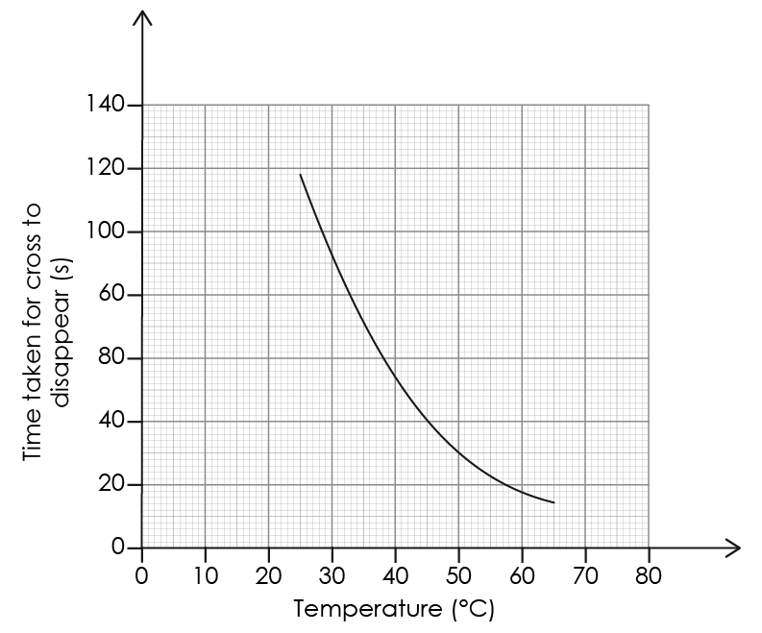
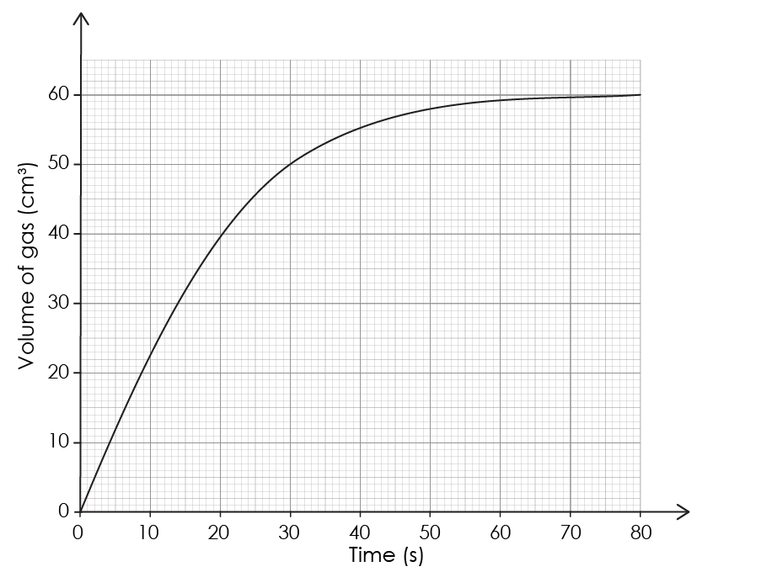
Describing the overall trend
Describe the overall trend in each of the following graphs:
Graph A
Graph B
Activity

Slide 4
Describing the overall trend – answer
Graph A: The rate of reaction decreases over time. The gradient of the slope becomes less steep.
Graph B: As the temperature increases the time taken for the cross to disappear decreases (the rate of reaction increases).
Answer

Slide 5
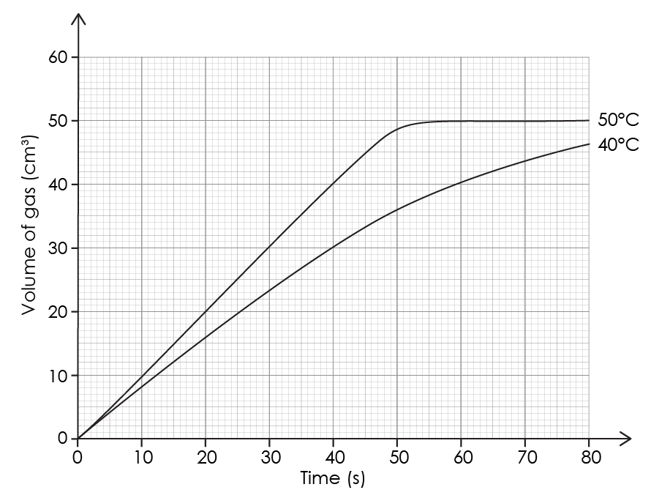
Describing a graph
Describe, in detail, the trends for each of the following graphs:
Graph A
Graph B
Activity

Slide 6
Describing a graph – answer
Graph A: The volume of gas produced in each time interval decreases. The initial rate of reaction between 0 and 15 seconds is fast. This slows down between 15 seconds and 55 seconds. The reaction stops at approximately 59 seconds.
Graph B: As temperature increases, the rate of reaction increases. At 50°C the reaction stops after approximately 55 seconds.
Answer

Slide 7
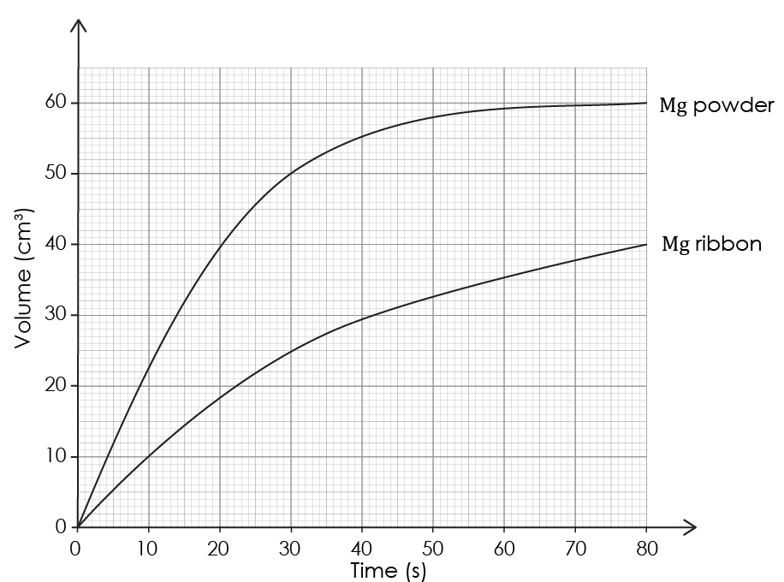
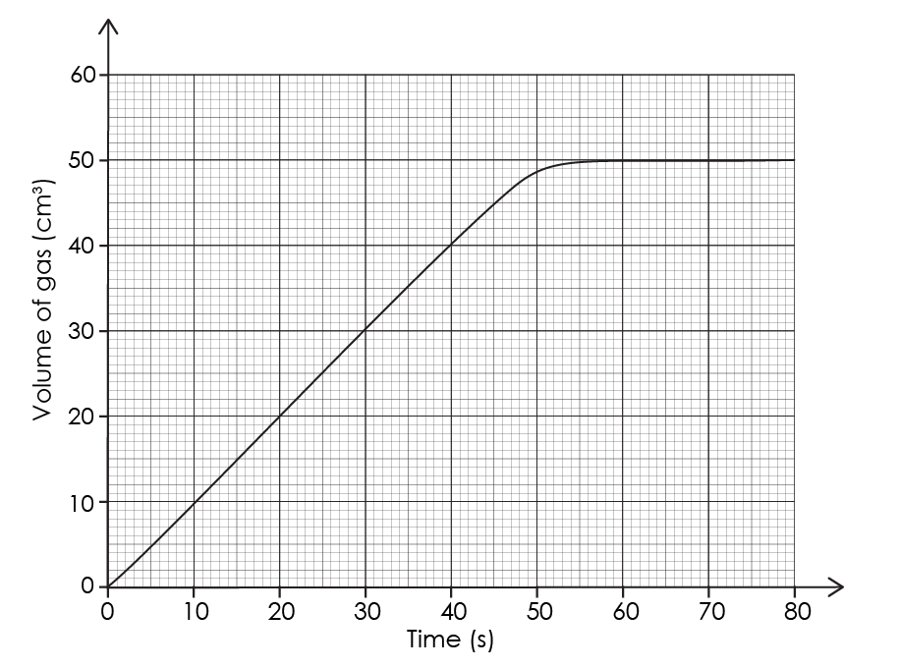
Explaining the trends
Explain the trends in the following graphs where excess magnesium is reacting with 1 mol/dm³ hydrochloric acid:
Graph A
Graph B
Activity

Slide 8
Explaining the trends – answer
Graph A: The rate of reaction is at its fastest between 0 and approximately 45 seconds. After 45 seconds the reaction slows down as the concentration of HCl decreases because there are fewer successful collisions between particles. The reaction stops at 55 seconds as the HCl has run out; it is the limiting factor.
Graph B: The rate of reaction for magnesium powder is greater than the rate for magnesium ribbon because magnesium powder has a greater surface area, allowing more frequent successful collisions.
Answer

