Slide 1

Stage 1
Algebra and equations
Downloaded from: rsc.li/4wqEoi

Slide 2
Introduction
Today, you will use the same estimation and checking skills you have already practised in maths but will apply them to real chemical situations. You will learn to predict missing results of reactions, write those reactions using words and symbols, and understand that mass never simply disappears, even when substances change completely (which might seem surprising at first).
Learning objectives
Make estimates of the results of simple calculations.
Recognise mass is conserved during a chemical reaction.
Understand some common symbols used in word and symbol equations.
Introduction

Slide 3
Lesson question
During this session we will cover the mathematics skills needed to answer the following question.
Iron reacts with sulfur when it is heated to form a compound called iron sulfide.
A learner carries out an experiment and records the following results:
Lesson question
Substance | Mass (g)
Iron (before the reaction) | 5.6
Sulfur (before the reaction) | 3.2
Iron sulfide (after the reaction) | 8.8
Notes:
This slide introduces the challenge question that learners will return to at the end of the session. It is not expected that learners attempt it at this point.

Slide 4
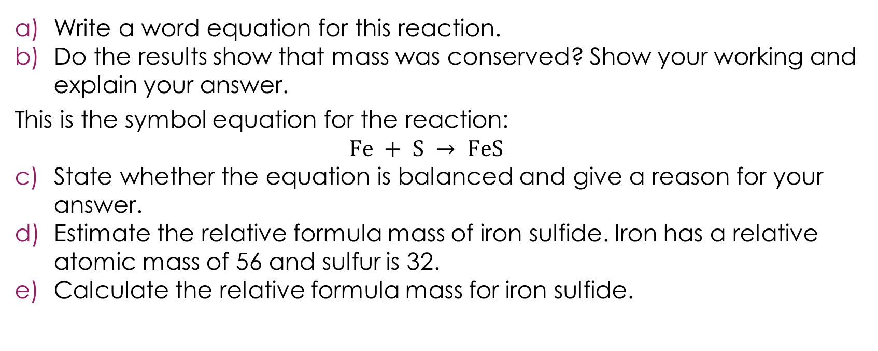
Lesson question continued
Substance | Mass (g)
Iron (before the reaction) | 5.6
Sulfur (before the reaction) | 3.2
Iron sulfide (after the reaction) | 8.8
Lesson question
Write a word equation for this reaction.
Do the results show that mass was conserved? Show your working and explain your answer.
This is the symbol equation for the reaction:
$$Fe + S → FeS$$
State whether the equation is balanced and give a reason for your answer.
Estimate the relative formula mass of iron sulfide. Iron has a relative atomic mass of 56 and sulfur is 32.
Calculate the relative formula mass for iron sulfide.
Notes:
Briefly talk through the scenario. The question combines three skills from the session:
writing a word equation
checking that the law of conservation of mass is upheld
knowing if an equation is balanced or not.
Check that learners understand the terms ‘relative formula mass’ and ‘relative atomic mass’. If they require support with these terms, revisit our accessible glossary to support this resource series: rsc.li/4wypuqq.

Slide 5
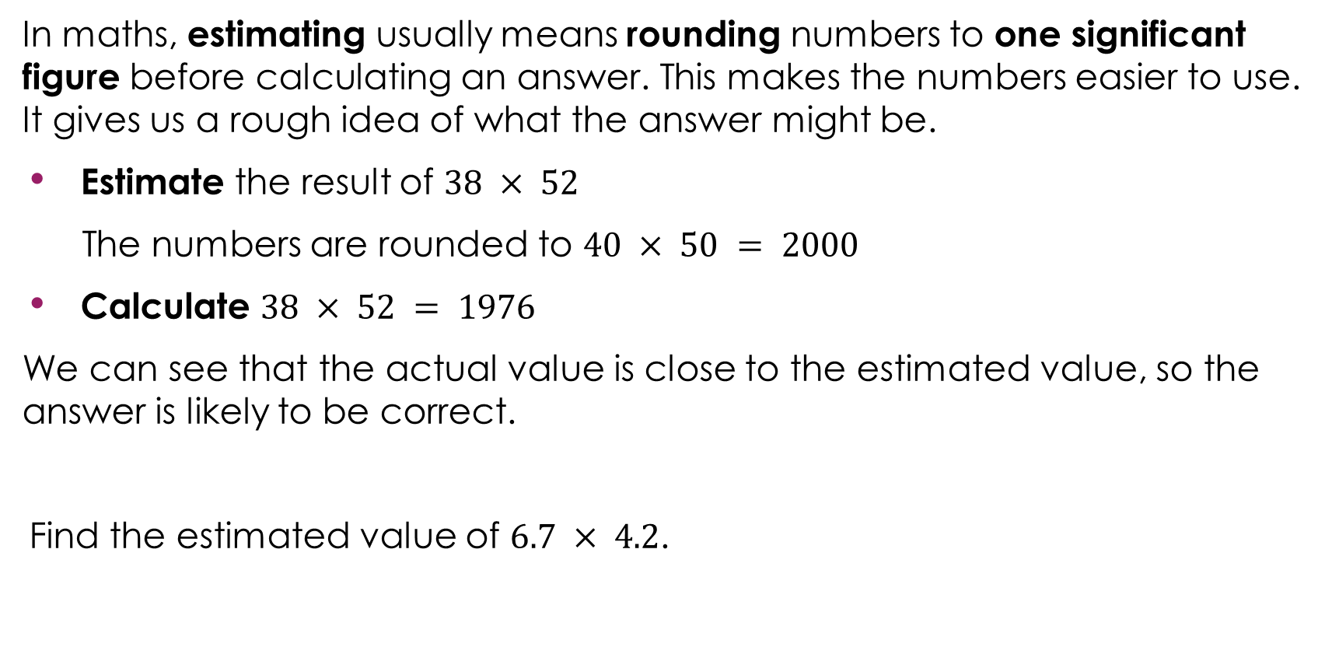
Making estimates in maths
In maths, estimating usually means rounding numbers to one significant figure before calculating an answer. This makes the numbers easier to use. It gives us a rough idea of what the answer might be.
Estimate the result of $38 × 52$
The numbers are rounded to $40 × 50 = 2000$
Calculate $38 × 52 = 1976$
We can see that the actual value is close to the estimated value, so the answer is likely to be correct.
Find the estimated value of $6.7 × 4.2$.
Notes:
Before showing the content of this slide, ask learners if they can recall how to estimate the result of a calculation in mathematics.
Recall what the term rounding to 1 significant figure means to check for understanding, and that 1 significant figure is not the same as 1 decimal place. This is covered in the understanding number stage 1 significant figure and rounding resources: rsc.li/4gbEt3p. You may need to revisit this resource with learners, as well as the accessible glossary: rsc.li/4wypuqq.
Show the slide and talk through each step of the worked example.
Ask learners to complete the question $6.7 × 4.2$ as practice.
6.7 is rounded to 7.0 and 4.2 is rounded to 4.0. Therefore, $7 × 4 = 28$.
The actual answer for $6.7 × 4.2$ is $28.14$, so the estimate is close to the true value.

Slide 6
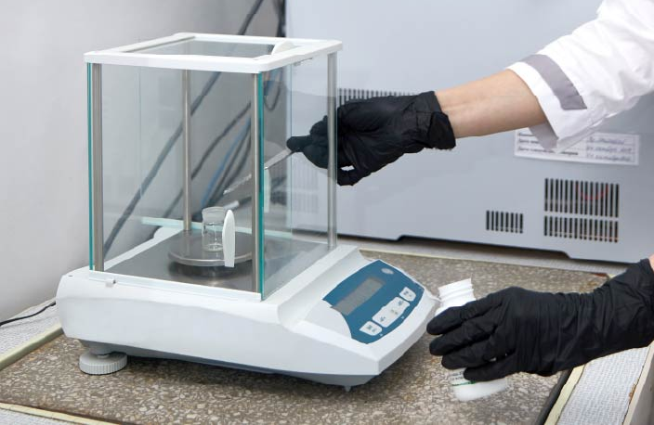
Making estimates in chemistry
In maths, we estimate to check our answers are roughly correct. In chemistry, the numbers we start with are often approximate.
If we measure out approximately 2 g of a substance, then any answer we calculate using that figure must be an estimate too.
Notes:
Many learners think an estimate means a rough guess. An estimate can be the result of a careful, accurate calculation, it is just that the numbers we put in were not perfectly exact. Learners often think that if they have done the maths calculation correctly, their answer must be exactly right. In chemistry, the answer is only as accurate as the values you started with.

Slide 7
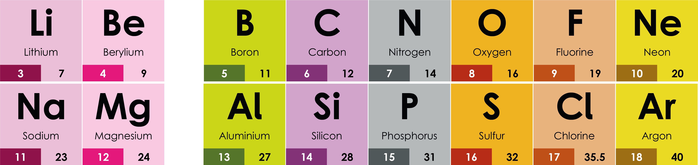
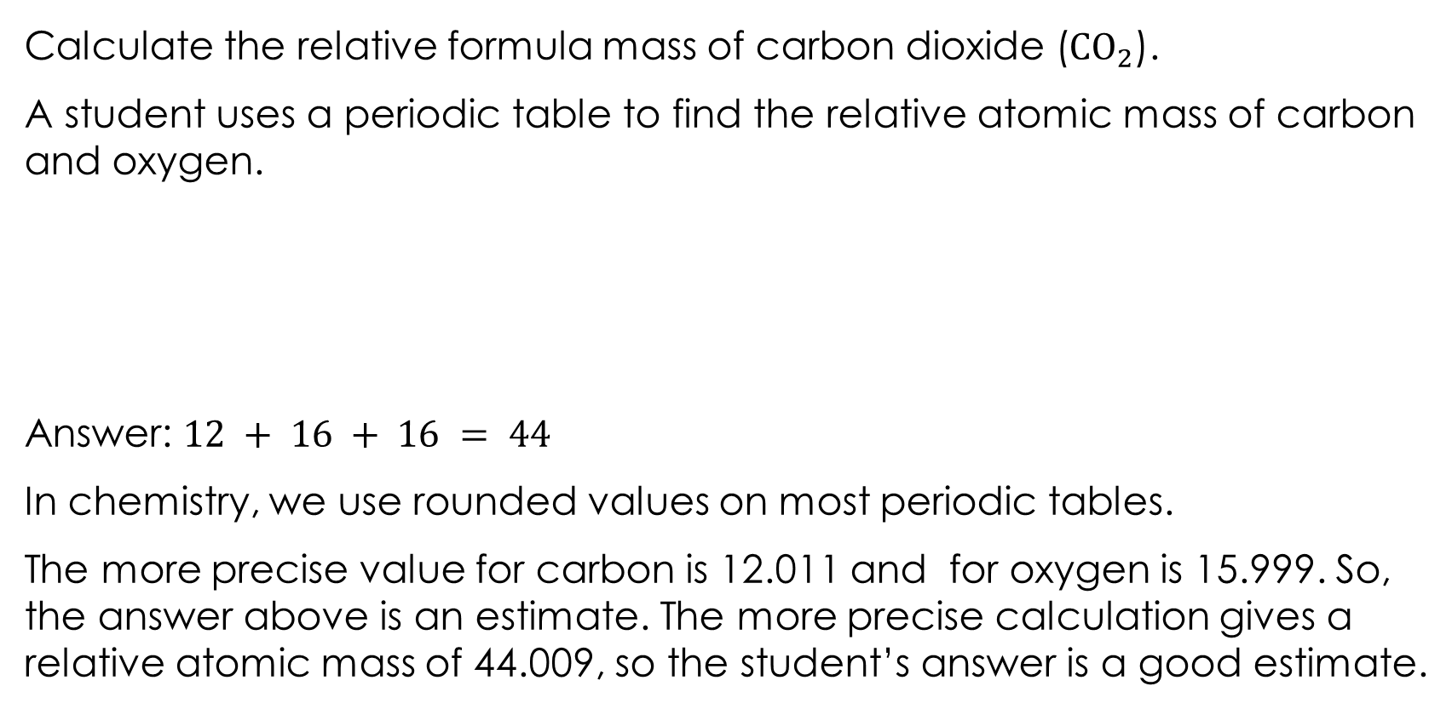
Making estimates in chemistry: example
Calculate the relative formula mass of carbon dioxide (${CO}_{2}$).
A student uses a periodic table to find the relative atomic mass of carbon and oxygen.
Answer: $12 + 16 + 16 = 44$
In chemistry, we use rounded values on most periodic tables.
The more precise value for carbon is 12.011 and for oxygen is 15.999. So, the answer above is an estimate. The more precise calculation gives a relative atomic mass of 44.009, so the student’s answer is a good estimate.
Notes:
This example shows that an estimate can be the result of a careful, accurate calculation, it is just that the numbers we put in were not perfectly exact.
In maths, learners round numbers to make calculations easier and then check their answer is roughly right. In chemistry, the periodic table has already done that rounding for us, so every calculation we do using it is technically an estimate which is close enough for the calculations needed at this point.

Slide 8
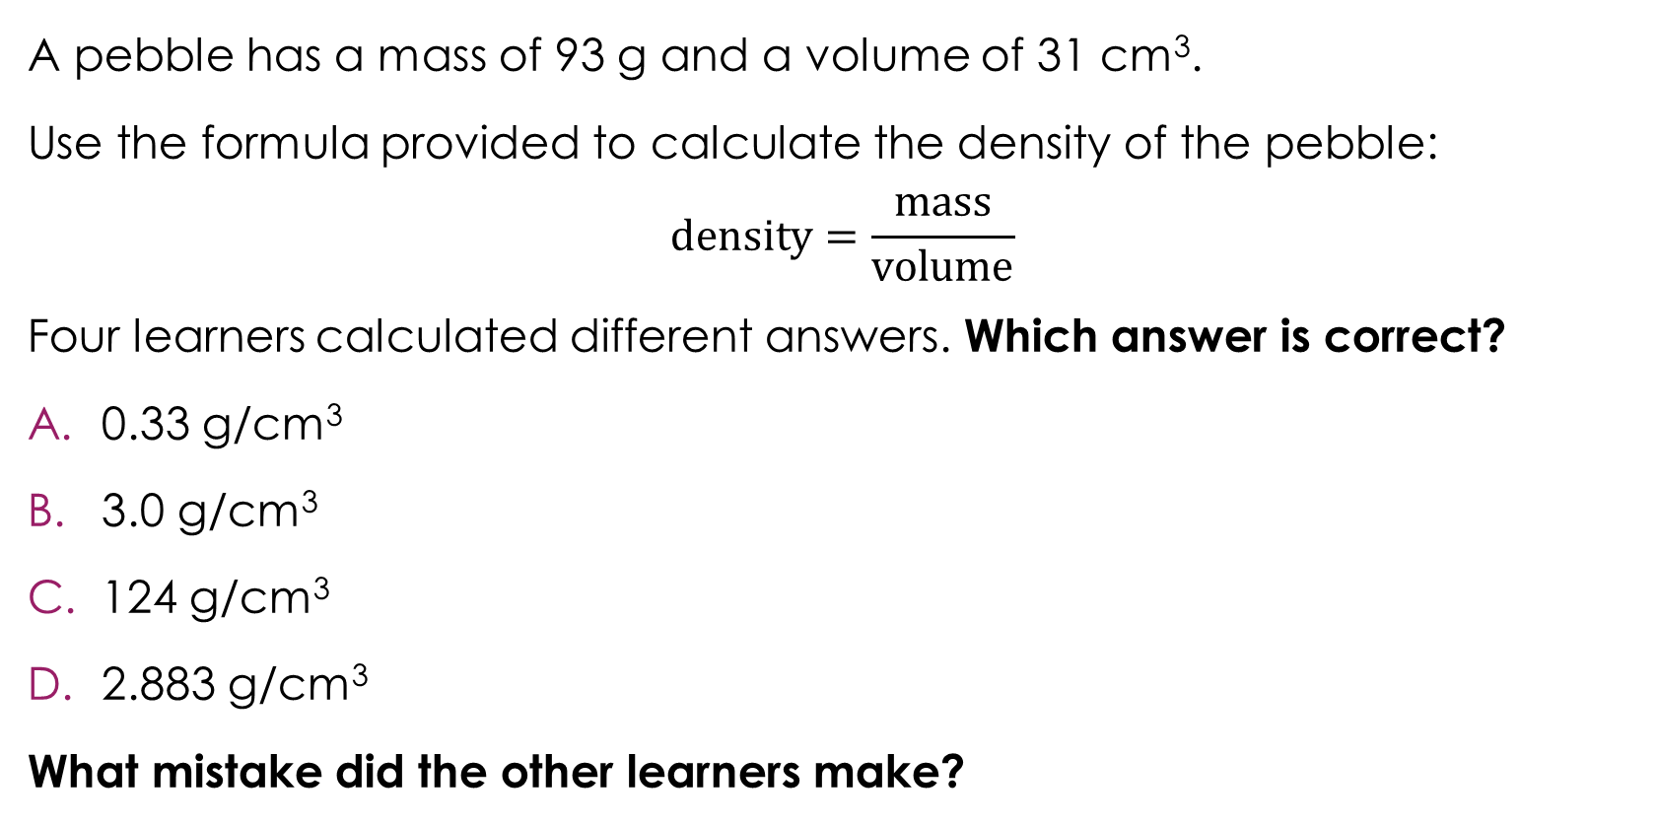
Which answer is correct?
A pebble has a mass of 93 g and a volume of 31 cm³.
Use the formula provided to calculate the density of the pebble:
$$density=\frac{mass}{volume}$$
Four learners calculated different answers. Which answer is correct?
0.33 g/cm³
3.0 g/cm³
124 g/cm³
2.883 g/cm³
What mistake did the other learners make?
Activity
Notes:
The focus of this slide is to encourage the habit of estimating before calculating. Learners who estimate first are much less likely to accept a wrong answer from their calculator without questioning it. Check and recap so that learners know how to round to 1 significant figure. Rounding 93 to 90 and 31 to 30 are both straightforward examples that most learners will manage confidently.
Ask learners to commit to an answer before revealing the answer (the next slide in this presentation). This is important, because if they see the answers first, the estimation step loses its purpose. Ask learners to hold up A, B, C or D on mini whiteboards before discussing as a class.

Slide 9
Which answer is correct? Answer
Correct answer:
0.33 g/cm³
3.0 g/cm³ ✓
124 g/cm³
2.883 g/cm³
What mistake did the other three learners make?
A is dividing the wrong way round.
C is adding instead of dividing.
D is multiplying instead of dividing.
Answer
Notes:
A dividing the wrong way round is common, especially when learners are not sure which number is the numerator.
B is the correct answer.
C adding instead of dividing often happens when learners are rushing.
D multiplying instead of dividing is another rushing mistake.
Discuss the wrong answers; each wrong answer represents a very common calculator mistake. It is worth spending time on each one.
Stress that the estimate does not need to be exact, it just needs to be close enough to tell you whether your answer is sensible. An estimate of 3 is enough to rule out 0.33, 124 and 2883 immediately. This directly mirrors what learners do in maths when they round to $1$ significant figure to check a calculation. Reminding learners of this connection can help those who are less confident in chemistry but stronger in maths.

Slide 10
Making estimates using a table of results
In chemistry, we often need to use the information provided to suggest or estimate a sensible number or value for missing readings.
A learner carries out an experiment to measure the temperature of a liquid as it cools every minute. Estimate the missing temperature of the liquid at 4 minutes. Use the following steps.
Time (minutes) | Temperature (°C)
0 | 90
2 | 85
4
6 | 75
8 | 70
Step 1: look at the range.
Step 2: look for a pattern.
Step 3: use the trend to estimate.
Step 4: check it makes sense.
Notes:
This slide introduces a different kind of estimation to what learners have seen before. Rather than rounding numbers to check a calculation, learners use the pattern in a set of data to suggest a missing value. This is a skill that comes up regularly in upper secondary science when data is incomplete or a reading has been missed.
In maths, estimation usually means rounding to $1$significant figure to simplify a calculation. Here, estimation means using scientific reasoning to suggest a value that fits the data. There is no single correct answer − any reasonable value supported by the pattern in the data would be acceptable. Learners may incorrectly think they are guessing, make sure they realise that they are using the evidence provided. A good estimate will be consistent with the trend shown in the rest of the data.
Work through the following steps while thinking out loud to decode the issue for learners.
Step 1: look at the range. The temperatures go from 90°C down to 70°C. So, our missing value must sit between 85°C and 75°C. It cannot be higher than 85, or lower than 75.
Step 2: look for a pattern. Every 2 minutes the temperature drops by 5°C. This is a very clear and consistent pattern.
Step 3: use the trend to estimate. If the temperature at 2 minutes is 85°C and it is dropping by 5°C every 2 minutes, then at 4 minutes we would expect the temperature to be 80°C.
Step 4: check it makes sense. Does 80°C fit between 85°C and 75°C? Yes. Does it follow the pattern? Yes. So, 80°C is a sensible estimate.
Discuss why is this still an estimate and not an exact answer.
We did not actually measure the temperature at 4 minutes; we are predicting it from the pattern. Once learners are comfortable identifying the trend and using it to fill in a gap, you can introduce messier real-world data where the pattern is less obvious, and the estimate requires more judgement. This skill connects directly to interpolation on a graph, where learners read off a value between two data points. If learners have covered line graphs, make this link explicit.

Slide 11

Conservation of mass
The word conservation comes from the Latin word conservare, which means ‘to keep together’.
In a chemical reaction, no atoms are created or destroyed. They are rearranged to form new substances.
If we have 10 bricks and rearrange them in a different way, we still have 10 bricks. This is the same with atoms in a chemical reaction.
Conservation of mass means that the total mass of the reactants before a chemical reaction always equals the total mass of products after it.
mass of reactants
mass of products
Notes:
Before revealing the slide content, ask learners where they have heard the word conservation before and discuss what they think it means. Reveal the etymology of the word conservation first as a useful hook. Learners will be familiar with the word from contexts like conservation of wildlife or energy conservation, where the idea of ‘keeping’ something is already present.
Check that learners understand the meaning of the words reactant and product in relation to a chemical reaction.
This slide introduces one of the most fundamental ideas in chemistry. Everything that follows in chemical calculations depends on learners understanding that mass is always conserved. Spend time making sure this concept is secure before moving on. You can also use the definition of conservation of mass in the accessible glossary.
The bricks analogy is deliberately simple. Use it to make the point that rearranging things does not change how many you have. Extend this by asking learners: ‘If I have 10 red bricks and 5 blue bricks and I build something new with them, how many bricks do I have at the end?’ This reinforces the idea before introducing atoms.
Finally, ask learners what the image is showing: both sides are level, meaning both sides have equal mass.

Slide 12
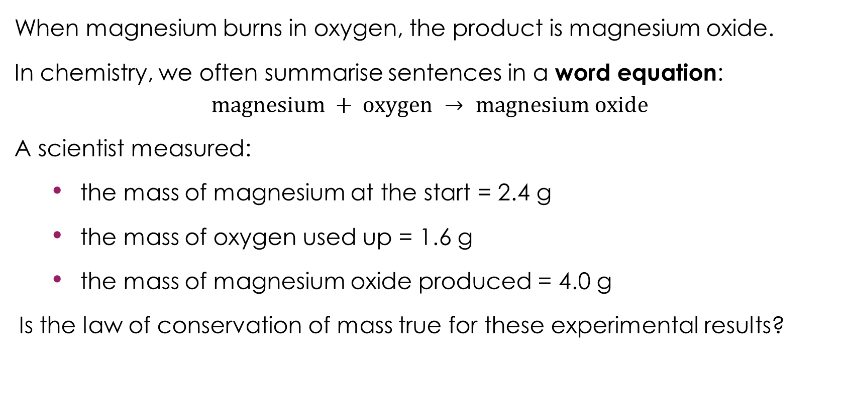
Conservation of mass in a chemical reaction
When magnesium burns in oxygen, the product is magnesium oxide.
In chemistry, we often summarise sentences in a word equation:
$$magnesium + oxygen → magnesium oxide$$
A scientist measured:
the mass of magnesium at the start = 2.4 g
the mass of oxygen used up = 1.6 g
the mass of magnesium oxide produced = 4.0 g
Is the law of conservation of mass true for these experimental results?
Activity
Notes:
This slide moves from the concept of conservation of mass to applying it with real numbers. Learners are asked to verify the law for themselves using experimental data. This is an important step, rather than just being told the law is true, they are checking it.
Draw learners' attention to the word equation on the slide and point out that the arrow separates the reactants from the products; everything to the left of the arrow is what we start with, everything to the right is what we end up with. The arrow in a chemical equation might be verbalised as ‘reacts to make’ or ‘produces.' The arrow shows the direction the reaction travels; everything on the left is what you start with, and everything on the right is what you end up with. The arrow itself represents the moment of change, where the atoms are rearranged into something new. Point out to learners that the arrow is not an equal sign, even though in terms of mass, both sides are equal. An equal sign would suggest the two sides are the same thing, but they are not. The substances have changed. The arrow captures the idea that a transformation has taken place. Get learners to read a word equation out loud, so they become comfortable with what is happening in a chemical reaction.
Use the next slide to model how to find out if mass has been conserved to learners by thinking out loud.

Slide 13
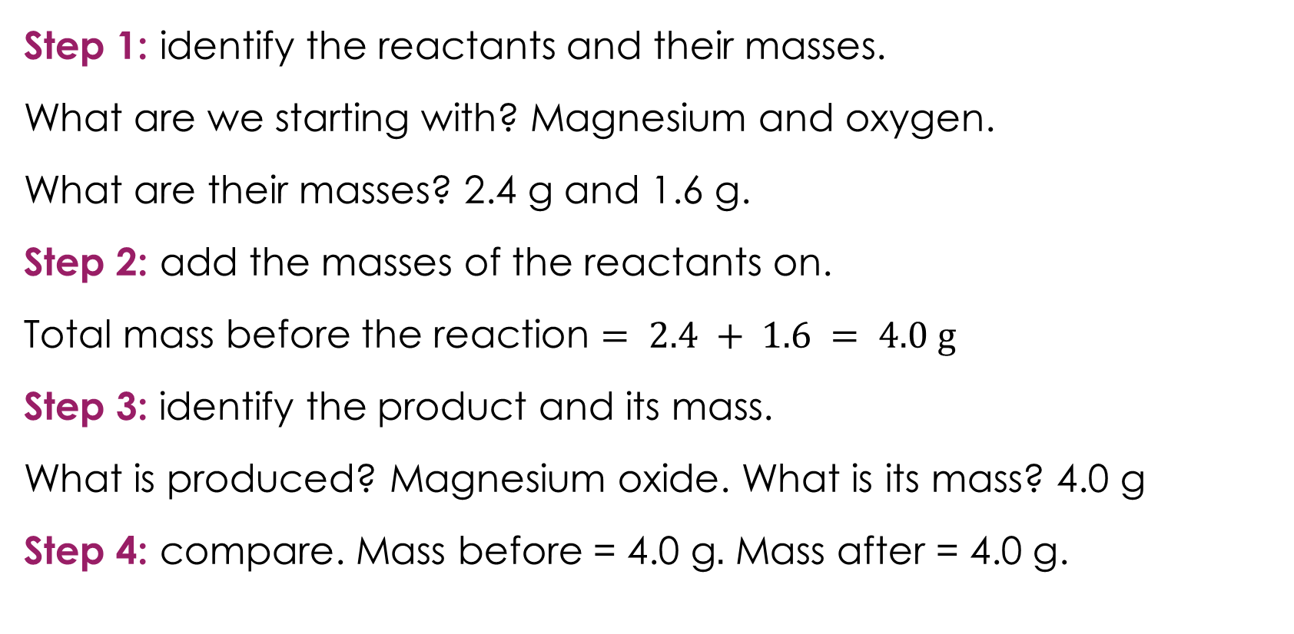
Conservation of mass in a chemical reaction – answer
Step 1: identify the reactants and their masses.
What are we starting with? Magnesium and oxygen.
What are their masses? 2.4 g and 1.6 g.
Step 2: add the masses of the reactants on.
Total mass before the reaction $= 2.4 + 1.6 = 4.0 g$
Step 3: identify the product and its mass.
What is produced? Magnesium oxide. What is its mass? 4.0 g
Step 4: compare. Mass before = 4.0 g$.$ Mass after = 4.0 g.
Answer
Notes:
Model how to find out if mass has been conserved to learners by thinking out loud.
Step 1: identify the reactants and their masses. Ask: ‘what are we starting with? Magnesium and oxygen. What are their masses? 2.4 g and 1.6 g.’
Step 2: add the masses of the reactants on the interactive white board or visualiser. ‘$Total mass before the reaction = 2.4 + 1.6 = 4.0 g$.’
Step 3: identify the product and its mass. Ask ‘what is produced? Magnesium oxide. What is its mass? 4.0 g.'
Step 4: compare. ‘Mass before = 4.0 g. Mass after = 4.0 g.’
They are equal, so yes, the law of conservation of mass is true here. In a reaction, nothing is lost and nothing is gained. The atoms just get rearranged into new substances, so the mass stays the same. All the atoms we started with are all still there, they have just been rearranged into magnesium oxide.
Some learners will not realise they need to add the mass of both reactants together before comparing them to the mass of the product. Explicitly say: ‘We need to add up everything on the left-hand side of the arrow and compare it to everything on the right-hand side.’

Slide 14
Conservation of mass when a gas is produced
Calcium carbonate reacts with hydrochloric acid to produce calcium chloride, water and carbon dioxide.
Summarise this chemical reaction using a word equation.
A learner carries out the experiment and measures the mass at the start and at the end.
Mass at the start: 50.0 g Mass at the end: 47.8 g
What has happened to the mass?
Carbon dioxide gas was produced and escaped into the air. Mass is still conserved but some of the mass has just moved into the air.
If the experiment had been carried out in a sealed container, what would you expect to happen?
Activity
Notes:
a) Read out the first sentence on the slide. Before revealing anything else on the slide, ask learners to attempt the word equation themselves (answers available on the next slide). If a prompt is needed, then ask learners to identify the reactants and the products first.
b) This slide tackles the most common situation where learners think conservation of mass has broken down. The mass appears to decrease, but no atoms have been lost. They have left the system as a gas. Make this critical point explicitly. It is also a deeply held misconception that some learners think gases have no mass.
c) This is a higher order question. Guide learners towards the answer (available on the next slide).

Slide 15
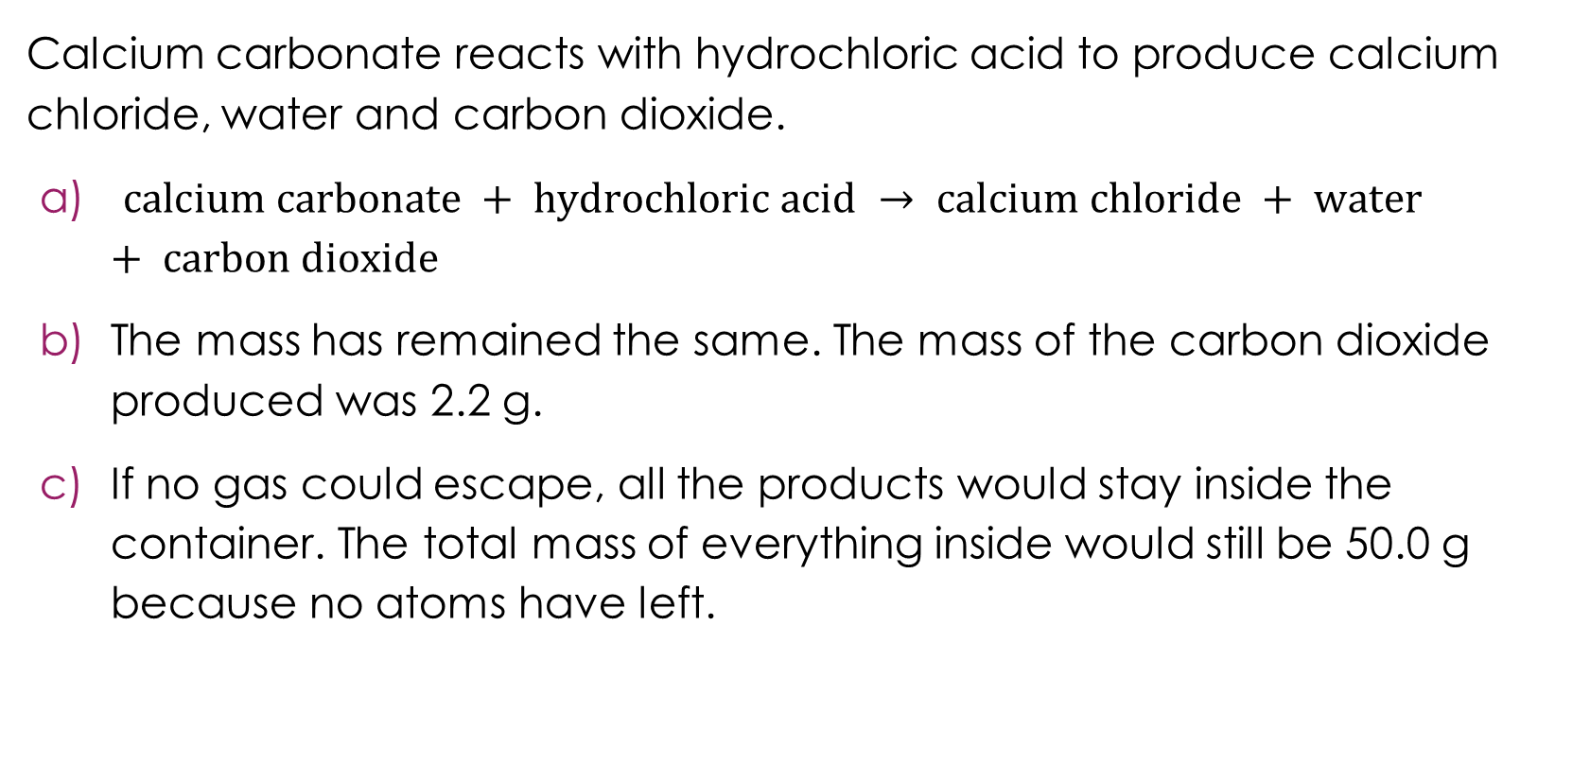
Conservation of mass when a gas is produced – answers
Calcium carbonate reacts with hydrochloric acid to produce calcium chloride, water and carbon dioxide.
$calcium carbonate + hydrochloric acid → calcium chloride + water + carbon dioxide$
The mass has remained the same. The mass of the carbon dioxide produced was 2.2 g.
If no gas could escape, all the products would stay inside the container. The total mass of everything inside would still be 50.0 g because no atoms have left.
Answers
Notes:
a) Learners may struggle to identify all three products. Carbon dioxide is the one most likely to be missed, which makes it a perfect lead into the discussion about why mass appears to decrease.
b) Model the mass calculation: ask learners to calculate the difference in mass between the start and end of the experiment and write this in a sentence. Learners should write something like this: The mass has decreased by 2.2 g from the start to the end of the experiment. Then ask: ‘Where did those 2.2 g go?’ This is the key question. Learners need to connect the missing mass to the carbon dioxide that escaped. The mass of carbon dioxide produced was 2.2 g. Some learners may still think that the law of conservation has not been upheld. Stress that the law of conservation of mass is always true and that we must account for all the products even gases. Learners may not think that a gas has mass. In this case, ask learners what the gas is made from. They should recognise that a gas is made up of atoms and atoms have mass.
c) Guide learners towards the answer: If no gas could escape, all the products would stay inside the container. The total mass of everything inside would still be 50.0 g. because no atoms have left. Learners may incorrectly believe that conservation of mass only applies in sealed containers. Learners sometimes reason that if the container is open, the rule does not apply. It is worth being clear that the law always holds; what changes is whether we can easily measure all the products.

Slide 16
From words to symbols
Word equations are useful because they tell us the names of the substances involved in a chemical reaction.
Chemists all over the world speak different languages, so it is useful to write chemical reactions in a way that everyone can understand.
This is why we use symbol equations. Instead of writing the name of each substance, we use the correct chemical symbols. These are the same in every country.
Do you know the chemical symbols for these elements?
Activity
Element | Symbol
Carbon
Calcium
Cobalt
Chlorine
Notes:
This slide bridges the gap between word equations, which learners have already used, and symbol equations, which are new. The key point is that symbols are a universal language and mean the same thing everywhere, which is why scientists use them.
If we translate the name of the element silver into French, it is argent. In Polish, silver is srebro. In Romanian it is argint and in Punjabi silver is ਚਾਂਦੀ [chandi]. To illustrate this point further, ask your class if anyone is multilingual. Invite them to share the translation for silver (or other elements) in their home language.
Show the table but do not reveal the answers yet (available on the next slide). Learners sometimes think the symbol is just an abbreviation of the English name. Point out that some symbols come from Latin, for example iron is $Fe$ from ferrum and sodium is $Na$ from natrium. This shows why we cannot always guess the symbol from the English name. However, there are several elements that do have single letter symbols that could cause confusion with two letter symbols starting with the same letter.

Slide 17
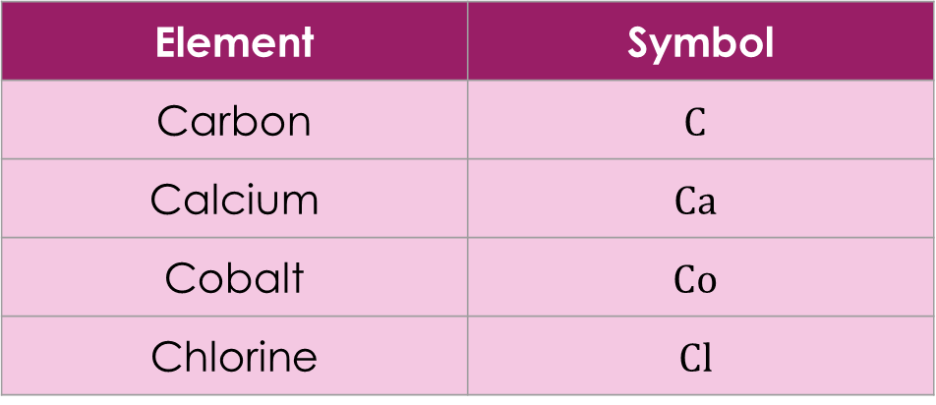
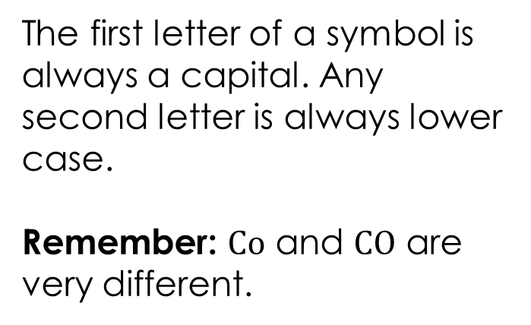
From words to symbols – answer
Do you know the chemical symbols for these elements?
Element | Symbol
Carbon | $$C$$
Calcium | $$Ca$$
Cobalt | $$Co$$
Chlorine | $$Cl$$
The first letter of a symbol is always a capital. Any second letter is always lower case.
Remember: $Co$ and $CO$ are very different.
Answer
Notes:
Answers: $C$ is carbon, $Ca$ is calcium, $Cl$is chlorine and $Co$ is cobalt. There are also $Cu,$which is copper, and$Cr,$which is chromium.
Extension
Expand the discussion: $H$ is hydrogen, $He$is helium and $Hg$ is mercury, $N$is nitrogen, $Na$ is sodium and $Ni$ is nickel. The capital and lower-case rule is important. When learners write chemical formulas, they must always write the first letter as a capital and the second letter, if there is one, as lower case.
We know $Co$ means cobalt (one element). However, $CO$ means carbon monoxide (two elements, carbon and oxygen). We can tell this because there are two capital letters. If a learner writes the symbol for cobalt as $CO$ (with both letters in capital) it is carbon monoxide, which completely changes the meaning and the reaction! Make this point explicitly to learners early on, as it is a very common source of confusion and can lead to errors in formulas and equations that are difficult to spot later.
Ask learners where they can go to find the names and symbols for elements if they are not sure. Learners can use a periodic table to help: rsc.li/4qUCR2Y.

Slide 18
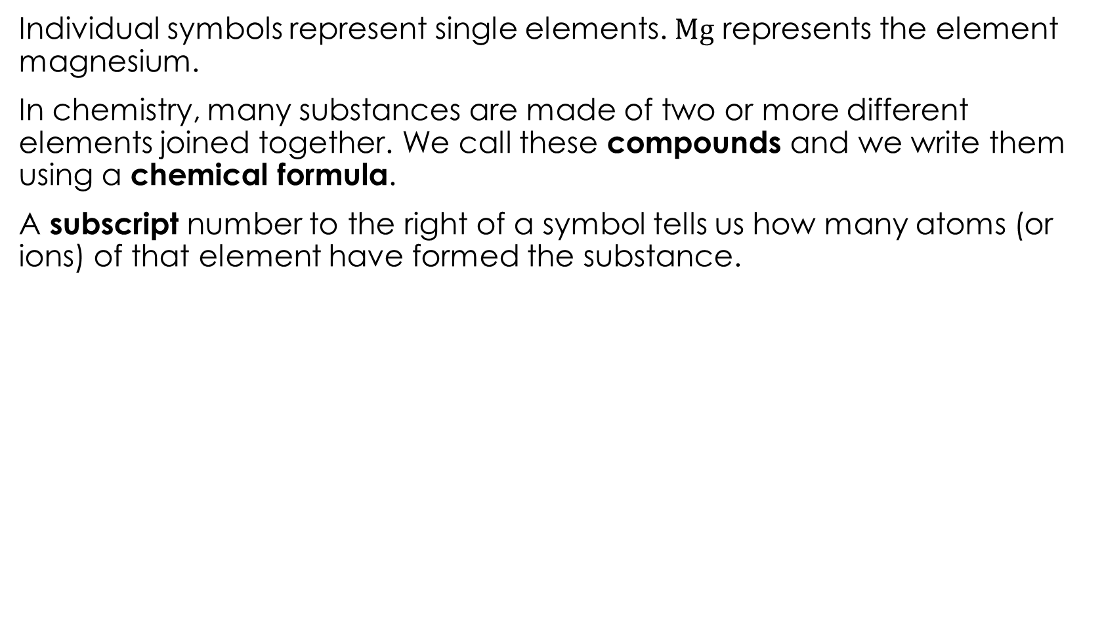
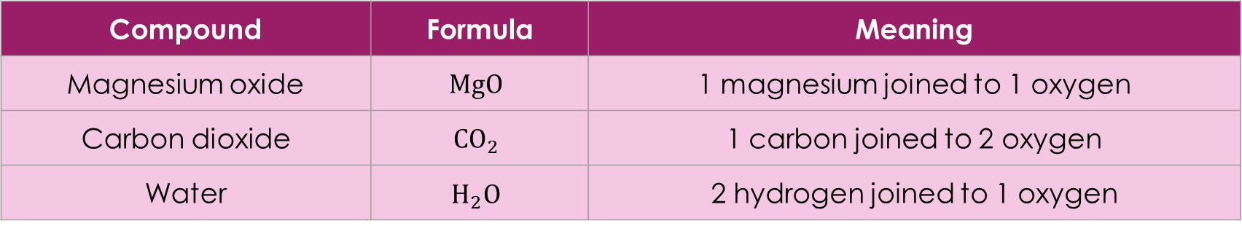
From symbols to formulas
Individual symbols represent single elements. $Mg$ represents the element magnesium.
In chemistry, many substances are made of two or more different elements joined together. We call these compounds and we write them using a chemical formula.
A subscript number to the right of a symbol tells us how many atoms (or ions) of that element have formed the substance.
Compound | Formula | Meaning
Magnesium oxide | $$MgO$$ | 1 magnesium joined to 1 oxygen
Carbon dioxide | $${CO}_{2}$$ | 1 carbon joined to 2 oxygen
Water | $$H_{2}O$$ | 2 hydrogen joined to 1 oxygen
Notes:
This slide introduces chemical formulas and the meaning of subscript numbers. Start by asking learners to define the term ‘element’ as an opportunity for recall. Then ask what the prefix ‘sub’ means. Think about a submarine − a vessel which goes below the surface of the sea. Sub means below. So, a subscript is writing below the line.
It is important that learners understand a formula contains information about how many atoms or ions of each element are present.

Slide 19
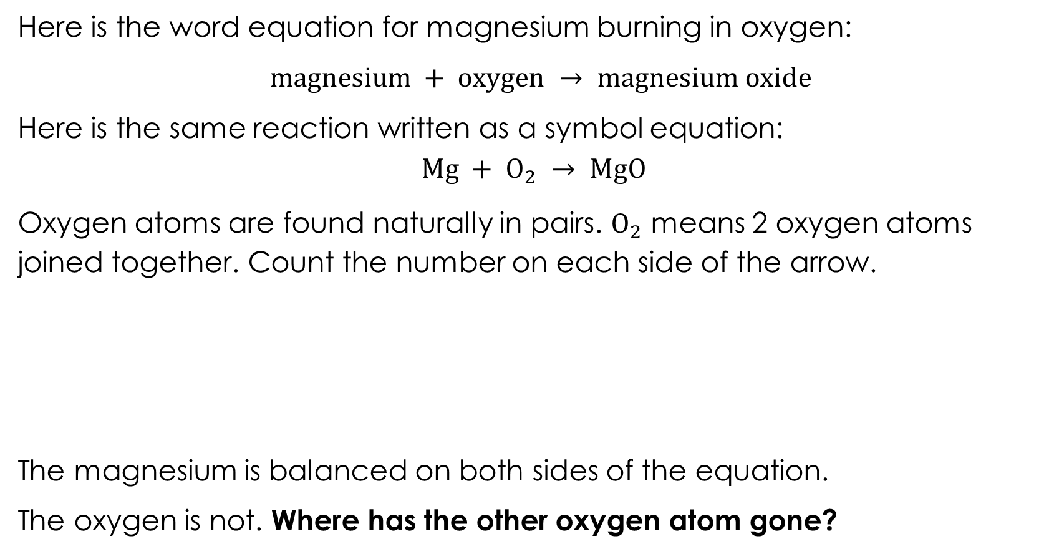
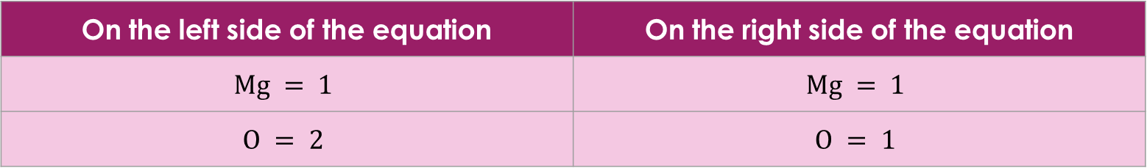
Reading a symbol equation
Here is the word equation for magnesium burning in oxygen:
$magnesium + oxygen → magnesium oxide$
Here is the same reaction written as a symbol equation:
$$Mg + O_{2} → MgO$$
Oxygen atoms are found naturally in pairs. $O_{2}$ means 2 oxygen atoms joined together. Count the number on each side of the arrow.
The magnesium is balanced on both sides of the equation.
The oxygen is not. Where has the other oxygen atom gone?
On the left side of the equation | On the right side of the equation
$$Mg = 1$$ | $$Mg = 1$$
$$O = 2$$ | $$O = 1$$
Notes:
This slide uses the magnesium example learners have already seen to introduce the idea of counting atoms (or ions) on each side of an equation. The question at the end is deliberately left open to create curiosity and lead into the next slide. Learners have already seen this word equation in the conservation of mass slides. Using a familiar example here aims to reduce the cognitive load and lets learners focus on the new skill of counting atoms (and ions).
Work through the table by thinking out loud with learners. Point to each symbol and count explicitly. For example: on the left I have $Mg$, that is 1 magnesium. I have $O_{2}$, that is 2 oxygen atoms. On the right I have $MgO$, that is 1 magnesium and 1 oxygen.
Where has the other oxygen atom gone?
This is the hook for the next slide. Do not answer it yet. Give students a moment to think and discuss before moving on. Some may suggest the equation is wrong. Others may suggest we need more $MgO$ on the right. Both responses are useful starting points. A common misconception is that learners think $O_{2}$ means 2 separate oxygen atoms rather than 2 oxygen atoms joined together. Clarify this but keep it simple at this stage, as the focus is on counting rather than bonding. Explain that not all elements form diatomic pairs.

Slide 20
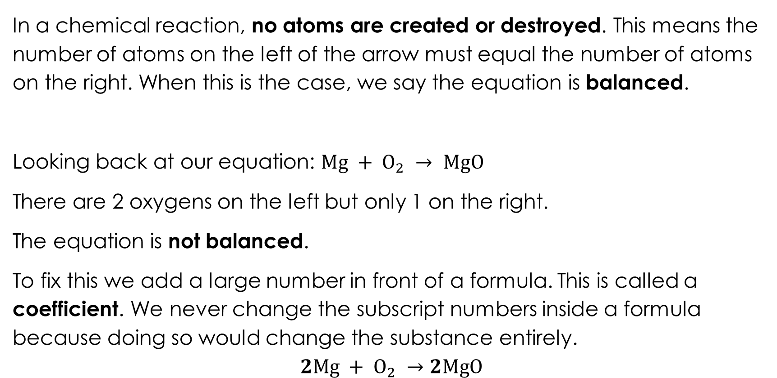
Balancing a symbol equation
In a chemical reaction, no atoms are created or destroyed. This means the number of atoms on the left of the arrow must equal the number of atoms on the right. When this is the case, we say the equation is balanced.
Looking back at our equation: $Mg + O_{2} → MgO$
There are 2 oxygens on the left but only 1 on the right.
The equation is not balanced.
To fix this we add a large number in front of a formula. This is called a coefficient. We never change the subscript numbers inside a formula because doing so would change the substance entirely.
$$2Mg + O_{2} →2MgO$$
Notes:
This slide introduces balancing as a direct consequence of conservation of mass. Ask learners to recall the law of conservation of mass (slide 11) and ask them what they would expect if it was upheld. Learners already know that atoms cannot be created or destroyed, so it should feel logical that both sides of the equation must have the same number of atoms.
Emphasise that we can only add coefficients (the big number) in front of formulas. We must never change the subscript numbers inside a formula. Changing a subscript changes the substance itself. For example, changing $MgO$ to $MgO₂$would turn magnesium oxide into a completely different substance. This is a rule learners must learn early and apply consistently.
Highlight the coefficients which have been added. The next slide asks learners to use the table method to show that the number of atoms/ions on each side are now balanced. Learners often incorrectly try to balance equations by changing subscripts rather than adding coefficients. This is the single most common error in this topic so address it directly before learners start practising independently. Balancing equations is one of the focal points of the stage 2 teacher-led presentation.

Slide 21
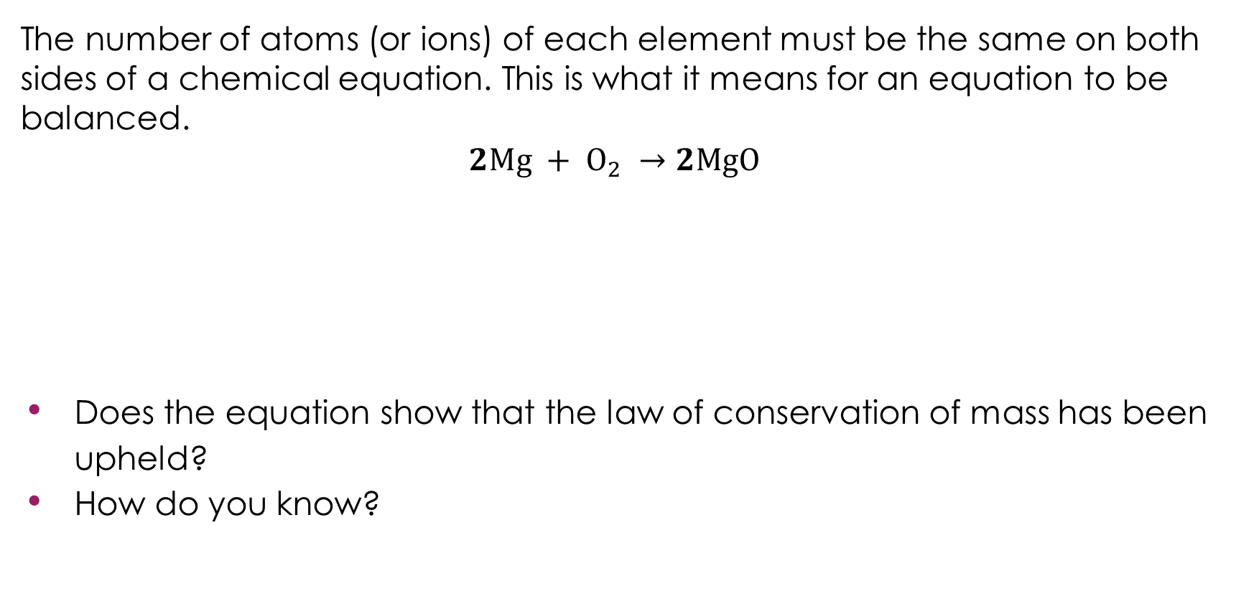
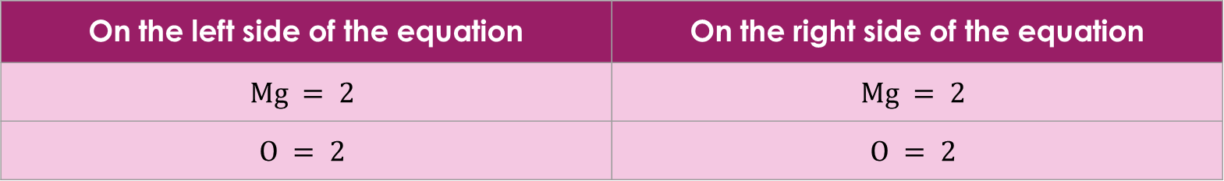
Is it balanced?
The number of atoms (or ions) of each element must be the same on both sides of a chemical equation. This is what it means for an equation to be balanced.
$$2Mg + O_{2} →2MgO$$
Does the equation show that the law of conservation of mass has been upheld?
How do you know?
Activity
On the left side of the equation | On the right side of the equation
$$Mg = 2$$ | $$Mg = 2$$
$$O = 2$$ | $$O = 2$$
Notes:
Ask learners to check the final equation themselves by counting both sides before revealing the completed table.
Link the table and equation back to conservation of mass. Once the equation is balanced ask learners: does this equation show conservation of mass? How do you know? A good answer would refer to the equal number of each type of atom/ion on both sides of the arrow.

Slide 22
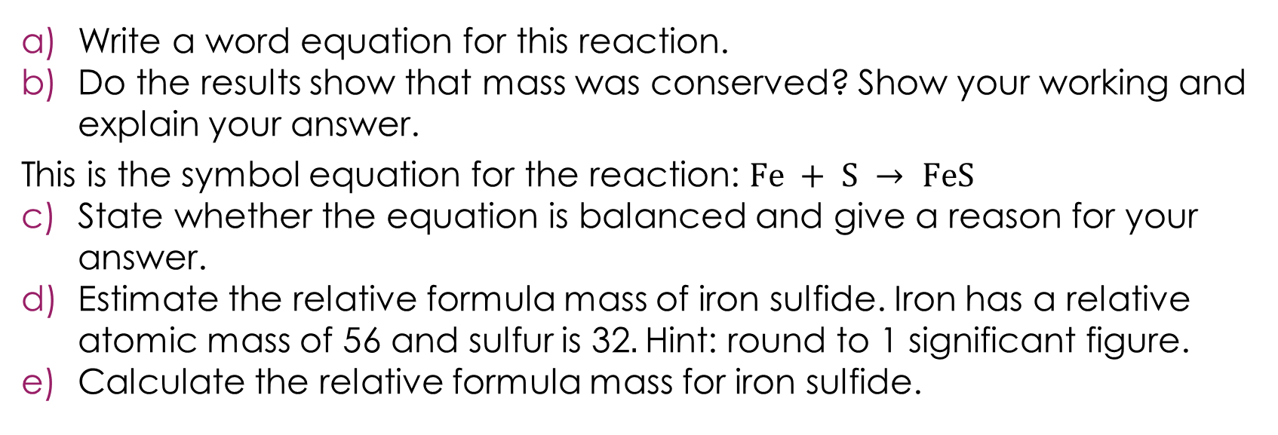
Returning to the lesson question
Iron reacts with sulfur when it is heated to form a compound called iron sulfide. A learner carries out an experiment and records the following results:
Substance | Mass (g)
Iron (before the reaction) | 5.6
Sulfur (before the reaction) | 3.2
Iron sulfide (after the reaction) | 8.8
Lesson question
Write a word equation for this reaction.
Do the results show that mass was conserved? Show your working and explain your answer.
This is the symbol equation for the reaction: $Fe + S → FeS$
State whether the equation is balanced and give a reason for your answer.
Estimate the relative formula mass of iron sulfide. Iron has a relative atomic mass of 56 and sulfur is 32. Hint: round to 1 significant figure.
Calculate the relative formula mass for iron sulfide.
Notes:
Return to the challenge question from the start of the session. Allow learners time to attempt the question independently before discussing as a class. The answers are on the next slide.

Slide 23
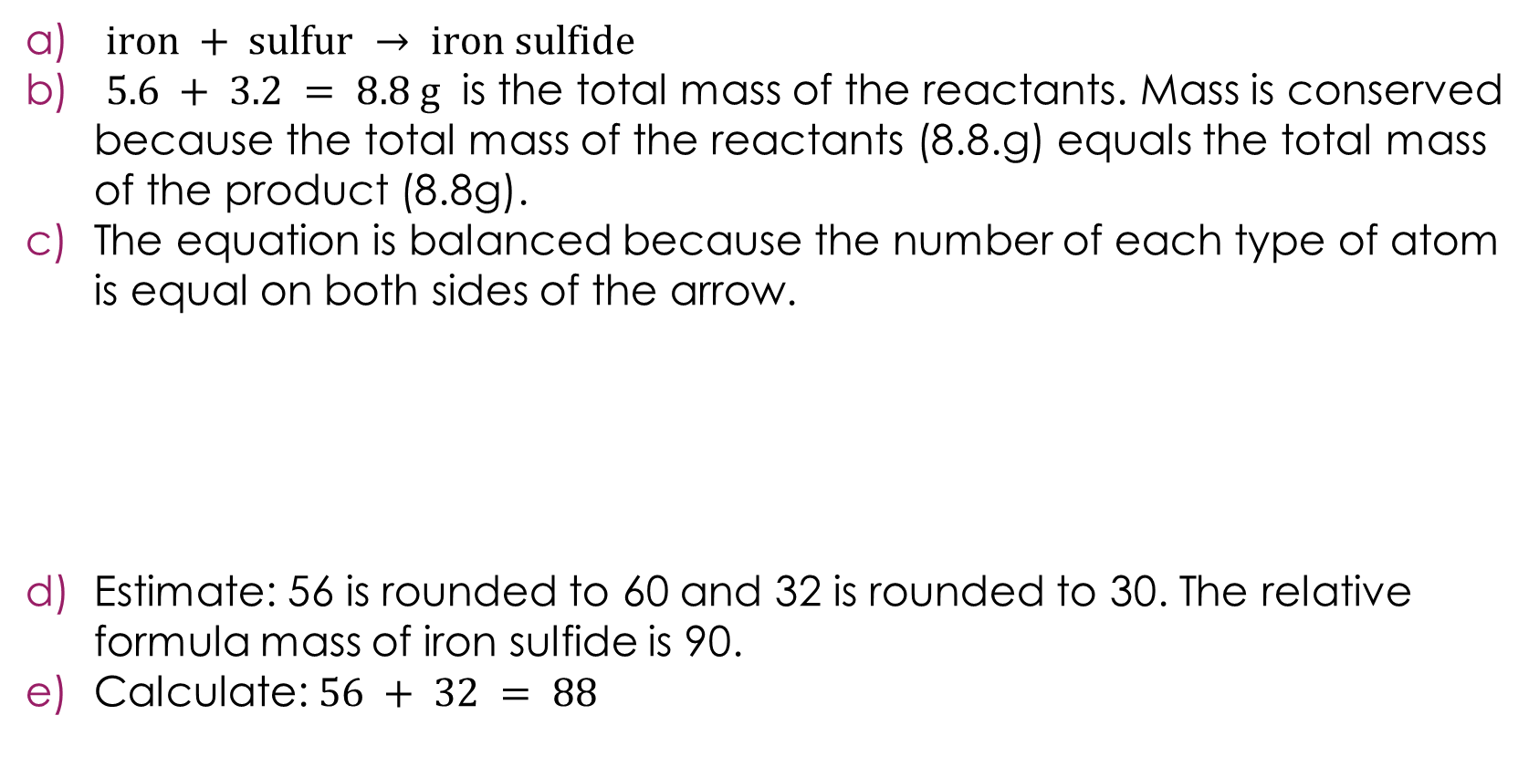
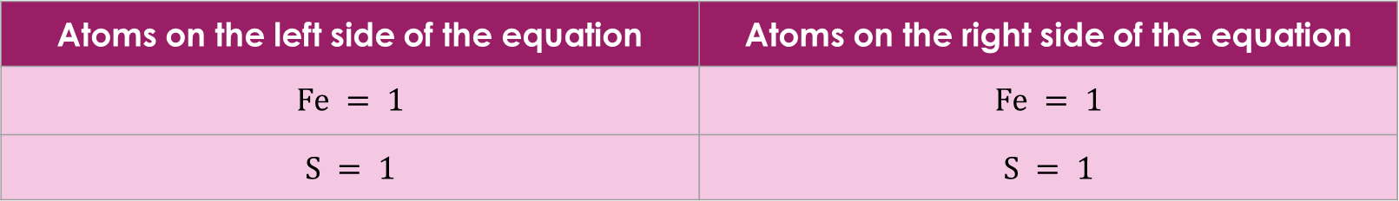
Returning to the lesson question – answers
$iron + sulfur → iron sulfide$
$5.6 + 3.2 = 8.8 g$ is the total mass of the reactants. Mass is conserved because the total mass of the reactants (8.8.g) equals the total mass of the product (8.8g).
The equation is balanced because the number of each type of atom is equal on both sides of the arrow.
Estimate: 56 is rounded to 60 and 32 is rounded to 30. The relative formula mass of iron sulfide is 90.
Calculate: $56 + 32 = 88$
Answers
Atoms on the left side of the equation | Atoms on the right side of the equation
$$Fe = 1$$ | $$Fe = 1$$
$$S = 1$$ | $$S = 1$$

Slide 24
Acknowledgements
Image on slide 6 © mariakray, Shutterstock
Image on slide 11 © ClearVector, Shutterstock

