Slide 1
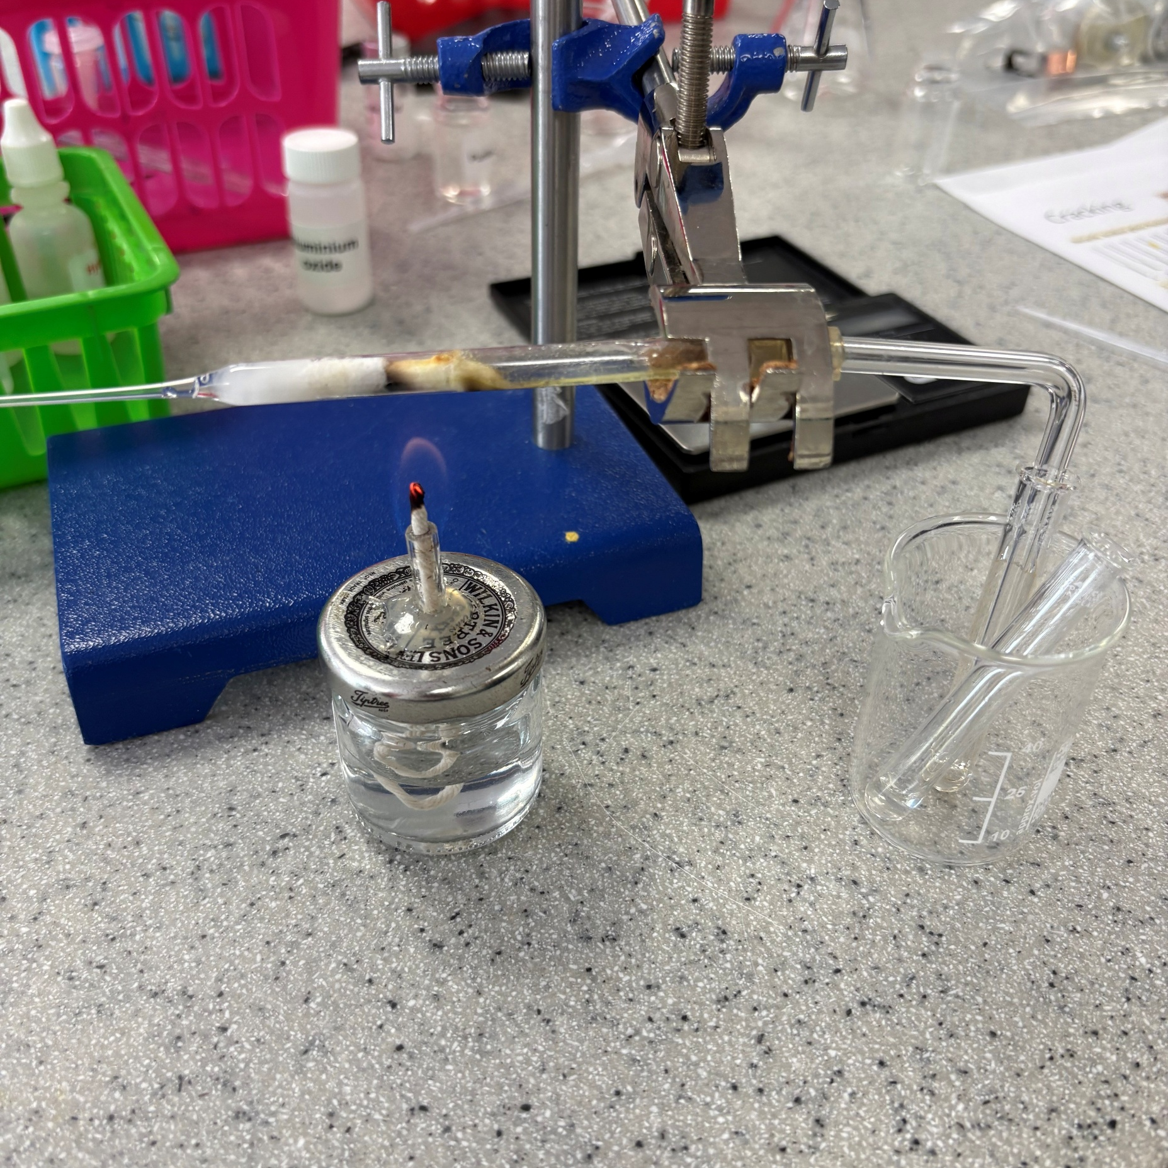
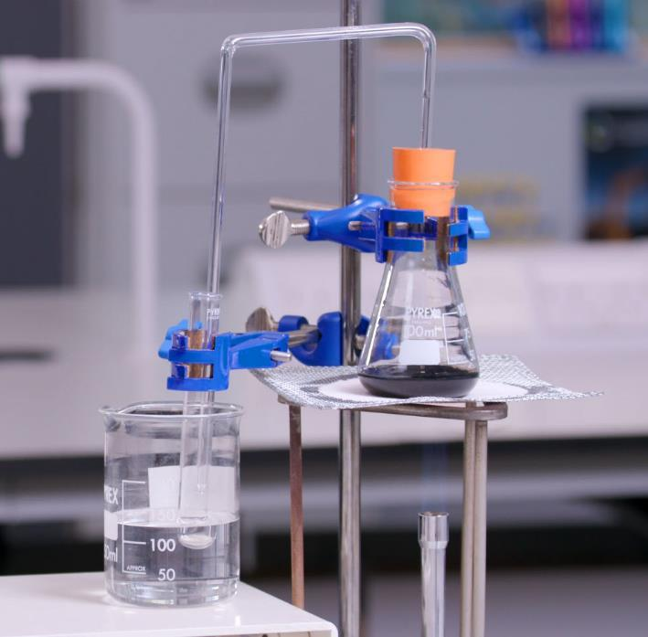
14–16 years
Microscale simple cracking
Integrated instructions
Downloaded from: rsc.li/3Utdw4q
Notes:
This method is based on a version written by CLEAPSS. The resource combines an experiment from our Nuffield practical collection and CLEAPSS Microscale cracking of liquid paraffin (at bit.ly/4yRRK9n).
Image © Royal Society of Chemistry

Slide 2

Integrated instructions
Integrated instructions use clear numbering, arrows and simple pictograms (for example, an eye showing when to make observations). They were developed using cognitive load theory and remove unnecessary information. Therefore, the instructions reduce extraneous load on learners, increasing the capacity of their working memory to think about what they are doing and why.
Read more at rsc.li/47bIKi5.

Slide 3
Learning objectives
Learning objectives
Observe the colour change associated with the bromine water test for unsaturated hydrocarbons.
Explain the purpose of cracking, as used in the petrochemical industry.

Slide 4



Integrated instructions for learners
◆ ~0.5 cm³ liquid paraffin 
Mineral wool 
Aluminium oxide 
 Clamp gently 
 Attach pipette 
⬥ Bromine water 
 Heat at junction 
RSC Microscale chemistry
Cracking hydrocarbons on a microscale
From rsc.li/3Utdw4q
 Observe 
Notes:
1. Add approximately 0.5 cm³ of liquid paraffin to a sealed Pasteur pipette, followed by mineral wool so that all the liquid is absorbed.
2. Place the aluminium oxide into the pipette above the mineral wool.
3. Add 0.5–1 cm³ of bromine water (or potassium manganate(VII) solution) to the test tube.
4. Set up the pipette and delivery tube as shown in the diagram above.
5. Support the pipette by gently clamping it around the rubber tubing.
6. Light the spirit burner and place it so that the flame heats the pipette at the junction of the wool and powder.

Slide 5
Discussion questions
Discussion questions
Liquid paraffin is a mixture of hydrocarbons. There will be no visible change when bromine water is added to liquid paraffin. What does this suggest about the composition of the paraffin mixture?
Mineral wool is inert and does not participate in this reaction. Suggest why it is added to the pipette.
What do the results of the bromine water test indicate has occurred during the reaction?
Suggest the benefits of using an aluminium oxide based catalyst, such as a zeolite, in industry.
Cracking reactions produce a mixture of alkanes and alkenes of different chain lengths. Suggest how this mixture could be separated.
Notes:
Answers given in the teacher and technician notes.

