Slide 1
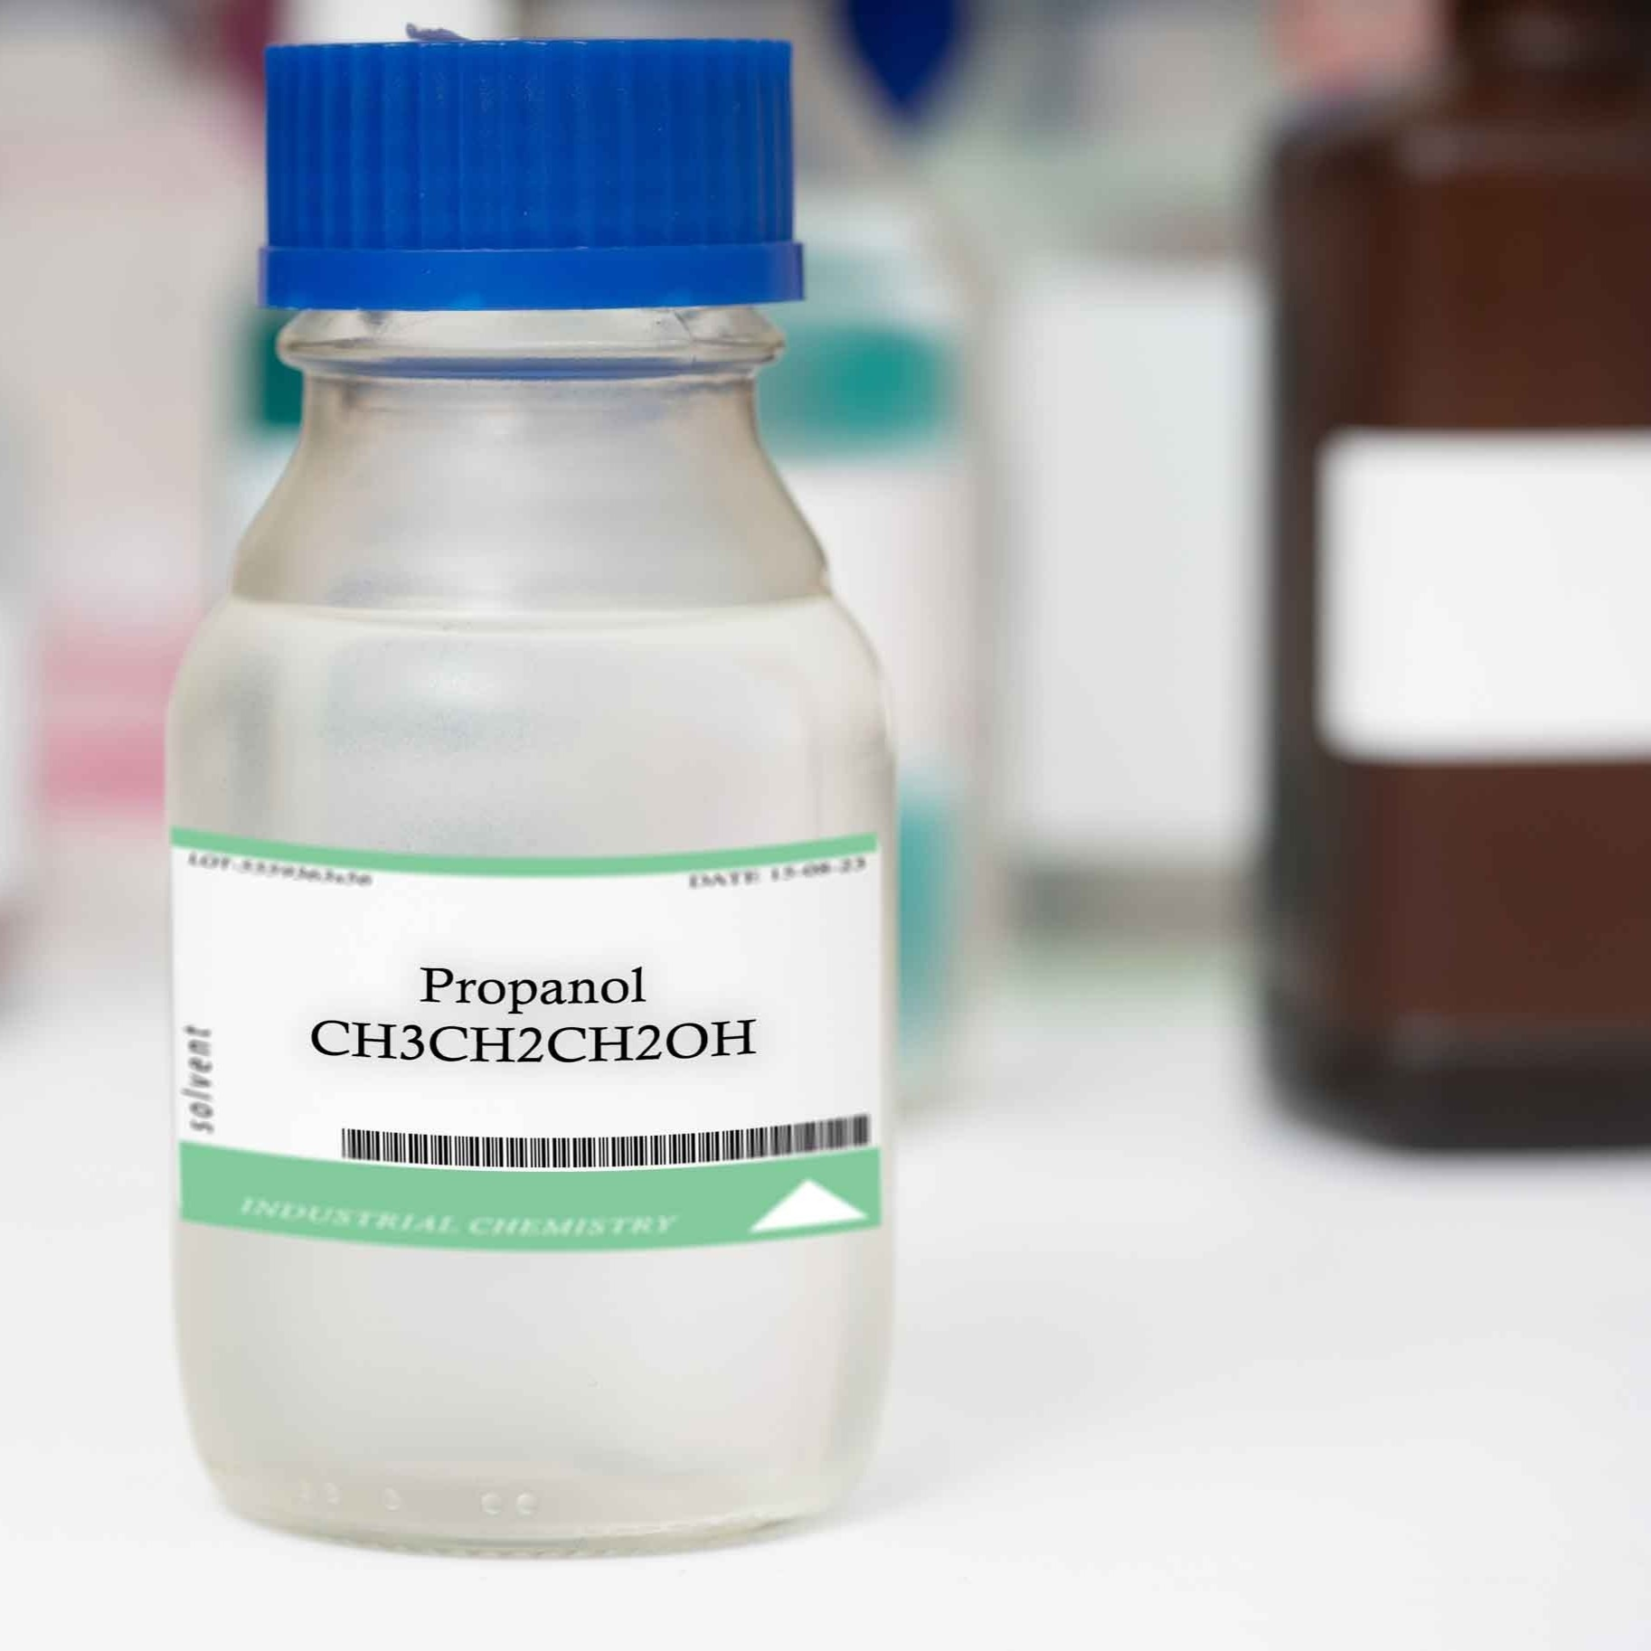
14–16 years
The properties of alcohols
Downloaded from: rsc.li/3UaInmj

Slide 2
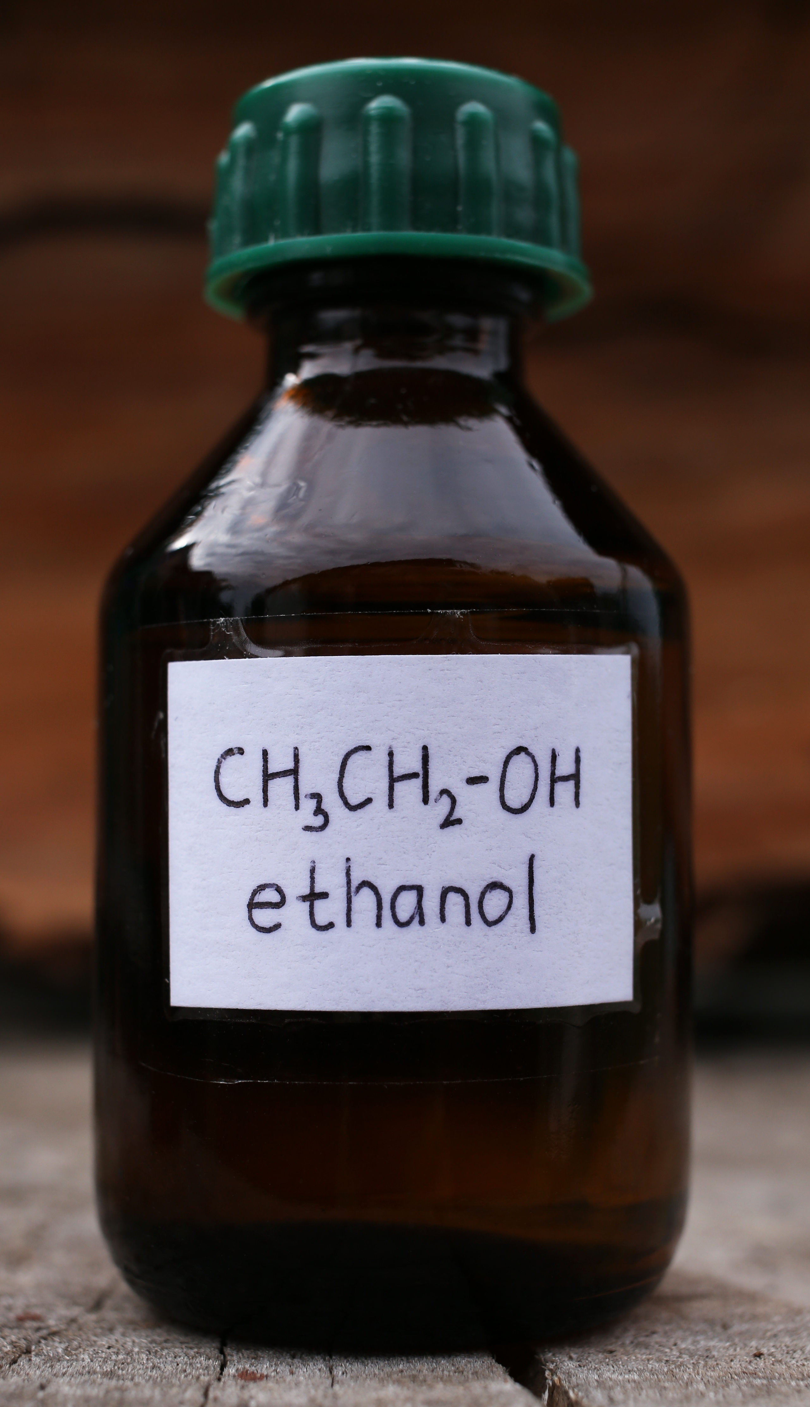
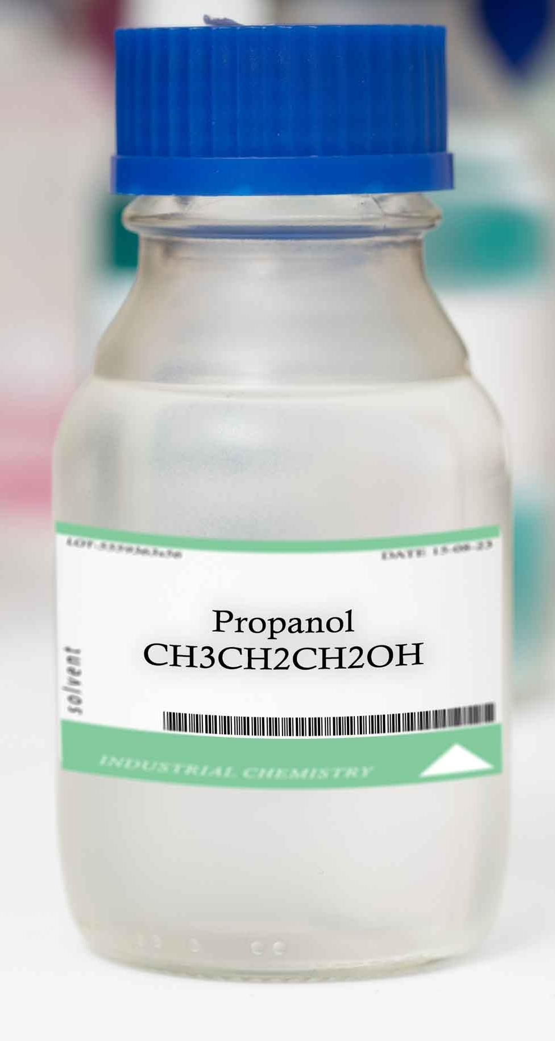
In this lesson …
Introduction
Ethanol and propan-1-ol are tested for:
pH
reaction with sodium
combustion
oxidation with acidified dichromate(VI) solution.
Notes:
Image 1 ©: Shutterstock/Ihor Matsiievskyi
Image 2 ©: Shutterstock/luchschenF

Slide 3
Learning objectives
Learning objectives
Make and record experimental observations.
Use your results to explain the properties of the alcohols.
Understand that members of the same homologous series behave in a similar way.

Slide 4
Equipment
What you will need
Test tubes x 2
Boiling tubes x 2
Test tube/boiling tube rack
Beakers (100 cm³) x 2
Can lid
Wooden splints, matches or gas lighter
Heat-resistant mat
Bunsen burner
Boiling tube holder
Dropping pipette (for water)
Universal indicator paper (full range, pH 1–14)
Forceps for sodium
Filter paper for sodium
White tile
Spotting tile
Spill tray (optional)
Safety equipment
Eye protection: splash-proof goggles
Container filled with tap water (e.g. washing-up bowl) to place the spotting tiles after use.

Slide 5




Chemicals
What you will need
Ethanol or Industrial denatured alcohol, IDA, 15 cm³
DANGER: Highly flammable./DANGER: Highly flammable. Harmful by ingestion.
Propan-1-ol, 15 cm³
DANGER: Highly flammable liquid and vapour. Causes serious eye damage. May cause drowsiness or dizziness.
Acidified potassium dichromate(VI) solution, 0.1 mol/dm³ in 1.4 mol/dm³ sulfuric acid, 3 cm³
DANGER: Corrosive (skin, eyes). Harmful (ingestion). Irritant (respiratory). Sensitiser (skin, respiratory). Serious Health Hazard (RE). Serious Health Hazard (CMR).
Sodium, 2 small pieces in oil (about 2 x 2 x 2 mm)
DANGER: Reacts violently with water. In contact with water releases flammable gases which may ignite spontaneously. Causes severe skin burns and eye damage.
Access to distilled water bottles

Slide 6
Method
Method
Carry out each of these tests firstly with ethanol and then propan-1-ol:
Place a few drops of the alcohol in a test-tube and add an equal number of drops of water. Do the liquids mix fully?
Place a drop of the alcohol on a piece of full-range indicator paper. Note the pH.
Place a few drops of alcohol on a can lid on a heat-resistant mat. Make sure that all the bottles of alcohols are closed and kept far away from the can lid. Ignite the alcohol with a lit splint and observe the flame.
Continued on next slide…

Slide 7
Method (continued)
Method (continued)
Using forceps, take two small pieces of sodium and place them on a piece of filter paper. Dab the pieces of sodium with the filter paper to remove any excess oil.
Place about 0.5 cm depth of each of the alcohols in a separate, dry, 100 cm³ beaker. To each, add a small piece of sodium (using forceps) and observe the reaction.
Place 3 drops of acidified potassium dichromate(VI) solution into two wells of the spotting tile and add 2 drops of ethanol to the first well and 2 drops of propna-1-ol to the second well. Observe the colour change(s) in each well over 5–10 minutes. Do you notice a change of smell that could come from a new compound?

Slide 8
Results table
Results table
Test | Observations
 | Ethanol | Propan-1-ol
Water
pH
Sodium
Combustion
Acidified potassium(VI) solution

Slide 9
Results
Results
Test | Observations
 | Ethanol | Propan-1-ol
Water | Miscible, mixes with water | Miscible, mixes with water
pH | green | green
Sodium | Fizzing/bubbles/effervescence, traces of white solid | Fizzing/bubbles/effervescence, traces of white solid
Combustion | Burns with blue flame | Burns with blue flame
Acidified potassium(VI) solution | Orange to green | Orange to green

Slide 10







Integrated instructions (test 1-3)
Test 1
Test 2
❹ 1 drop alcohol  
❶ 3–4 drops alcohol  
❷ 3–4 drops water  
c
❺ pH?  
UI
Test 3
❸ Fully mixed?  
❼ Light  
c
❻ 3–4 drops alcohol  
Close bottle and put away
Repeat all once for ethanol and once for propan-1-ol
❽ Observe flame  
c
RSC Nuffield practical collection
The properties of alcohols
https://rsc.li/3UaInmj
Notes:
Carry out each of these tests firstly with ethanol and then propan-1-ol:
Tests 1–3
1. Place a few drops of the alcohol in a test-tube and add an equal number of drops of water. Do the liquids mix fully?
2. Place a drop of the alcohol on a piece of full-range indicator paper. Note the pH.
3. Place a few drops of alcohol on a tin lid on a heat-resistant mat. Make sure that all the bottles of alcohols are closed and kept far away from the tin lid. Ignite the alcohol with a lit splint and observe the flame.

Slide 11
Integrated instructions (test 4)
Test 4
❸ 2–3 drops propan-1-ol
❑
❷ 2–3 drops ethanol 
❹ (Control) 
❶ 3–4 drops H⁺/Cr₂O₇²⁻(aq) in each   
✓
c
❺ Observations (5–10 min) 
RSC Nuffield practical collection
The properties of alcohols
https://rsc.li/3UaInmj
Notes:
Test 4
4. Using forceps, take two small pieces of sodium and place them on a piece of filter paper. Dab the pieces of sodium with the filter paper to remove any excess oil.
5. Place about 0.5 cm depth of each of the alcohols in a separate, dry, 100 cm 3 beaker. To each, add a small piece of sodium (using forceps) and observe the reaction.
6. Place 3 drops of acidified potassium dichromate(VI) solution into two wells of the spotting tile and add 2 drops of ethanol to the first well and 2 drops of propna-1-ol to the second well.
7. Observe the colour change(s) in each well over 5-10 minutes. Do you notice a change of smell that could come from a new compound?

Slide 12
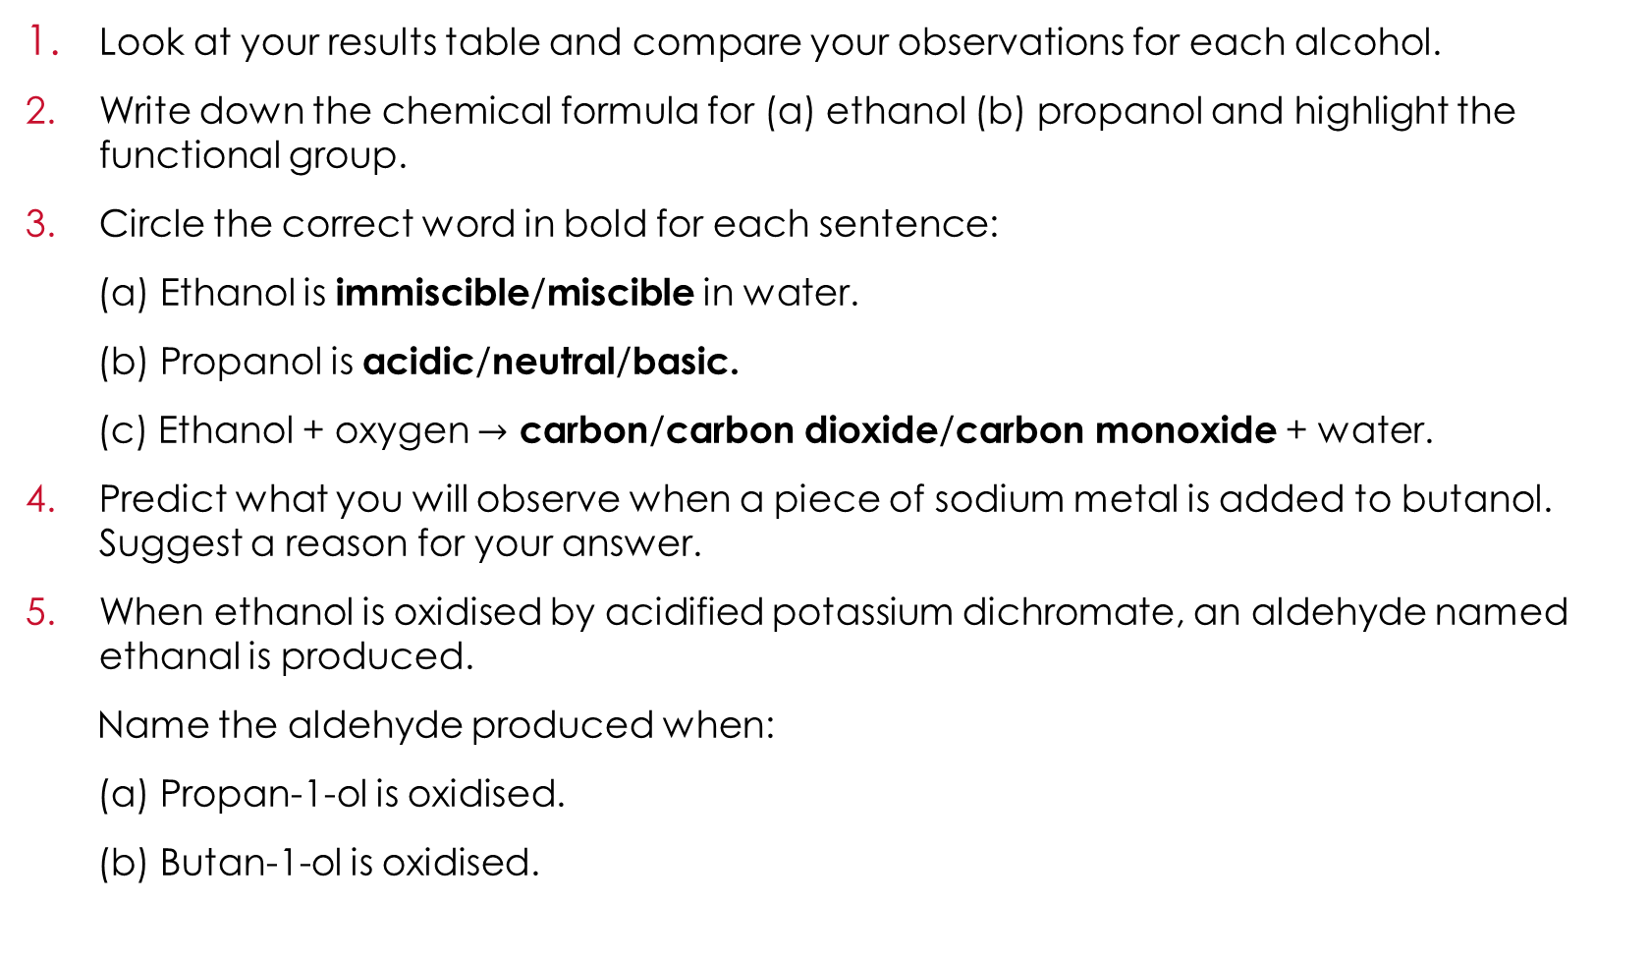
Follow-up questions
Evaluation
Look at your results table and compare your observations for each alcohol.
Write down the chemical formula for (a) ethanol (b) propanol and highlight the functional group.
Circle the correct word in bold for each sentence:
(a) Ethanol is immiscible/miscible in water.
(b) Propanol is acidic/neutral/basic.
(c) Ethanol + oxygen $→$ carbon/carbon dioxide/carbon monoxide + water.
Predict what you will observe when a piece of sodium metal is added to butanol. Suggest a reason for your answer.
When ethanol is oxidised by acidified potassium dichromate, an aldehyde named ethanal is produced.
Name the aldehyde produced when:
(a) Propan-1-ol is oxidised.
(b) Butan-1-ol is oxidised.

Slide 13
Challenge question
Challenge
Write a balanced symbol equation for:
(a) complete combustion of ethanol.
(b) the reaction of propanol and sodium.

Slide 14
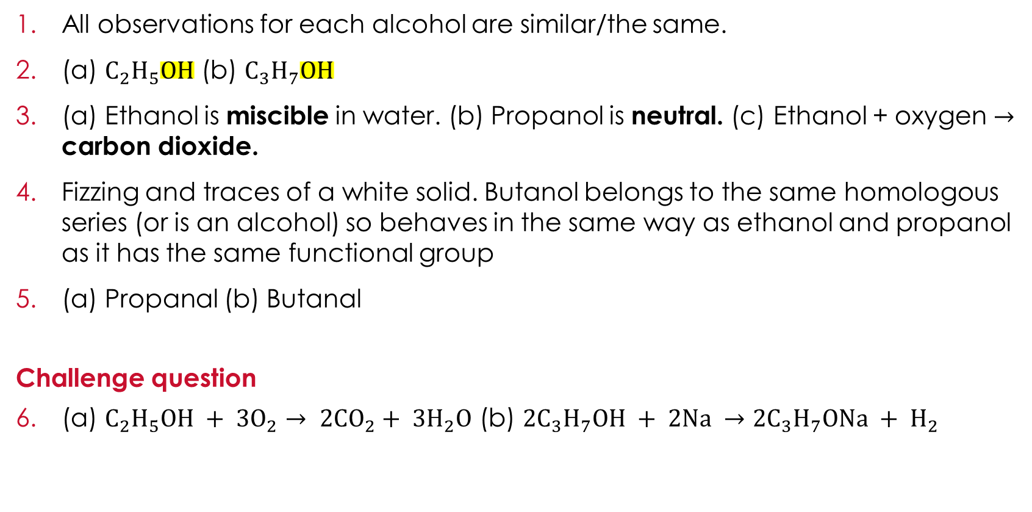
Answers
Answers
All observations for each alcohol are similar/the same.
(a) $C_{2}H_{5}OH$ (b) $C_{3}H_{7}OH$
(a) Ethanol is miscible in water. (b) Propanol is neutral. (c) Ethanol + oxygen $→$ carbon dioxide.
Fizzing and traces of a white solid. Butanol belongs to the same homologous series (or is an alcohol) so behaves in the same way as ethanol and propanol as it has the same functional group
(a) Propanal (b) Butanal
Challenge question
(a) $C_{2}H_{5}OH + 3O_{2}→ 2CO_{2}+ 3H_{2}O$ (b) $2C_{3}H_{7}OH + 2Na →2C_{3}H_{7}ONa + H_{2}$

