Slide 1
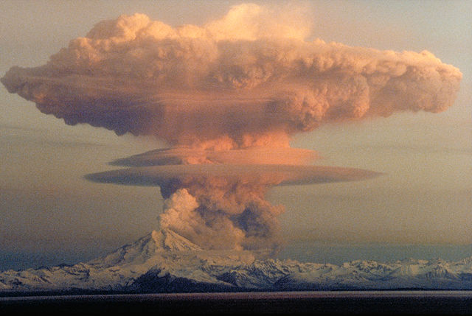

Volcanic ash could fight climate change
Read the full article at rsc.li/3euI6Bj
Dumping volcanic ash into the ocean could boost the rate at which carbon is drawn out of the atmosphere and locked into sediments. The process is simple to do and requires no changes to land usage – unlike reforestation programmes. It is also cheaper than other geoengineering approaches.
The deposition of volcanic ash supplies nutrients for marine algae. It increases the rate at which carbon dioxide is taken up by algae to help create their calcium carbonate exoskeletons – many of which sink to the seafloor and are buried. The ash can also become physically joined to plankton debris, increasing sinking rates. There is, however, a concern that volcanic ash could harm marine ecosystems. In addition, marine dumping in general is currently banned under an international convention.
Volcanic eruption, Redout, Kennay Peninsula, Alaska, USA
Notes:
This slide summarises a recent article published by Chemistry World.
Image credit: H. Zell, CC BY-SA 3.0 <https://creativecommons.org/licenses/by-sa/3.0>, via Wikimedia Commons

Slide 2
Volcanic ash could fight climate change
Read the full article at rsc.li/3euI6Bj
Dumping volcanic ash into the ocean could boost the rate at which carbon is drawn out of the atmosphere and locked into sediments. The process is simple to do and requires no changes to land usage – unlike reforestation programmes. It is also cheaper than other geoengineering approaches.
The deposition of volcanic ash supplies nutrients for marine algae. It increases the rate at which carbon dioxide is taken up by algae to help create their calcium carbonate exoskeletons – many of which sink to the seafloor and are buried. The ash can also become physically joined to plankton debris, increasing sinking rates. There is, however, a concern that volcanic ash could harm marine ecosystems. In addition, marine dumping in general is currently banned under an international convention.
Volcanic eruption, Redout, Kennay Peninsula, Alaska, USA
Give two effects of global climate change.
Explain how algae can lock up carbon dioxide.
Describe two other ways of reducing carbon footprint.
Notes:
This slide summarises a recent article published by Chemistry World.
Any two from:
Sea level rise, which may cause flooding and increased coastal erosion.
More frequent and severe storms.
Changes in the amount, timing and distribution of rainfall.
Temperature and water stress for humans and wildlife.
Changes in the food-producing capacity of some regions.
Changes to the distribution of wildlife species.
Algae can remove carbon dioxide by doing photosynthesis and also lock up carbon in carbonate exoskeletons. These are then deposited on seafloor and buried.
Any two from:
Increased use of alternative energy supplies.
Energy conservation.
Carbon capture and storage (where CO₂ is trapped in solvents and stored underground).
Carbon taxes and licenses.
Carbon off-setting including through tree planting.
Carbon neutrality – zero net release.

