Slide 1
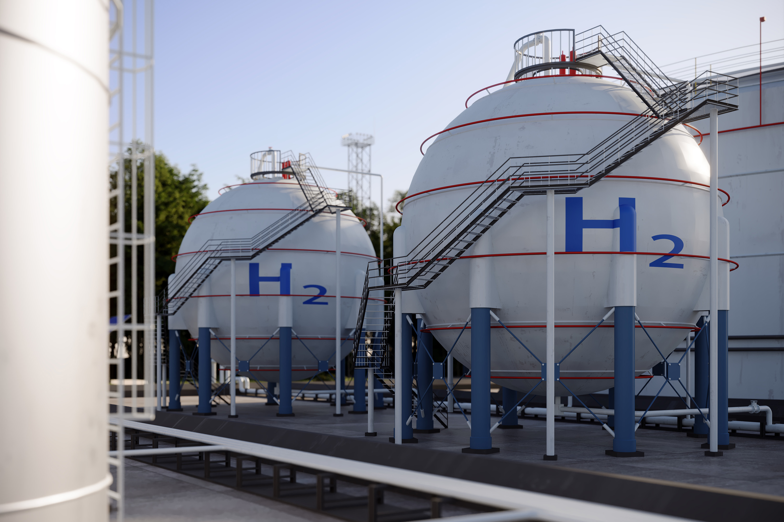
Scientists produce a five-metal nanoparticle
Science research news
Slide by Neil Goalby. Available from rsc.li/4vSARu1
Multi-metal nanocrystals are difficult to make because the different reactivities and structure of metals can lead to non-uniform crystals. Now scientists have made particles from a mixture of five metals. The metals were dissolved in solution and deposited onto ruthenium nanoparticle seeds. They made RuFeCoNiCu particles about 20–25 nm in size with a uniform composition. The nanoparticles were able to catalyse the decomposition of ammonia more effectively than single metal catalysts.
© Veni/Getty Images
New nanoparticle could boost hydrogen production
Questions
What part of the periodic table are the metals used found in? Explain how catalysts speed up chemical reactions. Suggest why these nanoparticles make effective catalysts.
Notes:
This slide summarises a recent Chemistry World article. Use this as a lesson starter when teaching about nanoparticles, catalysts and sustainable energy.
Answers:
Transition metals
Provide an alternative pathway for the reaction with a lower activation energy.
Answers could include:
Transition metals are often effective catalysts.
Nanoparticles have a large surface-to-area volume.
The alternative pathways offered by multi-metal catalysts may lead to lower activation energies than singular catalysts.

