Slide 1
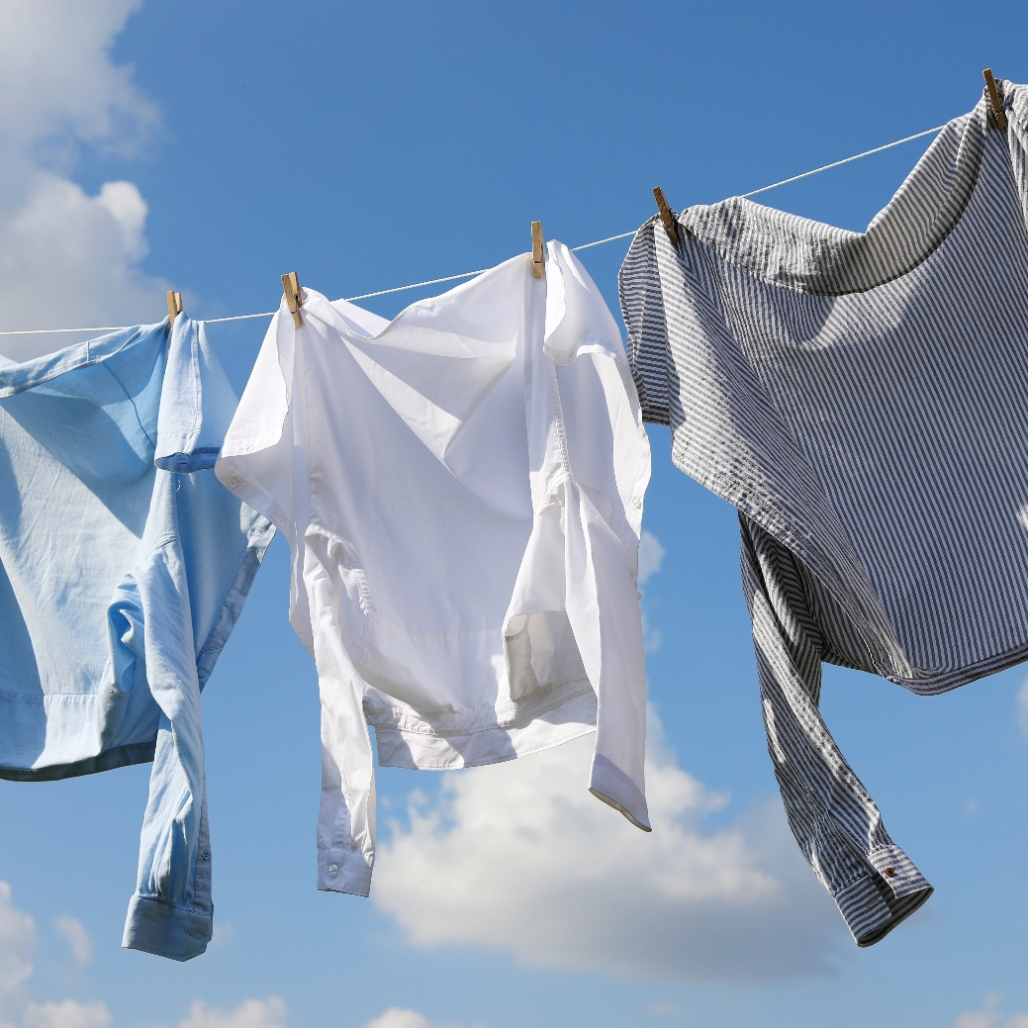
11–14 years
Rate of evaporation
Downloaded from: rsc.li/3F8qgWx

Slide 2
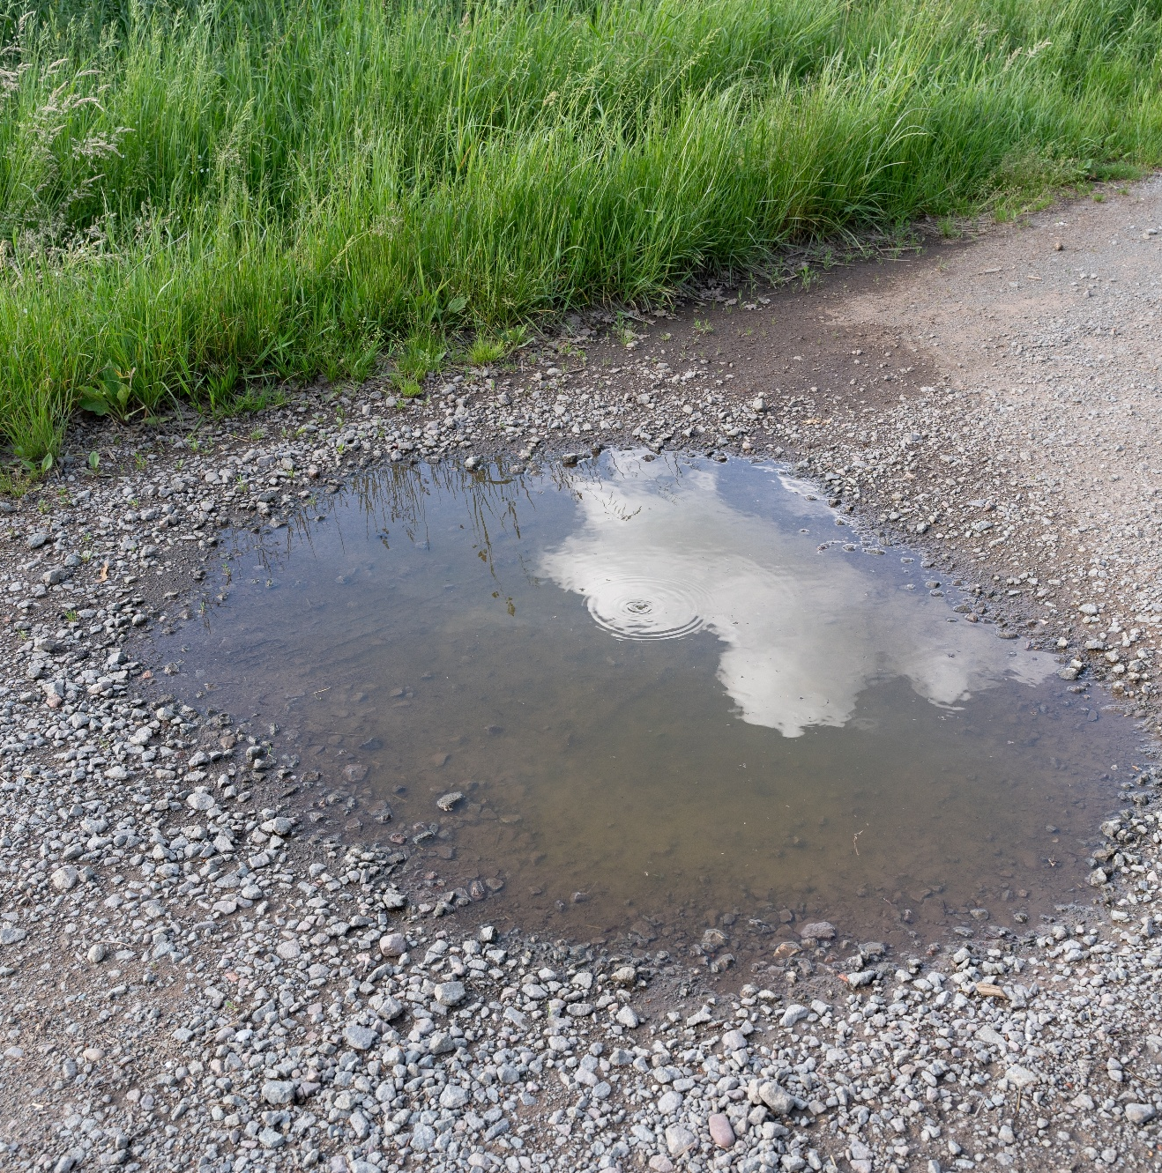
The problem
Introduction
Evaporation is the conversion of liquid to vapour without the boiling point necessarily being reached.
How will this puddle change as the water evaporates?
In today’s lesson you will investigate the time taken for a drop of propanone to evaporate under different conditions.
Source: Shutterstock/Mentor Beqiri
Notes:
https://www.shutterstock.com/image-photo/puddle-water-on-country-road-countryside-2439228235

Slide 3
Learning objectives
Learning objectives
During this lesson you will:
carry out an investigation into the rate of evaporation of propanone.
make and record observations.
use particle theory to explain your results.

Slide 4
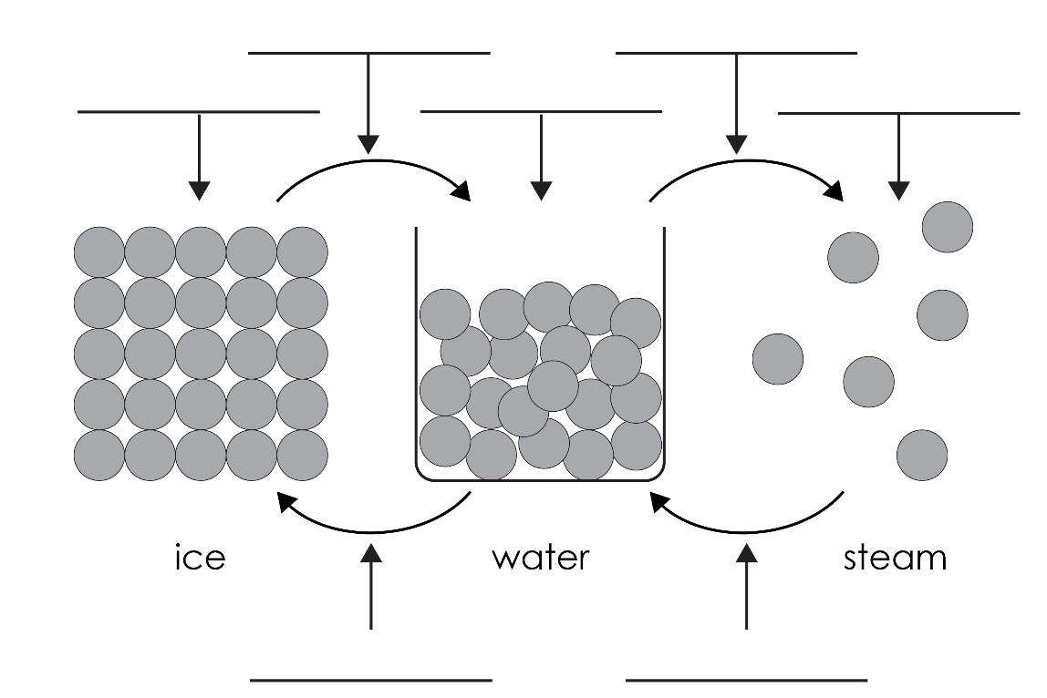
Revisiting changes of state
D
E
A
B
C
Starter
F
G
Notes:
Mini-whiteboard exercise to recap particle theory and changes of state.
A solid
B liquid
C gas
D melting
E evaporating
F freezing
G condensing

Slide 5
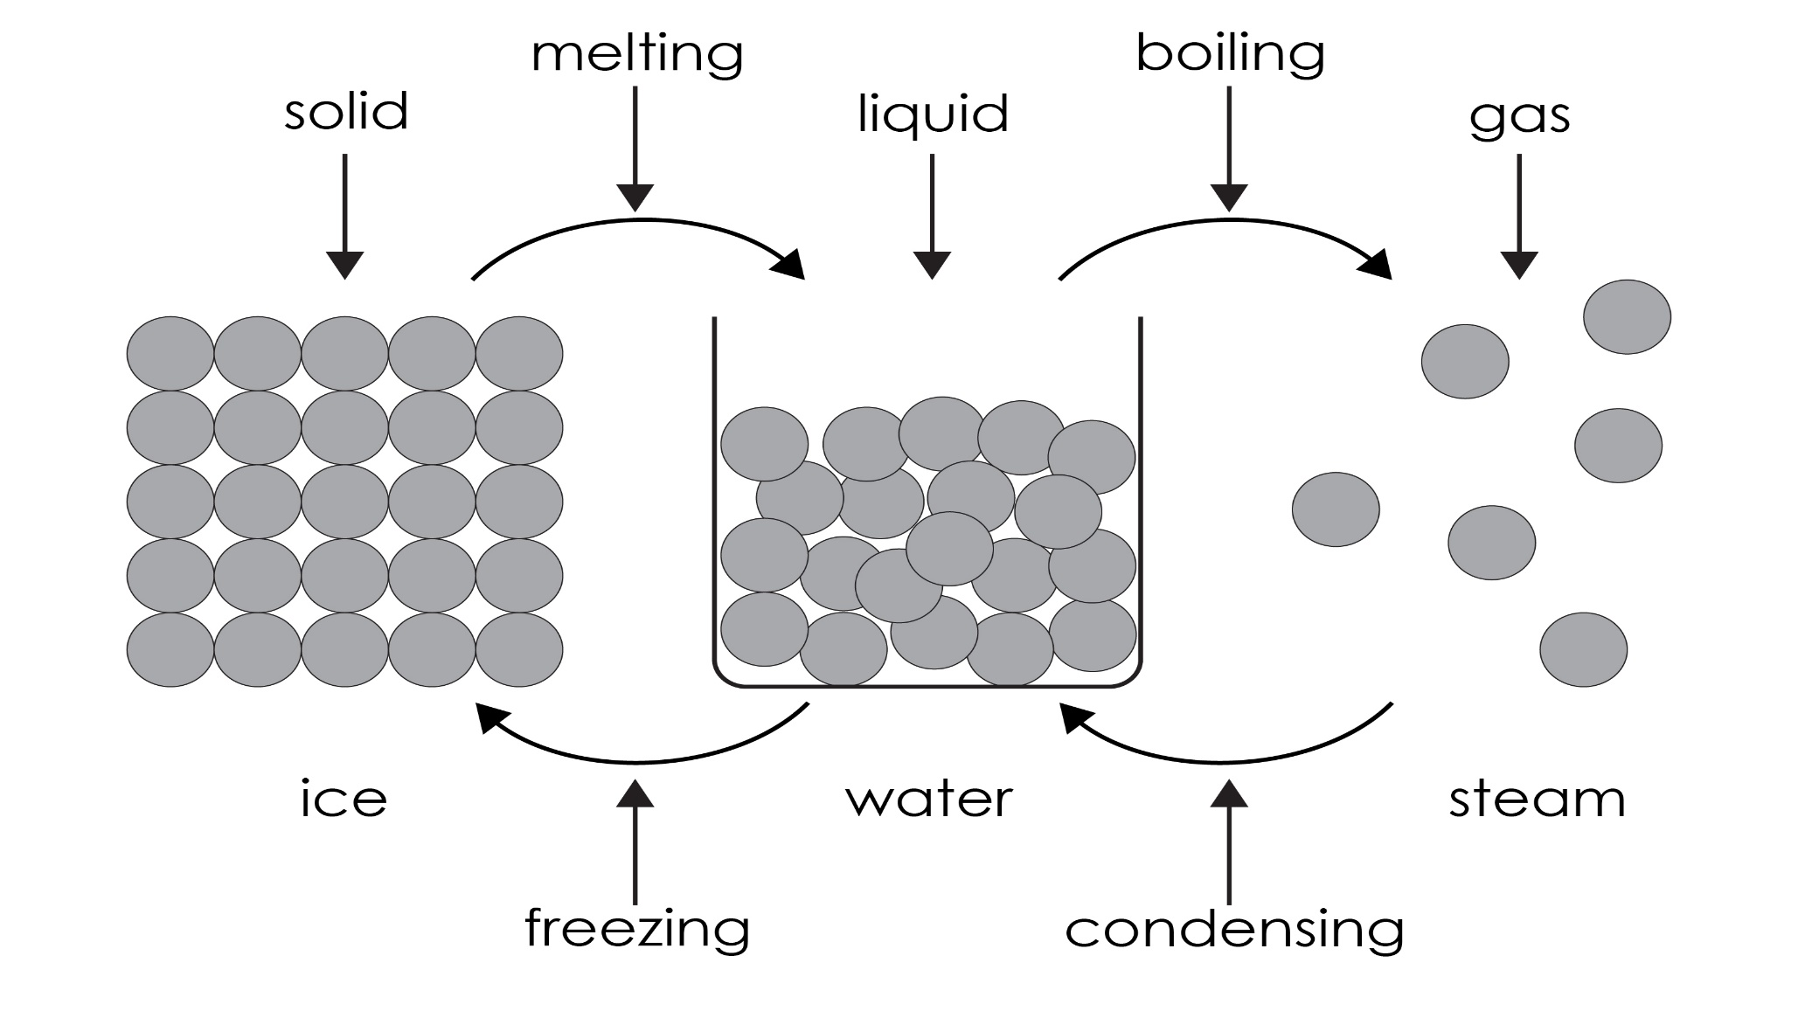
Revisiting changes of state: answers
D
E
A
B
C
Starter: answers
F
G
Notes:
Mini-whiteboard exercise to recap particle theory and changes of state.
A solid
B liquid
C gas
D melting
E evaporating
F freezing
G condensing

Slide 6
Planning
Conditions | How to achieve
Warm | Warm slide in hands and hold on a flat palm. Alternatively, place the slide in warm water then dry it.
Cool | Room temperature. Or keep the slides in a fridge, cool box or between two bags of cooling gel.
Spread out | Spread the drop of propanone on the slide with a matchstick.
Unspread | Drop to be left as one drop on the slide.
Air flow | Blow across drop, fan with book or use a hairdryer on a cool setting.
Planning

Slide 7
Method
Method
Put a drop of propanone onto a microscope slide and time how long it takes to evaporate.
Change the conditions and repeat the experiment, ensuring that you record the conditions used and the time taken for each one.

Slide 8
Results table
Conditions |  |  | Evaporation time (s)
Warm? | Spread out? | Air movement?
Results

Slide 9
Results table
Conditions |  |  | Evaporation time (s)
Warm? | Spread out? | Air movement?
 |  | 
 |  | 
 |  | 
 |  | 
 |  | 
 |  | 
 |  | 
 |  | 
Results

Slide 10
Questions
Questions
1. Draw a particle diagram to show how the particles rearrange during evaporation.
2. For your investigation state the following:
(a) The control variables
(b) The dependent variable
(c) The independent variable
3. Draw a bar chart of your results.
4. List the conditions in order, from those taking the shortest time to evaporate to those taking the longest time to evaporate.
5. Use your results to answer the following questions. Suggest a reason for your answer.
(a) Which conditions resulted in the fastest rate of evaporation?
(b) Which conditions resulted in the slowest rate of evaporation?

Slide 11
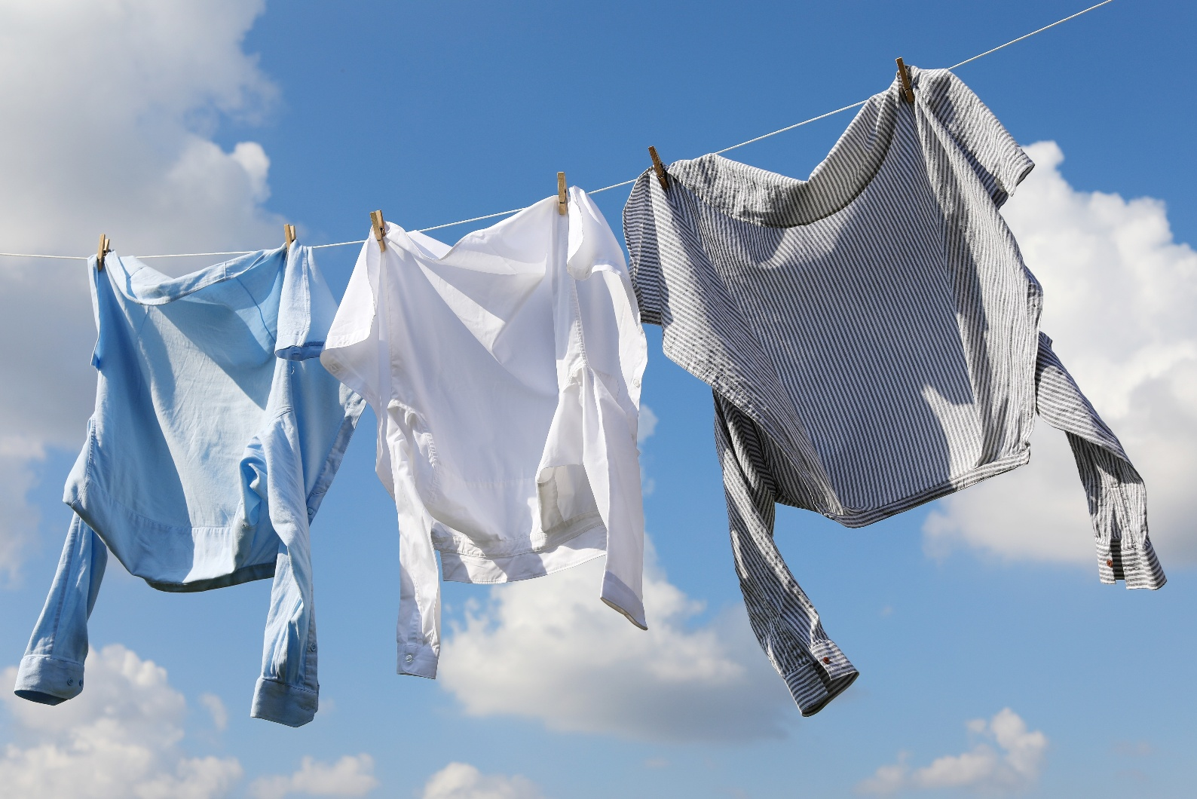
Questions
Questions
6. Explain why it takes less time for the washing to dry on a sunny, windy day than on a dull, calm day.
Source: Shutterstock/New Africa
Notes:
https://www.shutterstock.com/image-photo/clean-clothes-hanging-on-washing-line-2222146781

Slide 12
Learning objectives
Learning objectives
During this lesson you will:
carry out an investigation into the rate of evaporation of propanone.
make and record observations.
use particle theory to explain your results.
Have you met all of the learning objectives?

