Slide 1

11–14 years
Particles in motion?
Notes:
Image © Shutterstock / Saqib_Raza

Slide 2

Particles in motion
Introduction
Look at the image.
What do you see?
© Shutterstock / Saqib Raza
Notes:
Image © Shutterstock / Saqib_Raza
Use this image to promote discussion at the start of the lesson.
Here we see, shafts of sunlight illuminating specks of ‘sparkling’ dust.
Bring out the idea that particles in the gas state are in continuous motion. We know this because over the years scientists have built up a body of evidence through carrying out a range of different experiments.
Ask for other examples of evidence for moving particles e.g. dust being blow about in the air or sun shining through a crack in the drawn curtains, showing dust in the air.
At this stage, you may wish to demonstrate or use a video clip to show Brownian motion as further evidence. Alternatively this could be a good follow up to the class practical.
https://www.stem.org.uk/resources/elibrary/resource/28836/brownian-motion
https://spark.iop.org/brownian-motion-smoke-cell

Slide 3
Learning objectives
During this lesson, you will:
investigate the motion of particles in a gas.
use particle theory to explain your observations.

Slide 4

Key terms
Find more support for vocabulary in our Key Terms support bundle for 11–14 Particle model.
Available to download from: rsc.li/4cmvSbS
Equipment words:
Bung or cork
Delivery tube
Dropper
Measuring cylinder
Test tube
Timer
Chemistry words:
Chemical change
Chemical reaction
Colourless
Concentration
Density
Diffusion
Gas
Limewater
Liquid
Particle
Particle theory
Key terms
Notes:
Mini whiteboard activity
Draw the piece of equipment named.
Name the piece of equipment being held up
write down the meaning of the key terms when given the key term
write down the key term when given the definition.
Find more support for literacy and vocabulary in our Key Terms support bundle for 11-14 Particle model, available to download from: rsc.li/4cmvSbS

Slide 5
Practical experiment
Equipment (per group)
Apparatus
Test tubes, x 3
Cork
Delivery tube and bung
Safety equipment
Eye protection: safety glasses to EN166F
Chemicals
Limewater 0.02 mol dm^{–3}
Calcium carbonate
Hydrochloric acid 0.5 mol dm^{–3}
You are going to carry out a practical activity to explore the motion of particles in a gas.
You will produce a test tube full of carbon dioxide by reacting calcium carbonate with hydrochloric acid.
You will then check to see if diffusion occurs by holding the test tube of carbon dioxide over a test tube of air and vice versa.
The practical

Slide 6

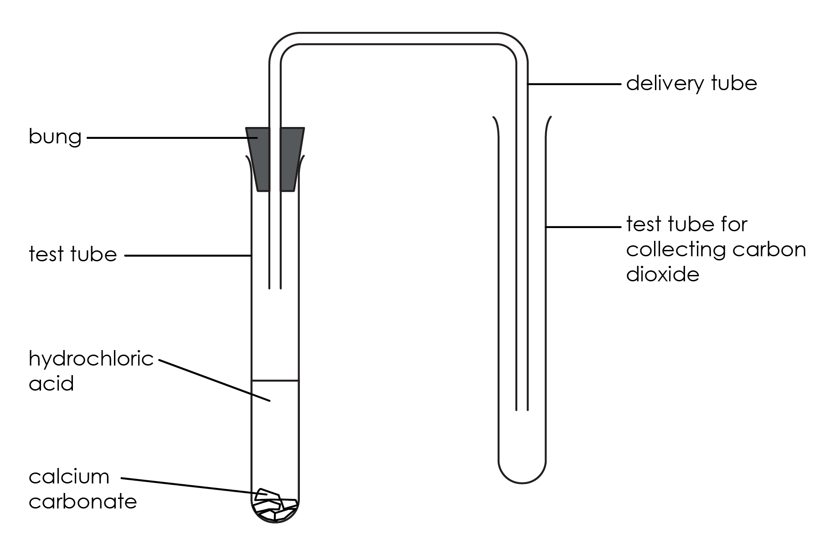
Diagram
The practical

Slide 7
Method
Set up the apparatus as shown in the diagram.
Put a spatula of calcium carbonate into the first test tube.
Add 10 cm³ of hydrochloric acid and quickly replace the bung and delivery tube.
Carbon dioxide gas is created. Allow the gas to pass into the second test tube for about 1 minute, then remove the delivery tube and cork this second test tube.
Hold the test tube of carbon dioxide upside down over a similar test tube containing air.
Remove the cork and place the tubes mouth-to-mouth.
After 5 minutes, add a drop of limewater to each test tube. Bung and shake the tubes. Record observations.
Repeat this experiment but this time at step 5 hold the test tube of air upside down over the test tube of carbon dioxide.
The practical

Slide 8


Integrated instructions
❶ Add:
sodium calcium carbonate 
10 cm³ of HCl 
❼ Repeat, but at ❺ hold test tube of air on top 
❷ Quickly add bung and delivery tube 
❻ Add a drop of limewater to each test tube, cork and shake 
5.00
c
❸ Allow gas to collect for 1 minute 
01.00
❺ Hold collection test tube above a test tube containing air.
Remove bung for 5 minutes 
❹ Cork collection test tube 
Royal Society of Chemistry
From rsc.li/3F6wKBt
Notes:
Particles in motion?
Put a spatula of calcium carbonate into the first test tube.
Add 10 cm³ of hydrochloric acid
Quickly replace the bung and delivery tube.
Allow the gas to pass into the second test tube for about one minute,
Remove the delivery tube and cork the test tube.
Hold the test tube upside down over a similar test tube containing air. Remove the cork and place the tubes mouth-to-mouth.
Add a drop of limewater to each test tube; bung and shake the test tube. Record observations,
Repeat this experiment but this time at step 6 hold the test tube of air upside down over the test tube of carbon dioxide

Slide 9
Questions
Write a word equation for the reaction of calcium carbonate with hydrochloric gas.
State the test for carbon dioxide gas.
Which of the four test tubes contained carbon dioxide gas at the end of the experiment?
Which is denser, air or carbon dioxide?
Questions
Notes:
Find answers to these questions and explanations in the teacher notes at https://rsc.li/3F6wKBt.

Slide 10

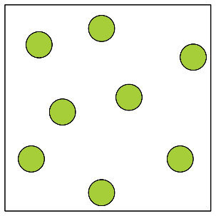
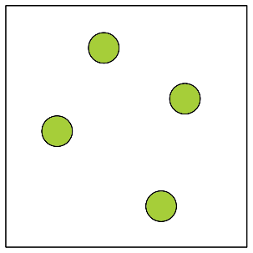
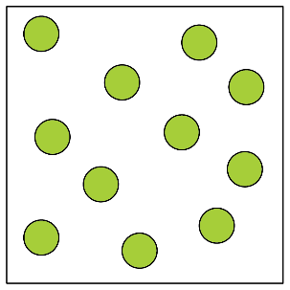
Questions
5. Concentration is a measure of the number of particles per unit area.
The diagrams show a sample of gas particles at different concentrations.
List the samples in order from highest concentration to lowest concentration.
Questions
A | B | C | D
Notes:
Find answers to these questions and explanations in the teacher notes at https://rsc.li/3F6wKBt.

Slide 11
Questions
6. Complete the sentence.
Diffusion is …
7. Does this experiment support the idea that particles of a gas are in motion? Suggest a reason for your answer.
Questions
Notes:
Find answers to these questions and explanations in the teacher notes at https://rsc.li/3F6wKBt.

