Slide 1
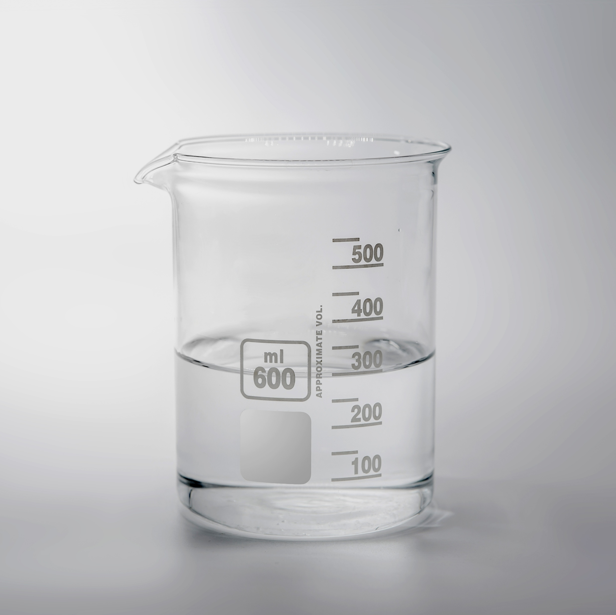
11–14 years
Solutions
Downloaded from: rsc.li/4hLVIaV

Slide 2
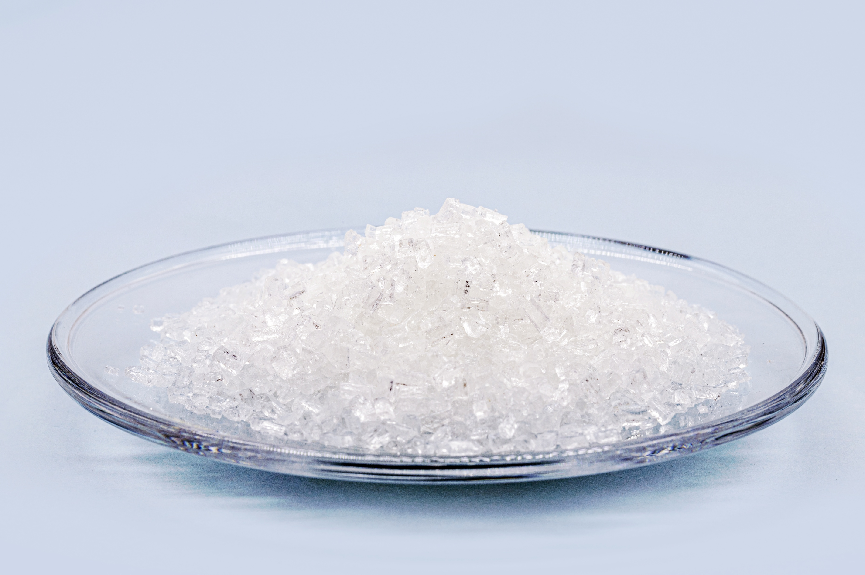
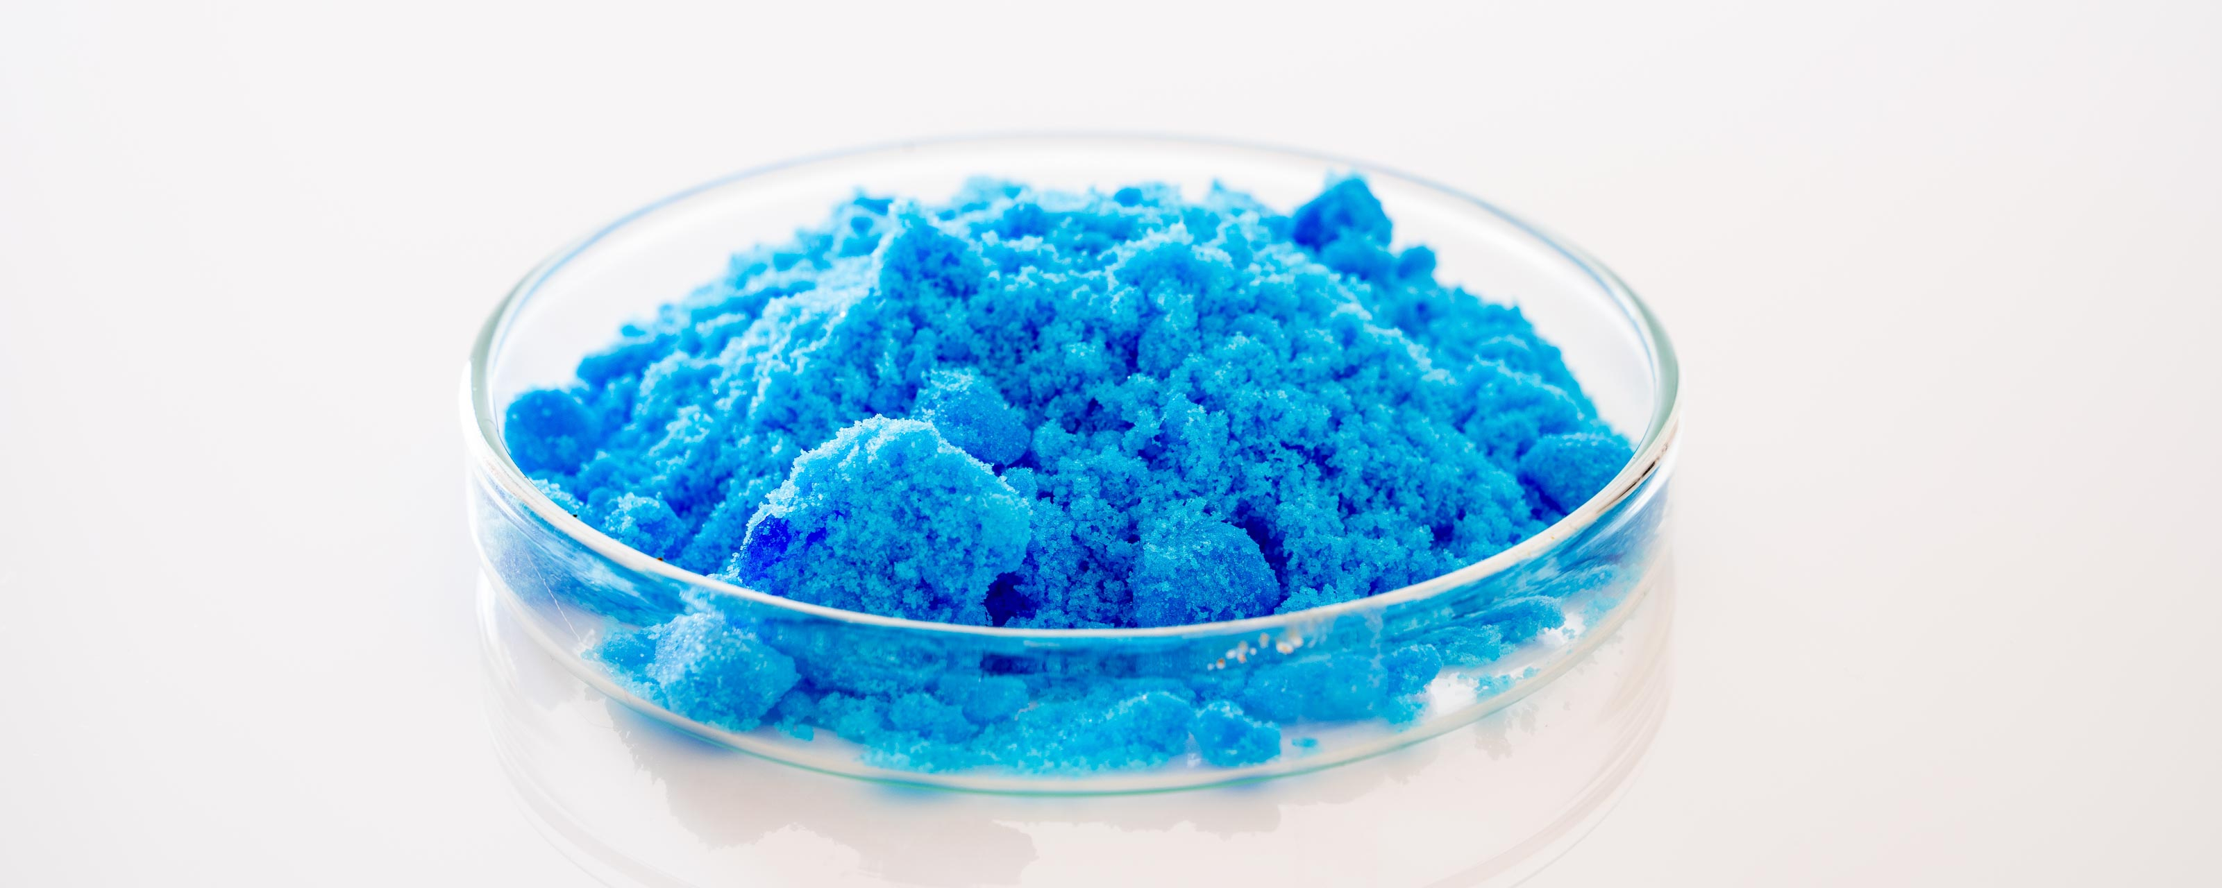
The problem
Introduction
A group of students conduct an experiment where they dissolve two solids, separately, in water to produce two solutions. The solids are sodium chloride (table salt) and blue copper(II) sulfate.
They know that all solids, liquids and gases are made of tiny particles.
© Shutterstock

Slide 3
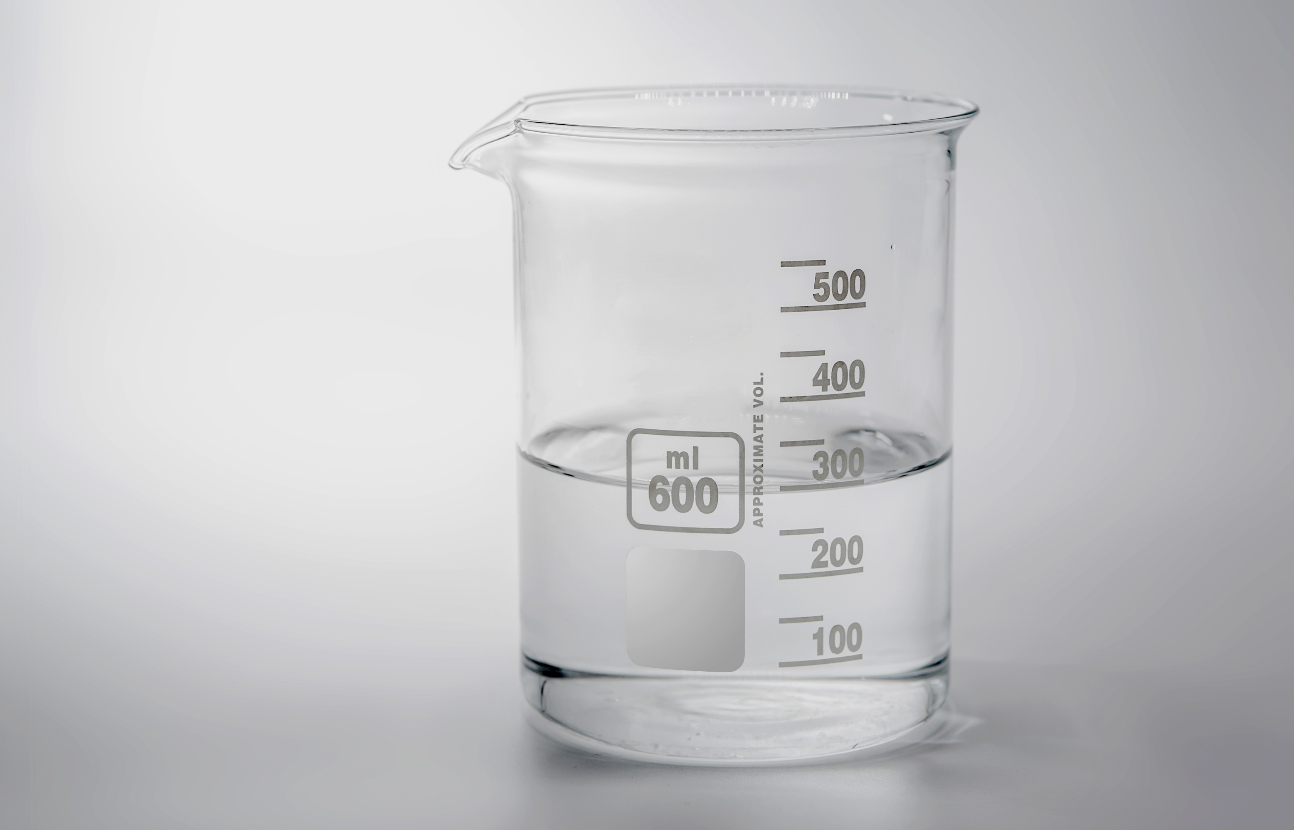
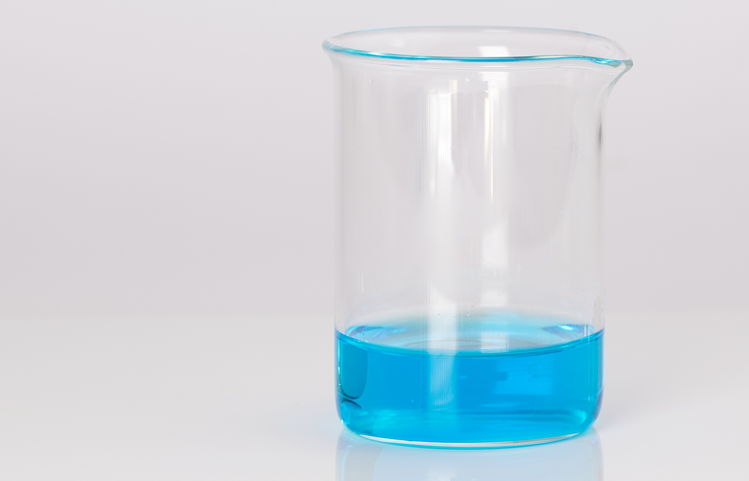
The problem
What happened when a solution was formed?
Introduction
All images © Shutterstock

Slide 4






Questions
First, the students discussed what happens when a solution is formed.
The solid cannot be destroyed because you can get the solid back, if you let the water evaporate.
The solutions are no longer pure water.
The solid breaks up into tiny particles too small to see, which is why it disappears.
Why would the solid particles split up in water?
Because the solid disappears, the solid is destroyed and no longer exists.
The solids must become gases, since you cannot see them and you cannot see gases.
Suggestions I
Ravi
Jo
Yara
Alice
Sam
Tadhg

Slide 5
Questions
The solid cannot be destroyed because you can get the solid back, if you let the water evaporate.
The solutions are no longer pure water.
The solid breaks up into tiny particles too small to see which is why it disappears.
Why would the solid particles split up in water?
Because the solid disappears, the solid is destroyed and no longer exists.
The solids must become gases, since you cannot see them and you cannot see gases.
Ravi
Jo
Yara
Alice
Sam
Tadhg
(a) Which of the students (it could be more than one) do you agree with?
(b) Suggest an answer to Tadhg’s question in terms of the forces of attraction between particles.

Slide 6
Answers
(a) Which of the students (it could be more than one) do you agree with?
The solid cannot be destroyed because you can get the solid back, if you let the water evaporate.
Sam is incorrect to think that the particles of sodium chloride are destroyed. They are simply being rearranged. Instead of being grouped together, in the solid, they are spread out into the solution. This touches an important concept in science, which is that the particles are never destroyed. In chemical reactions the particles get rearranged but are not created or destroyed.
Yara is therefore correct and pointed out an important piece of evidence to back up her idea.
Discussion of answers
Because the solid disappears, the solid is destroyed and no longer exists.
Yara
Sam

Slide 7

Answers
(a) Which of the students (it could be more than one) do you agree with?
Jo’s statement is incorrect but is not as far from the truth as you might think.
Gases are clear, transparent and invisible (unless coloured) because the particles are spread out in an irregular arrangement. The sodium chloride disappears when it dissolves because the particles spread out in the water and end up in an irregular arrangement.
Discussion point: can you think of any other evidence to link transparency and the irregular arrangement of particles?
The solids must become gases, since you cannot see them and you cannot see gases.
Discussion of answers
Jo

Slide 8
Answers
(a) Which of the students (it could be more than one) do you agree with?
Ravi’s statement is correct. The solutions are mixtures.
Alice is also correct; the particles are much too small to see.
The solutions are no longer pure water.
The solid breaks up into tiny particles too small to see which is why it disappears.
Discussion of answers
Ravi
Alice

Slide 9
Answers
(b) Suggest an answer to Tadhg’s question in terms of the forces of attraction between particles.
To answer Tadhg’s question, we need to consider the forces of attraction between particles in both the solid and solution.
Particles attract each other. The sodium particles attract the chloride particles and vice versa. There must be forces of attraction between the water particles and the sodium chloride particles.
The forces must be sufficiently strong to overcome the forces of attraction holding the sodium and chloride particles to each other.
Discussion of answers
Why would the solid particles split up in water?
Tadhg

Slide 10
Questions
The students noticed that solid copper sulfate is blue and so is the solution. They also saw that while solid sodium is white, the solution is not.
The sodium chloride particles were only white when they were grouped together in lumps big enough to see and colourless when they were spread apart, as in a solution.
The solids must become gases, since you cannot see them and you cannot see gases.
Suggestions II
Sodium chloride solution is clear.
Copper sulfate is like coloured glass: it is
transparent and coloured.
Sodium chloride is colourless.
If that is true, the copper sulfate particles must be blue all the time.
Yara
Jo
Tadhg
Alice
Ravi
Sam

Slide 11
Questions
The sodium chloride particles were only white when they were grouped together in lumps big enough to see and colourless when they were spread apart, as in a solution.
The solids must become gases, since you cannot see them and you cannot see gases.
Tadhgium chloride solution is clear.
Copper sulfate is like coloured glass: it is
transparent and coloured.
Sodium chloride is colourless.
If that is true, the copper sulfate particles must be blue all the time.
Yara
Jo
Tadhg
Alice
Ravi
Sam
2. (a) Arrange the students into the order in which you think their statements showed the most reasoning based on their observations (e.g. If you think Alice made the best contribution to the group’s understanding by good reasoning, put her name at the top of the list). Explain your reasons for the order that you decide.
(b)What colour would you expect copper sulfate gas to be, if it exists?

Slide 12
Answers
2. (a) Arrange the students into the order in which you think their statements showed the most reasoning based on their observations.
Ravi
The sodium chloride particles were only white when they were grouped together in lumps big enough to see and colourless when they were spread apart, as in a solution.
Discussion of answers
The answer to this is open for debate, but I put Ravi’s statement first, as it shows the greatest reasoning.
The sodium chloride particles appear white when they are all grouped together and colourless when they are spread out. So, it seems logical to suggest that the whiteness is caused by the grouping together.

Slide 13
Answers 2a cont.
The sodium chloride particles were only white when they were grouped together in lumps big enough to see and colourless when they were spread apart, as in a solution.
Ravi
The solids must become gases, since you cannot see them and you cannot see gases.
If that was true, the copper sulfate particles must be blue all the time.
Discussion of answers
Jo
Sam
Jo and Sam both shed light on the contrast with copper sulfate. It seems reasonable to suggest that copper sulfate’s blue colour is caused in a different way from sodium chloride’s whiteness because copper sulfate solution keeps the colour blue. Notice that we can make this logical statement, even if we know nothing about how copper sulfate appears blue!

Slide 14
Answers 2a cont.
The sodium chloride particles were only white when they were grouped together in lumps big enough to see and colourless when they were spread apart, as in a solution.
Ravi
Discussion of answers
The solids must become gases, since you cannot see them and you cannot see gases.
If that was true, the copper sulfate particles must be blue all the time.
Sam
Jo
Copper sulfate is like coloured glass: it is transparent and coloured.
Alice
Alice’s statement is helpful, scientists look for similar situations that they have met, to help explain or make predictions about the part of science they are considering.

Slide 15
Answers 2a cont.
The sodium chloride particles were only white when they were grouped together in lumps big enough to see and colourless when they were spread apart, as in a solution.
Ravi
The solids must become gases, since you cannot see them and you cannot see gases.
Discussion of answers
If that was true, the copper sulfate particles must be blue all the time.
Sam
Jo
Copper sulfate is like coloured glass: it is transparent and coloured.
Alice
Tadhg
Sodium chloride solution is clear.
Sodium chloride is colourless.
Yara
Tadhg and Yara are both correct. ‘Clear’ is the opposite of cloudy. When solids fully dissolve, they form clear solutions. A cloudy appearance is good evidence that some solid has not dissolved. The solution was also colourless. These are accurate descriptions but do not show as much reasoning as the others.

Slide 16
Answers
2. (b) What colour would you expect copper sulfate gas to be, if it exists?
It would seem reasonable to suppose, from particle theory, that copper sulfate gas would be a very pale blue. Blue, because the particles are blue. Pale, because in a gas the particles are spread out, far apart from each other. However, if you tried to show this by an experiment in the laboratory you would find a few surprises. When (hydrated) copper sulfate is heated strongly, it first loses water (water of crystallisation) and turns white. This suggests that the blue appearance depends on the copper having some water with it. If copper sulfate is further heated it decomposes into simpler substances, gases are formed but they are not copper sulfate. This implies that copper sulfate will not exist as a gas.
Discussion of answers

Slide 17
Why does the particle model let us down when making a prediction about copper sulfate gas?
The particle model assumes that the particles remain the same in the solid, liquid and gaseous states. In the different states the same particles are simply arranged and move differently. But in chemical reactions new substances are formed – i.e. different particles are produced. So, when you heat a solid, two things might happen, a physical change such as melting or a chemical change like decomposition.
The question has tested the limits of the model we were using to explain our observations. To understand what really happens to copper sulfate we need to introduce a different model. The process of testing a model until we find situations where it lets us down is frequently involved when new ideas in science emerge. It is the process that Einstein used to help develop his Theory of Relativity.
So don’t be disappointed if you get an unexpected result.

Slide 18
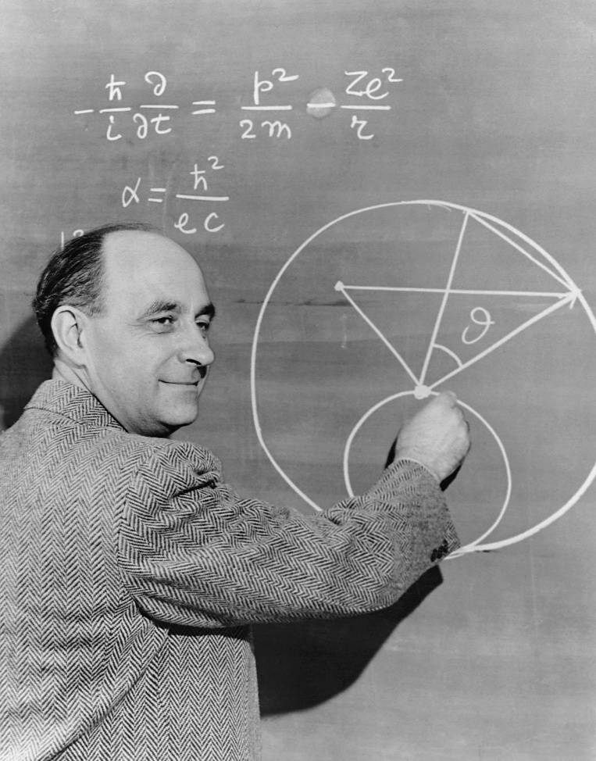
How science works…
‘There are two possible outcomes: if the result confirms the hypothesis (theory), then you’ve made a measurement. If the result is contrary to the hypothesis, then you’ve made a discovery.’
Enrico Fermi – famous scientist
© CORBIS/Corbis via Getty Images

Slide 19
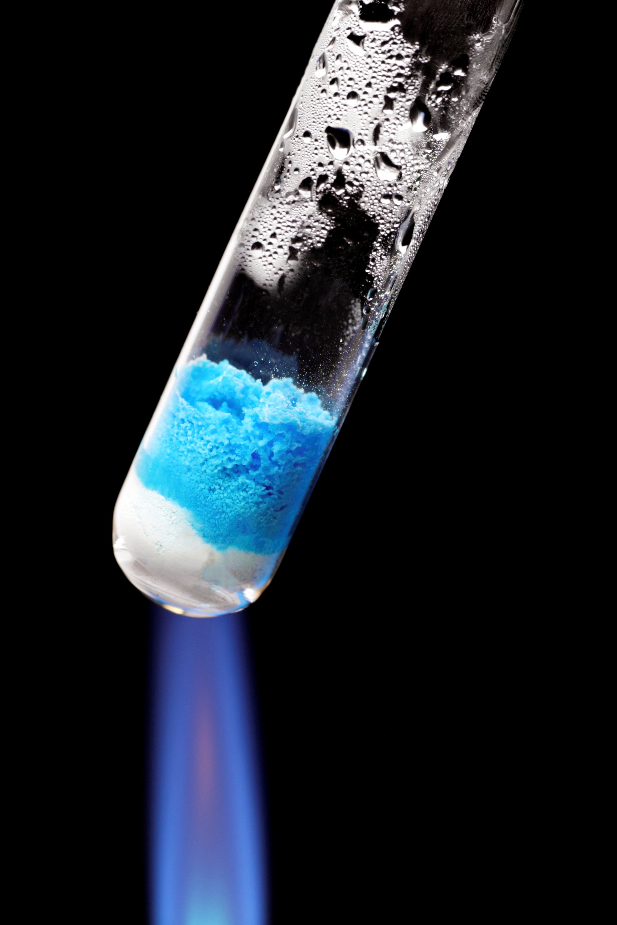
Questions
3. The blue copper sulfate crystals that have been discussed so far are more fully called hydrated copper(II) sulfate.
Questions
Alice took some of the blue hydrated copper(II) sulfate crystals and heated them strongly in a test tube. Alice saw that the blue crystals changed colour to white, she wrote down that ‘steam’ rose from the test tube.
Alice
© Science Photo Library

Slide 20
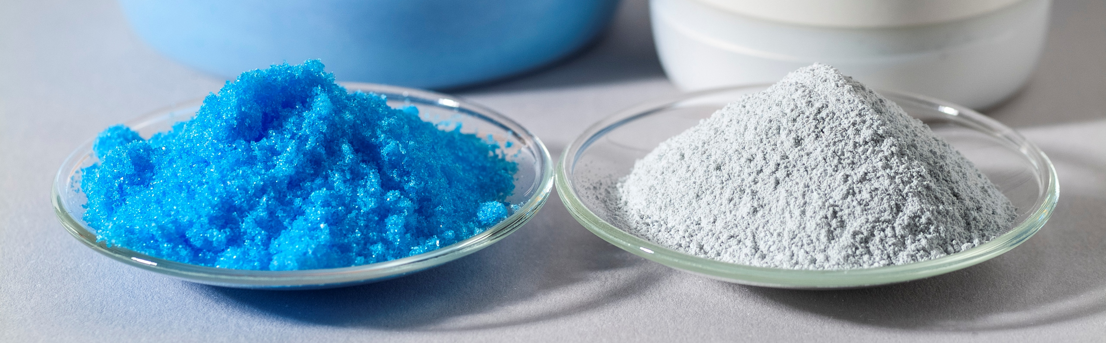
Questions
3. (a) Rearrange Alice’s thoughts into a sensible order.
Sodium chloride crystals have no water since they are already white.
© Science Photo Library
The hydrated copper(II) sulfate contains water.
Coloured compounds will change to white when heated if they lose water.
When it is heated, the blue hydrated copper(II) sulfate loses water.
The white residue is copper sulfate with no water – anhydrous copper(II) sulfate.
Alice
The copper(II) sulfate needs water to be blue – without water it is white.
The hydrated copper(II) sulfate changes when it is heated.

Slide 21
Answers
3. (a) Rearrange Alice’s thoughts into a sensible order.
© Science Photo Library
Answers
1. The hydrated copper(II) sulfate changes when it is heated.
2. When it is heated the blue hydrated copper(II) sulfate loses water.
3. The hydrated copper(II) sulfate contains water.
4. The white residue is copper sulfate with no water – anhydrous copper(II) sulfate.
5. The copper(II) sulfate needs water to be blue – without water it is white.
6. Sodium chloride crystals have no water since they are already white.
7. Coloured compounds will change to white when heated if they lose water.

Slide 22
Questions
3. (b) Alice draws some big conclusions from this single experiment. Which of her conclusions do you think are reasonable?
(c) Which of her conclusions do you think are unreasonable? Explain your reasons.
Questions
1. The hydrated copper(II) sulfate changes when it is heated.
2. When it is heated the blue hydrated copper(II) sulfate loses water.
3. The hydrated copper(II) sulfate contains water.
4. The white residue is copper sulfate with no water – anhydrous copper(II) sulfate.
5. The copper(II) sulfate needs water to be blue – without water it is white.
6. Sodium chloride crystals have no water since they are already white.
7. Coloured compounds will change to white when heated if they lose water.

Slide 23
Answers
(b) Alice draws some big conclusions from this
single experiment. Which of her conclusions do
you think are reasonable? Explain your reasons.
There does seem to be a link between copper sulfate being blue and the presence of water. Copper sulfate solution is blue and so are the hydrated crystals (which do indeed contain some water). Since the blue colour disappears when the water is driven off by heating it seems reasonable to infer that the copper(II) sulfate needs water to be blue – without water it is white.
(c) Which of her conclusions do you think are unreasonable? Explain your reasons.
Sodium chloride crystals have no water since they are already white. Sodium chloride solution is colourless. There is no evidence that water gives colour to sodium chloride.
Coloured compounds will change to white when heated if they lose water. This is too general a conclusion for just one substance. You would need many more examples before stating a general trend as Alice has.
© Science Photo Library
Discussion of answers

