Slide 1
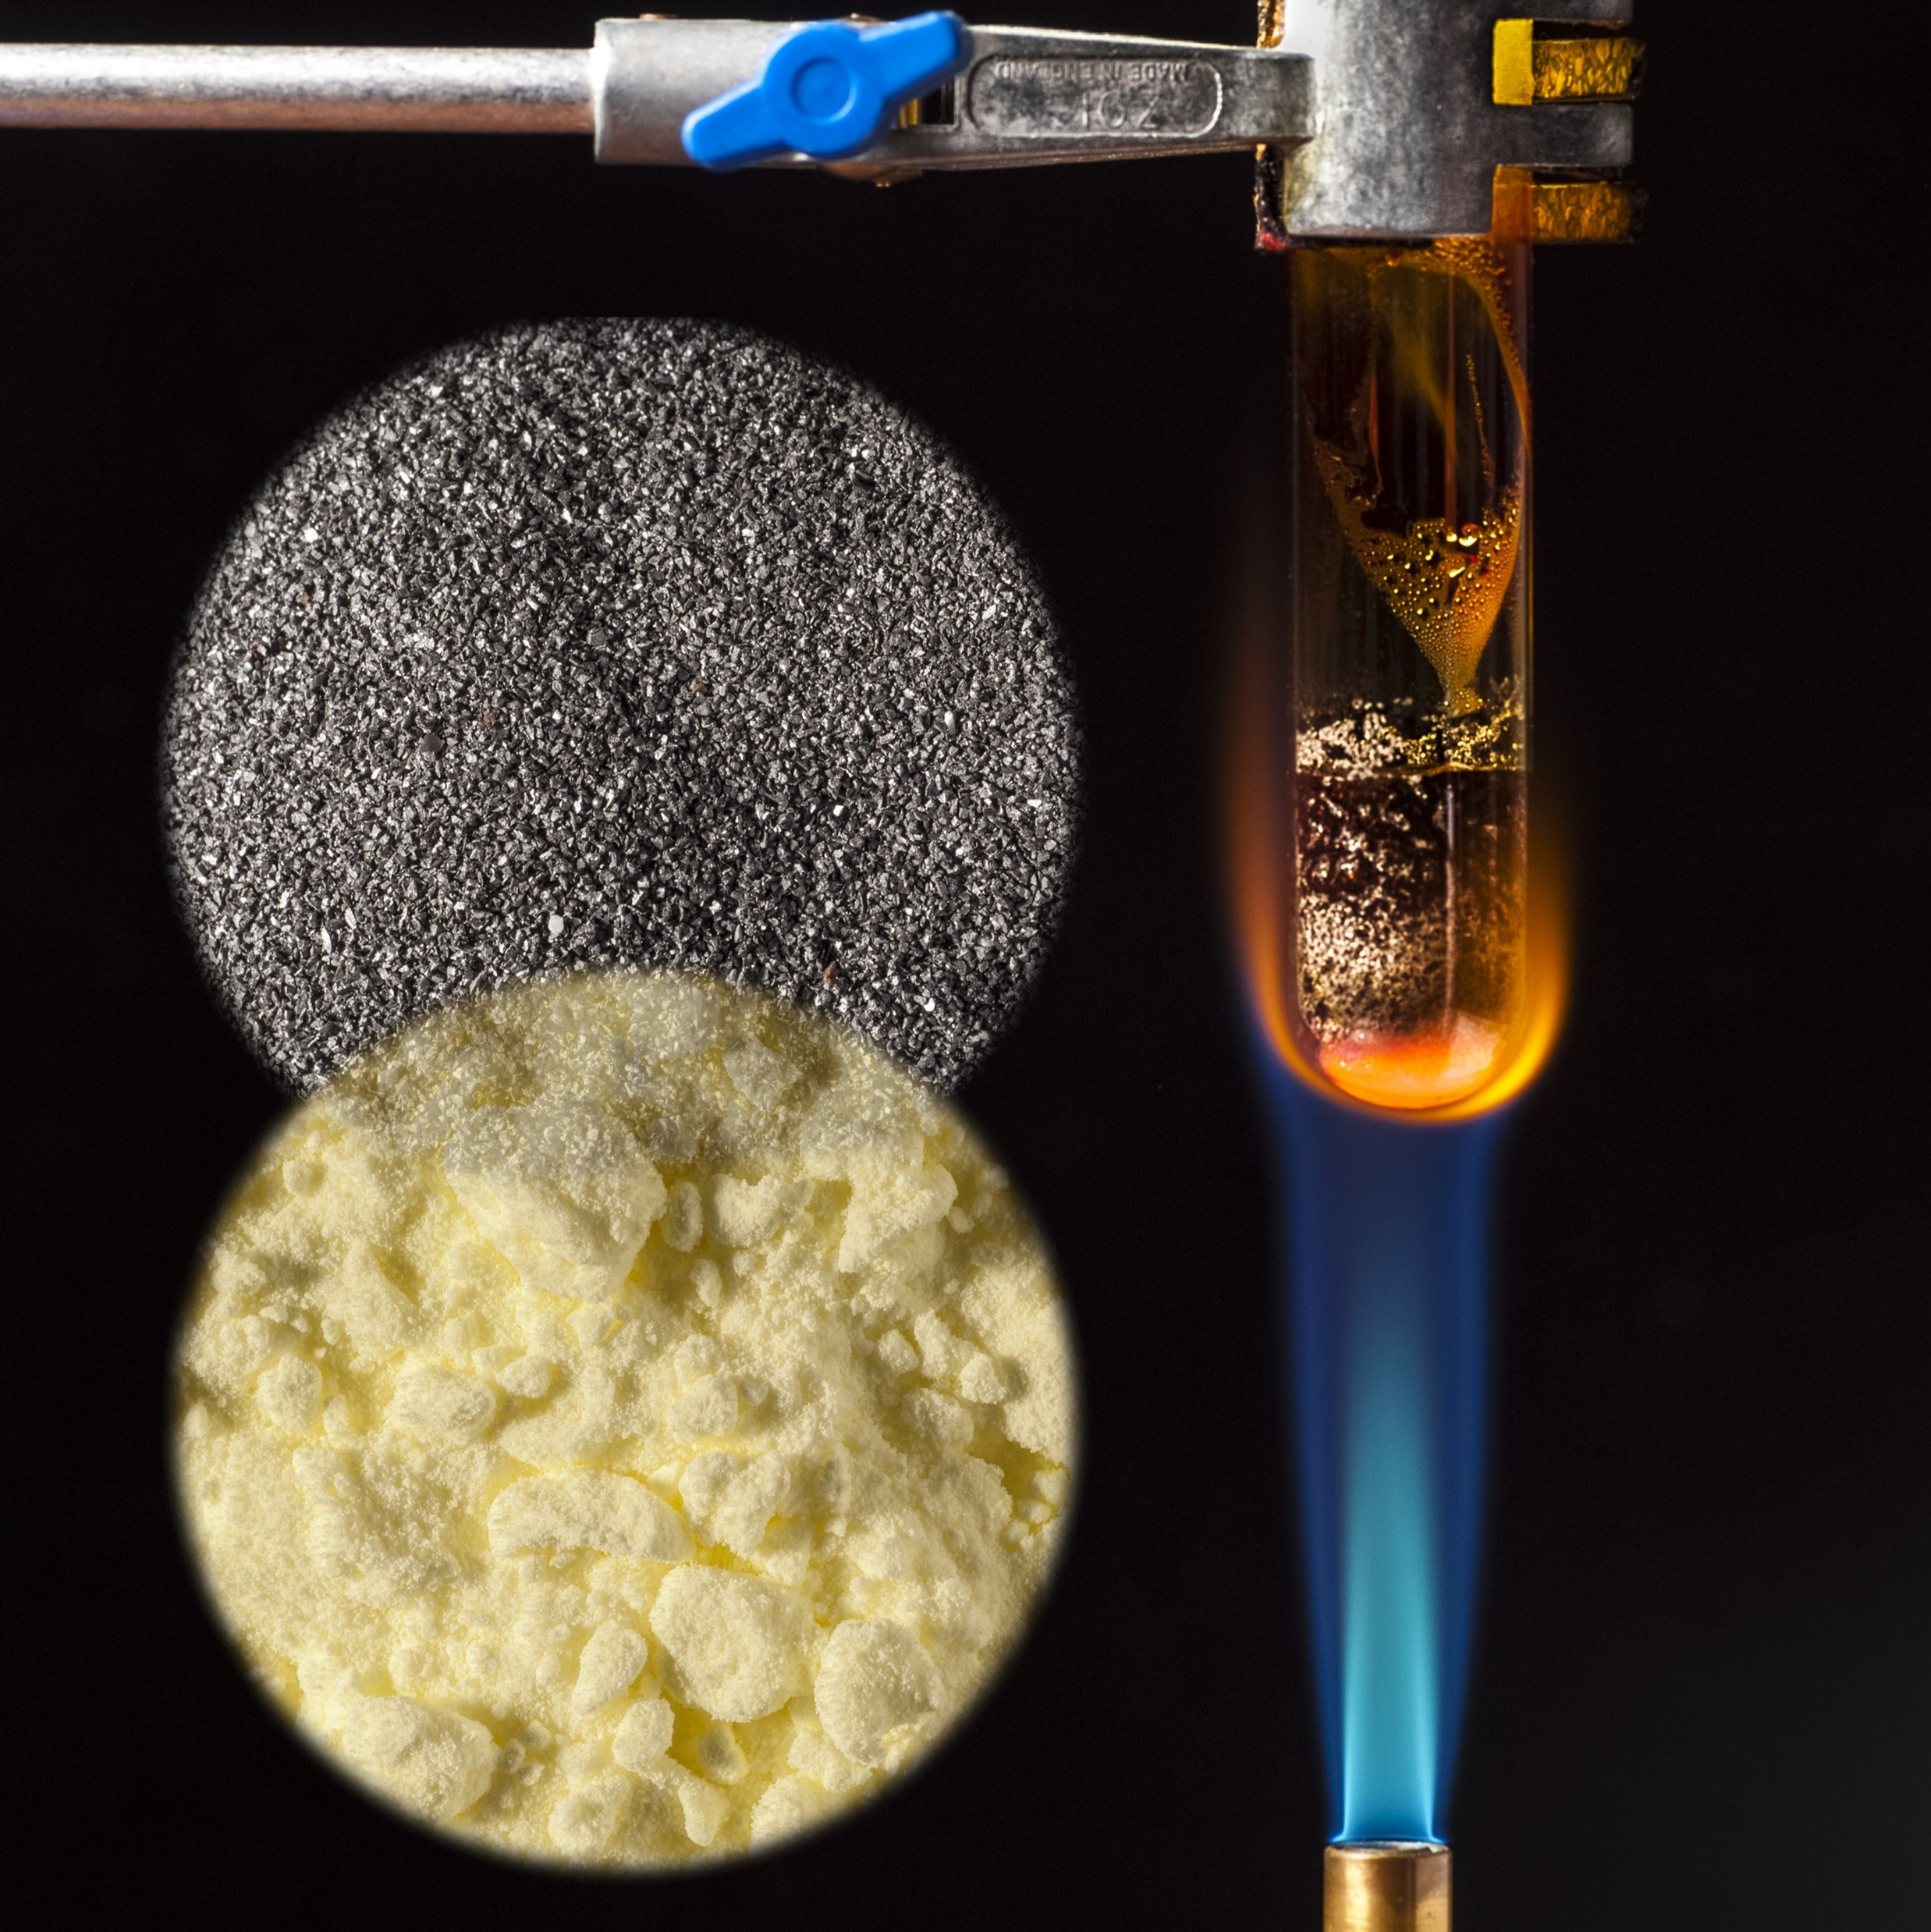
11–14 years
Iron and sulfur reaction
Downloaded from: rsc.li/3LVXGeC

Slide 2
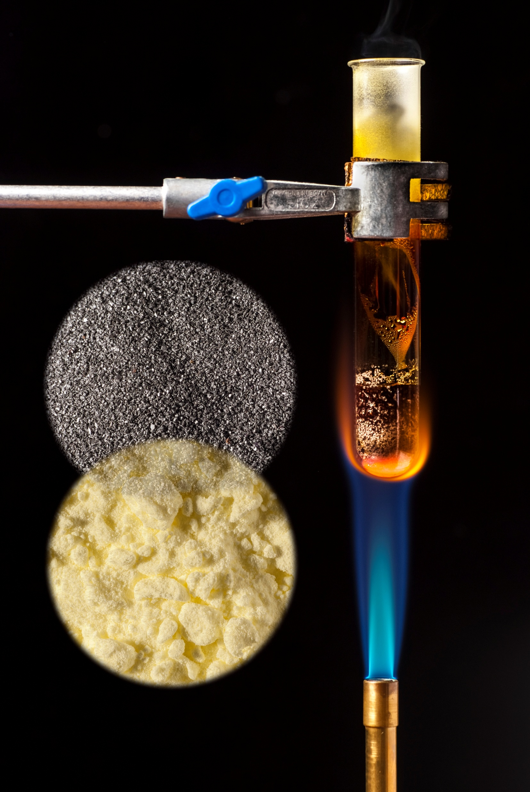
Introduction
Introduction
When chemical reactions occur, atoms are rearranged to form different substances. The original elements, once combined, have different chemical and physical properties than when they were reactants.
In this demonstration and class experiment, you will observe an exothermic reaction of two elements, iron and sulfur, to form the compound iron sulfide. The two solids are mixed and heated in a test tube (or ignition tube) and changes in their properties can be observed.
© Science Photo Library

Slide 3
Learning objectives
During this lesson, you will:
Recall definitions of elements and compounds.
Safely heat a mixture of two elements and record observations.
Calculate masses using the principles of conservation of mass.
Plot data and make predictions from the graph.
Learning objectives

Slide 4



Revisiting elements and compounds
Look at the particle diagrams below and determine which are elements and which are compounds. Explain your answer.
Revisiting elements and compounds

Slide 5
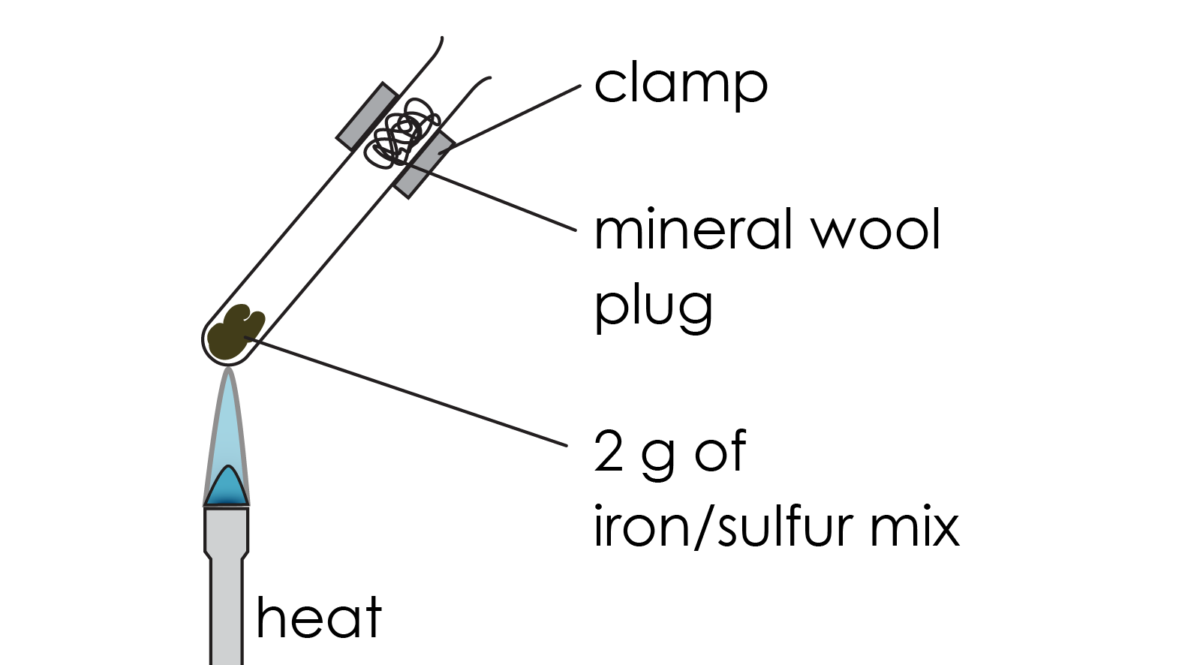
Method
You will be provided with a pre-prepared ignition tube containing the iron−sulfur mixture and a mineral wool plug.
Using suitable tongs or test tube holders, heat the iron−sulfur mixture in the tube until it just starts to glow. Then, turn off your Bunsen burner.
Leave the ignition tube to cool on the heat resistant mat.
Method

Slide 6
Results table
Substance | Appearance and properties
Iron (Fe)
Sulfur (S)
Iron sulfide (FeS)
Results

Slide 7
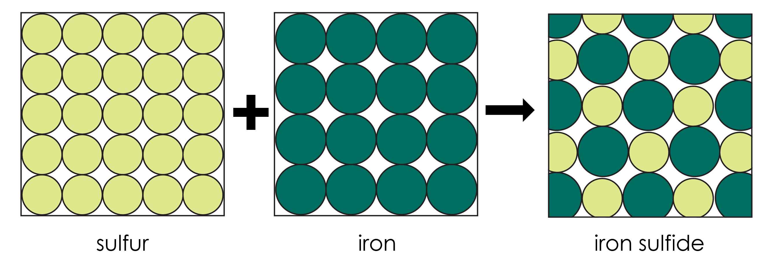
Revisiting conservation of mass
The law of conservation of mass is a key concept when learning about chemical reactions. It states that no atoms are lost or made during a chemical reaction.
This means that the total mass of reactants equals the total mass of products.
Conservation of mass
5 g
5 g

Slide 8
Follow-up questions
Describe the appearance of the mixture of iron and sulfur before you heated it. Include information on both the state and colour.
Explain how you know that a chemical reaction has occurred between iron and sulfur. Refer to descriptions of changes in colour in your answer.
In the reaction you completed, you reacted iron (Fe) with sulfur (S) to produce iron sulfide (FeS).
  Write a word equation for this reaction.
  Write a symbol equation for this reaction.
  Identify the reactants in this reaction.
  Identify the product in this reaction.
Follow-up questions

Slide 9
Follow-up questions
When iron reacts with sulfur to produce iron sulfide, mass is conserved. Explain what this means using the principle of conservation of mass.
Calculate the mass of iron sulfide formed when 1 gram of iron reacts exactly with 0.57 grams of sulfur.
Calculate the mass of sulfur needed to react exactly with 2.5 grams of iron to produce 3.9 grams of iron sulfide.
Follow-up questions

Slide 10
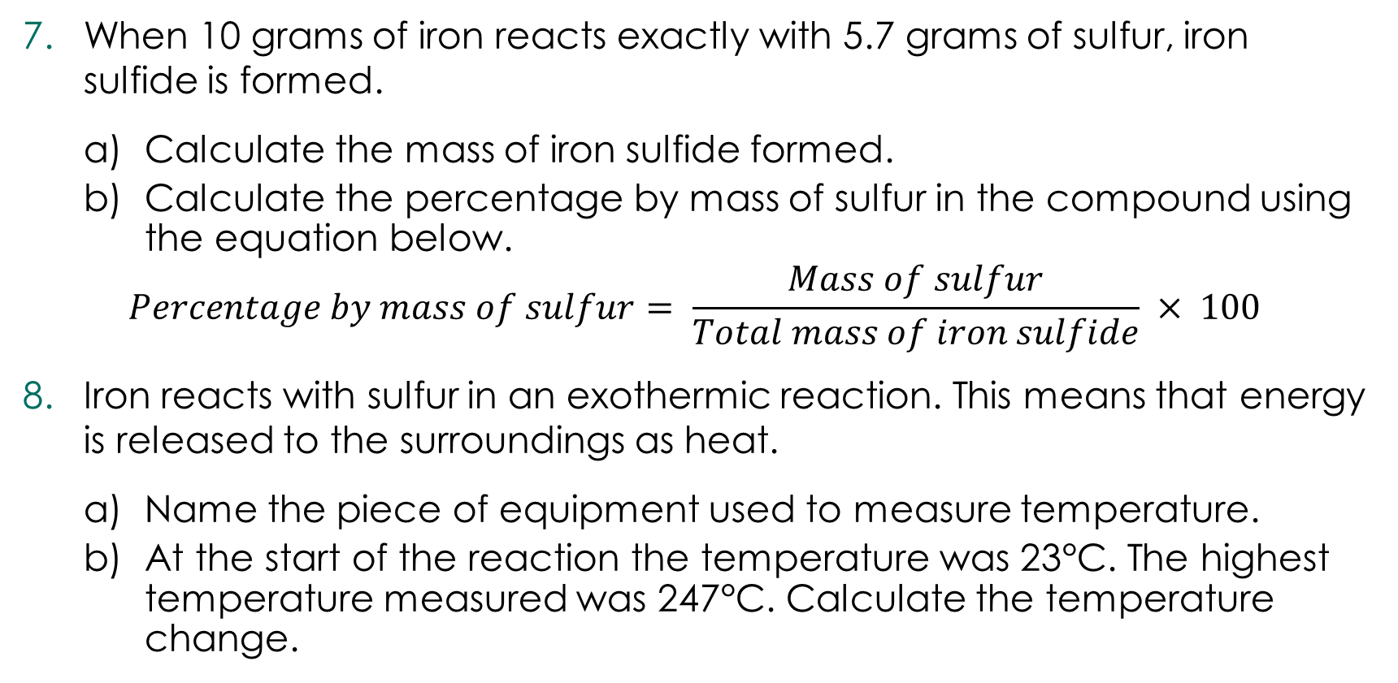
Follow-up questions
When 10 grams of iron reacts exactly with 5.7 grams of sulfur, iron sulfide is formed.
  Calculate the mass of iron sulfide formed.
  Calculate the percentage by mass of sulfur in the compound using the equation below.
$$Percentage by mass of sulfur= \frac{Mass of sulfur}{Total mass of iron sulfide} × 100$$
Iron reacts with sulfur in an exothermic reaction. This means that energy is released to the surroundings as heat.
  Name the piece of equipment used to measure temperature.
  At the start of the reaction the temperature was 23°C. The highest temperature measured was 247°C. Calculate the temperature change.
Follow-up questions

Slide 11
Follow-up questions
A student reacted iron and sulfur so they reacted completely to form iron sulfide. They increased the mass of iron and sulfur each time and recorded the final mass of iron sulfide produced to one decimal place.
  Their results are shown in the table below.
  Plot a graph of the data above.
  Draw a line of best fit.
  The student forgot to record the data for the mass of iron sulfide produced when 5 grams of iron was used. Predict the mass of iron sulfide using the line of best fit.
  Predict the mass of iron used to produce 10 grams of iron sulfide.
Follow-up questions
Mass of iron (g) | Mass of iron sulfide (g)
1 | 1.6
2 | 3.1
3 | 4.7
4 | 6.3
6 | 9.4
7 | 11.0
8 | 12.6
9 | 14.1

Slide 12
Answers
Unscaffolded
The mixture of iron and sulfur is made up of a yellow powdery solid (sulfur) and a grey, metallic solid (iron).
Scaffolded
Answers
 | Iron is yellow
 | Iron is grey
 | Sulfur is grey
 | Sulfur is yellow
 | Iron sulfide is black
 | Iron sulfide is shiny yellow

Slide 13
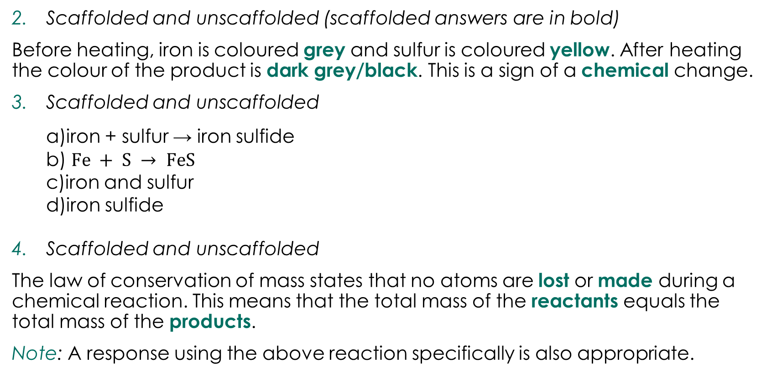
Answers
Scaffolded and unscaffolded (scaffolded answers are in bold)
Before heating, iron is coloured grey and sulfur is coloured yellow. After heating the colour of the product is dark grey/black. This is a sign of a chemical change.
Scaffolded and unscaffolded
  iron + sulfur → iron sulfide
  $Fe + S → FeS$
  iron and sulfur
  iron sulfide
Scaffolded and unscaffolded
The law of conservation of mass states that no atoms are lost or made during a chemical reaction. This means that the total mass of the reactants equals the total mass of the products.
Note: A response using the above reaction specifically is also appropriate.
Answers

Slide 14
Answers
Scaffolded and unscaffolded
iron + sulfur → iron sulfide
1 g 0.57 g 1.57 g
Scaffolded and unscaffolded
iron + sulfur → iron sulfide
2.5 g 1.4 g 3.9 g
Scaffolded and unscaffolded
  67 g
  85%
Scaffolded and unscaffolded
  Thermometer
  224°C
Answers

Slide 15
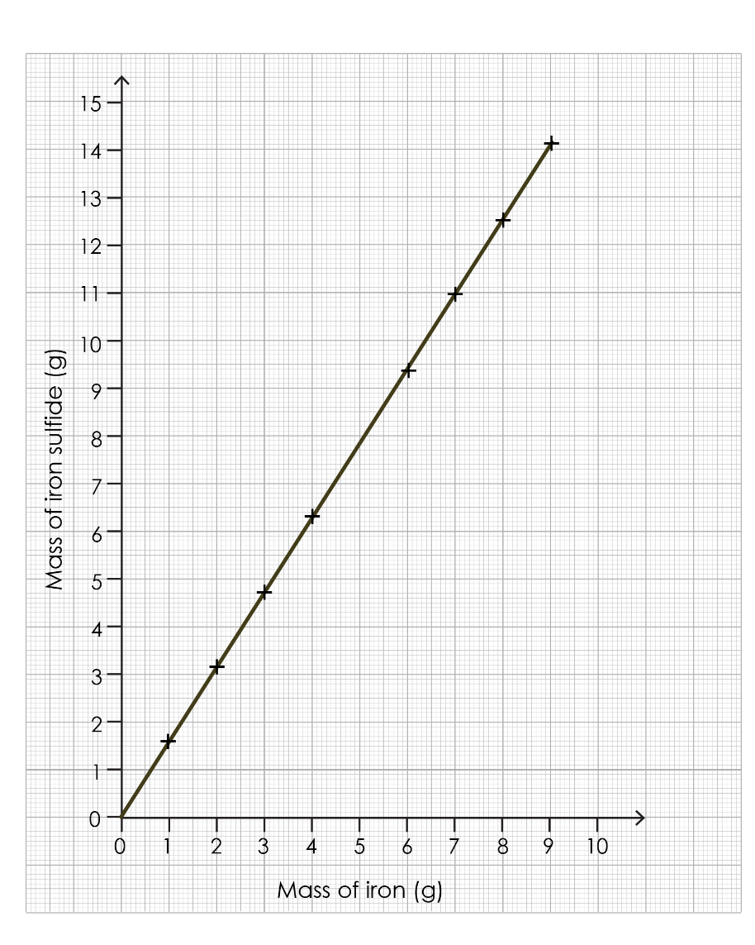
Answers
Scaffolded and unscaffolded
  7.8 g
  6.4 g
Answers

Slide 16
Graph – success criteria
Identify the maximum value on each axis​.
Label the x-axis with the independent variable ​.
Label the y-axis with the dependent variable​.
Make sure that the scale on each axis is even​.
Plot each data point with a cross​.
Draw a line of best fit using a pencil and a ruler.
Success criteria

